Slide 1

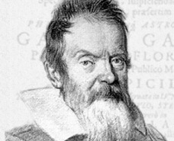
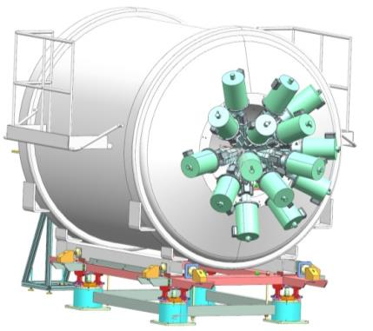
Coupling of germanium detectors to the ISS
Francesco Recchia
Department of Physics and Astronomy
University of Padova
ISS Science Meeting – Manchester - July 13th 2017

Slide 2
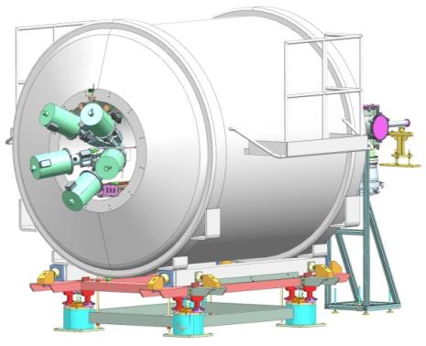
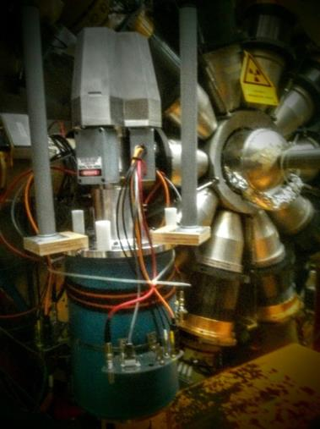
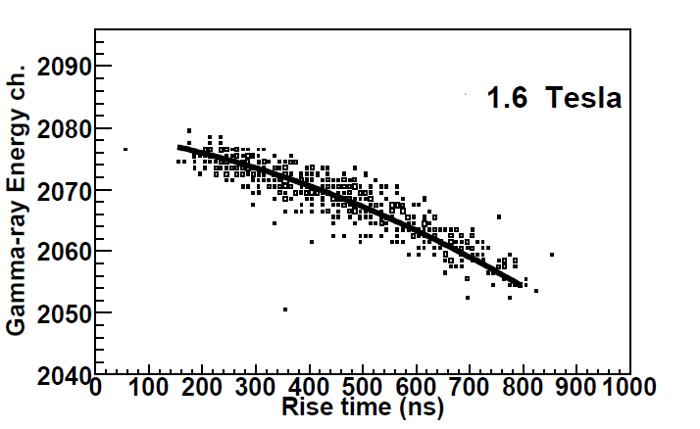
Superconducting Solenoid + Germaniums
ISS superconducting solenoid
Add germanium detectors
  Proper signal treatment is needed
Notes:
An idea being explored is the coupling…

Slide 3
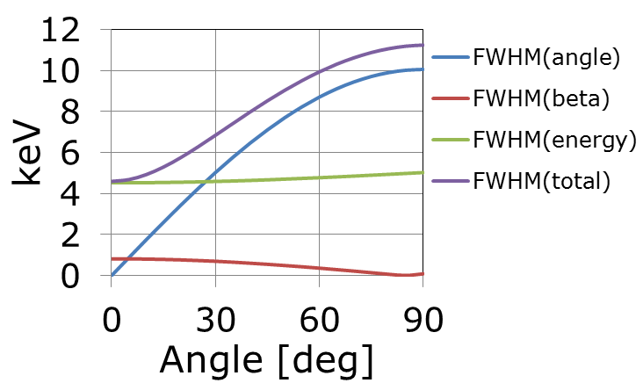
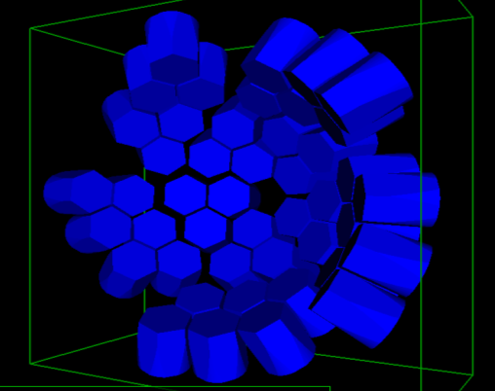
Superconducting Solenoid + Germaniums
1. Response function
Packing 15 triple clusters
Expected efficiency ~ 10%

Slide 4
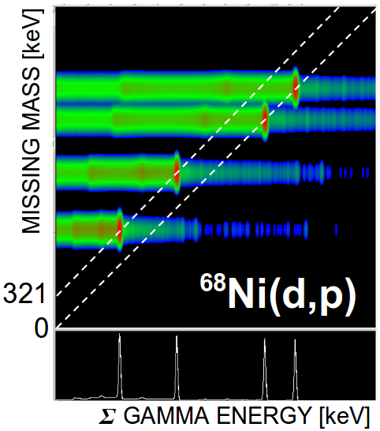
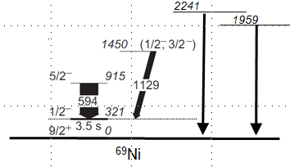
Superconducting Solenoid + Germaniums
3. Excitation vs Deexcitation
Information for spin-parity assignment
Feeding to isomers
Anti-Compton gate

Slide 5
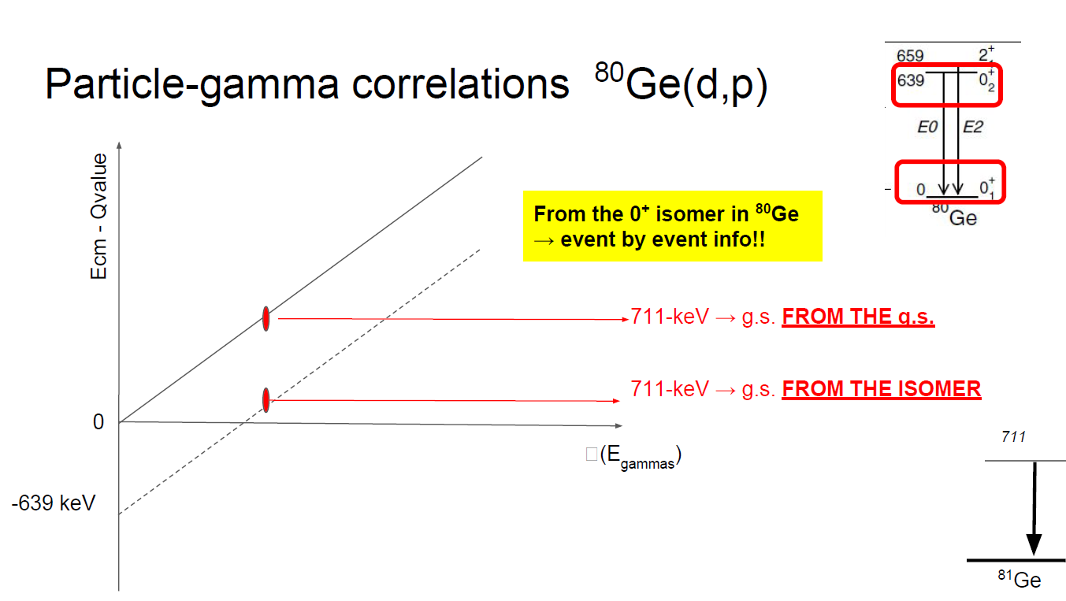
Superconducting Solenoid + Germaniums
4. Isomers
MISSING MASS
GAMMA ENERGY

Slide 6
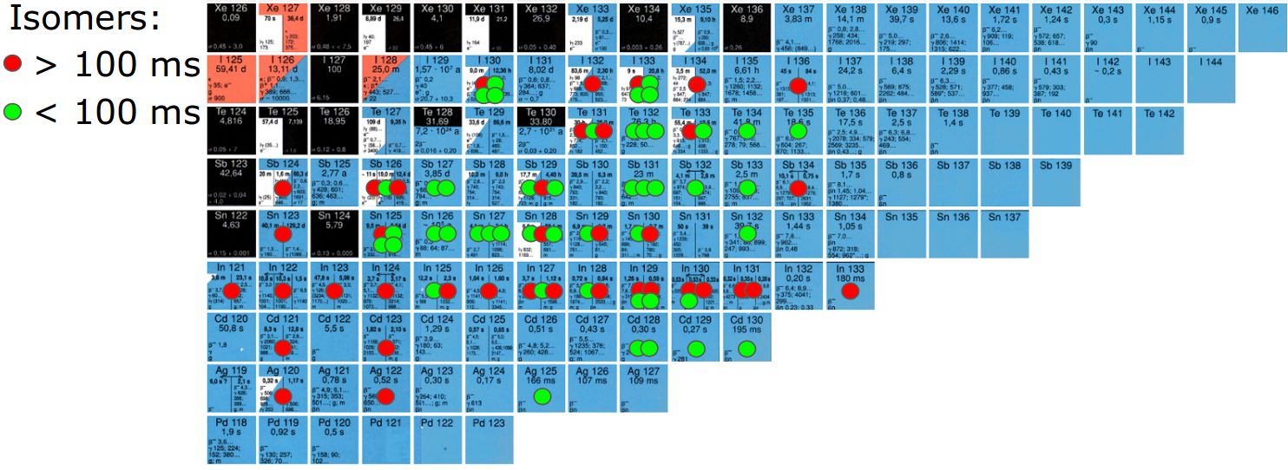
Superconducting Solenoid + Germaniums: nuclear structure
Spectroscopic factors
Lifetime measurements: feeding under control
Neutron unbound states

Slide 7
Developments

Slide 8
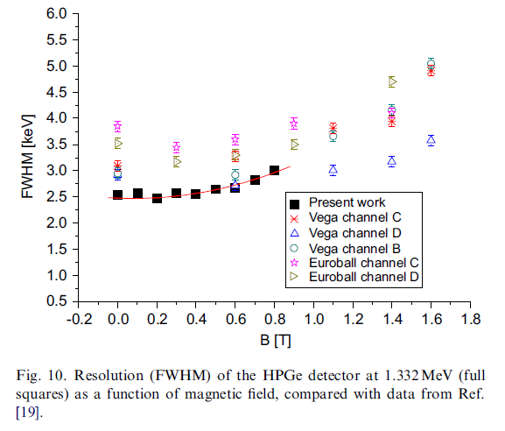
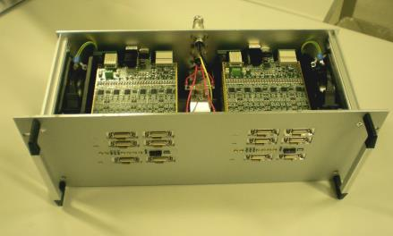
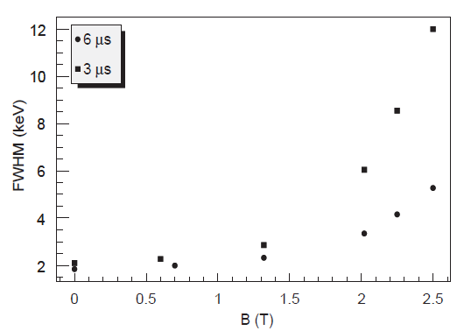
1. HPGe in magnetic fields
Detector geometry allowing close packing
Preamplifiers and digitizers by the Galileo project
Pulse shape analysis
Test with sources w/o chamber
Detector
Preamps
Digitizer
preamplifier
K. Szymanskaa,, P. Achenbachb, M. Agnelloa, E. Bottad, A. Bracco … NIM A 592 (2008) 486–492
A. Sanchez Lorente (NIM A) arXiv:nucl-ex/0606022v2 18 Dec 2006
M Agnello NIM A 606(2009)560–568
PCIe board
Local
processing
Storage
2x 32 channels digitizer

Slide 9
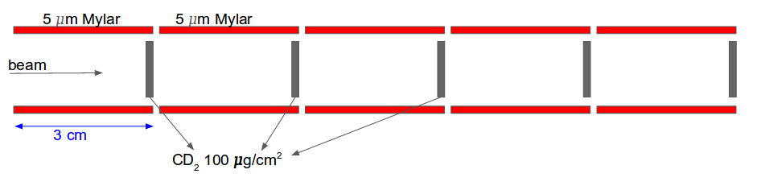
2. Target position and thickness
Target off center
What is the obtainable resolution and efficiency with the target off-center?
How to calculate / measure them?
Vertex detector for a stack of targets
CATS:
windows: 1.5 um + catodes = 5 um of mylar total
5 µm of mylar → 150 keV energy loss for protons

Slide 10
Physics cases
Proposed scientific contribution to the project

Slide 11
Superconducting Solenoid + Germaniums: nuclear astrophysics s-process
⁷⁹Se(d, pγ)⁸⁰Se used as a surrogate for the
⁷⁹Se(n, γ) reaction
long lived isomer in ⁷⁹Se that will be present in the secondary beam
together with the ⁷⁹Se sitting on the ground state.

Slide 12
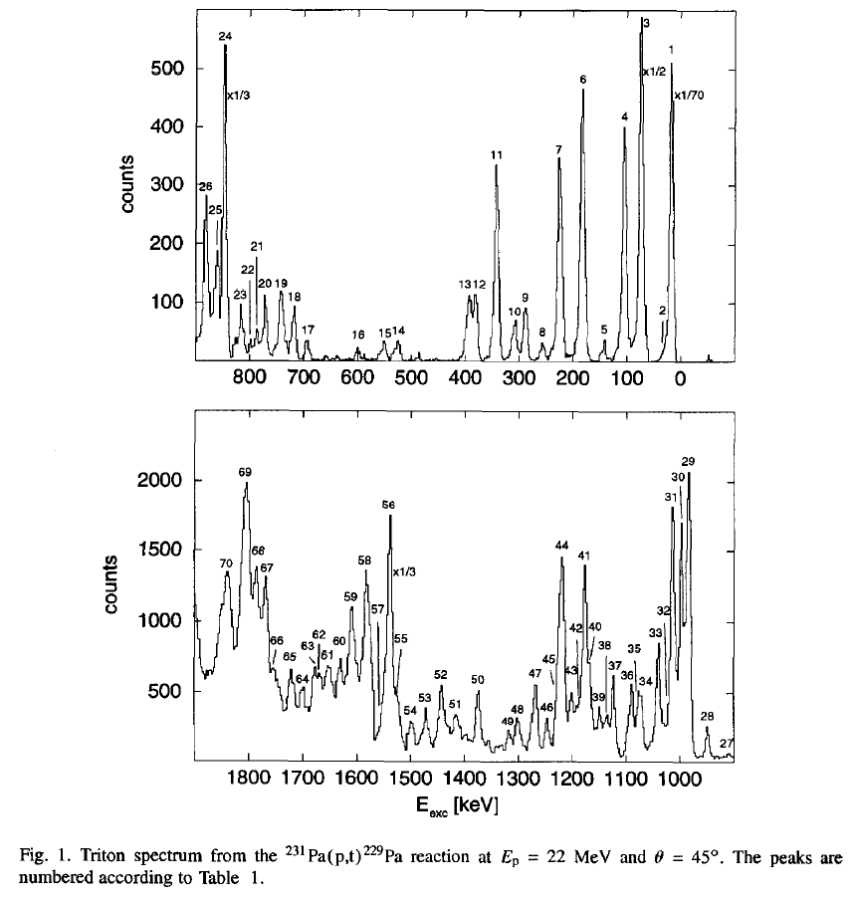
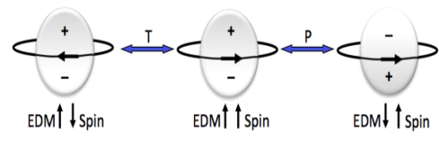
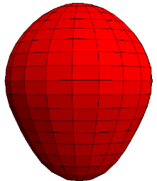
Superconducting Solenoid + Germaniums: fundamental symmetries
²²⁹Pa: Previously studied w/ ²³¹Pa(p,t) → (p,p’)?
²²³Rn(p,p’) or ²²²Ra(p,p’)
Permanent electric dipole moments in atoms
Beyond the Standard Model
Dominance of matter over antimatter (CP violation)
²²⁵Ra, ²²³Rn, ²²⁹Pa are special (several thousand times more sensitive than ¹⁹⁹Hg)
→ NUPRASEN-SPES workshop
“Probing fundamental symmetries and interactions by low energy excitations with RIB”
Pisa, 1-2 February 2018
+
-
+
-
+
²²⁹Pa
-
+
-
+
-

Slide 13
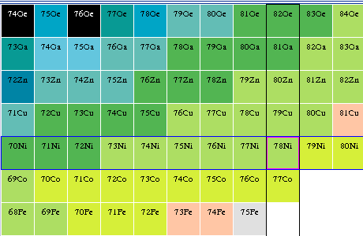
s_{1/2} phenomenology: ⁸¹Ge(d,p) and ⁷⁹Zn(d,p)
What is the structure of this state??
What is its relation to the spherical and super-deformed 0⁺ states predicted in ⁷⁸Ni?
????
0⁺₂
1492
2⁺
1100
1/2⁺
⁸¹Ge(d,p) from g.s. and from 1/2⁺
⁷⁹Zn(d,p) from g.s. and from 1/2⁺
> 200 ms
9/2⁺
0⁺
746 ms
⁷⁹Zn
⁸⁰Zn

Slide 14
Octupole collectivity in ¹⁴⁸Dy
Z
1.579
3⁻
66
¹⁴⁸Dy
¹⁴⁹Dy
¹⁵⁰Dy
0⁺
65
¹⁴⁶Tb
¹⁴⁷Tb
¹⁴⁸Tb
¹⁴⁹Tb
¹⁴⁶Gd
64
¹⁴⁴Gd
¹⁴⁵Gd
¹⁴⁶Gd
¹⁴⁷Gd
¹⁴⁸Gd
B(E3) ≈ 37(4) W.u.
63
¹⁴²Eu
¹⁴³Eu
¹⁴⁴Eu
¹⁴⁵Eu
¹⁴⁶Eu
¹⁴⁷Eu
Octupole collectivity: proton scattering from d_{5/2} to h_{11/2}
Blocking effect by proton occupying the h_{11/2} orbital in ¹⁴⁸Dy?
62
¹⁴¹Sm
¹⁴²Sm
¹⁴³Sm
¹⁴⁴Sm
¹⁴⁵Sm
¹⁴⁶Sm
61
¹⁴⁰Pm
¹⁴¹Pm
¹⁴²Pm
¹⁴³Pm
¹⁴⁴Pm
stable nuclei
60
¹⁴⁰Nd
¹⁴¹Nd
¹⁴²Nd
¹⁴³Nd
79
80
81
82
83
84
N
¹⁴⁸Dy(p,p’) to measure the B(E3)

Slide 15
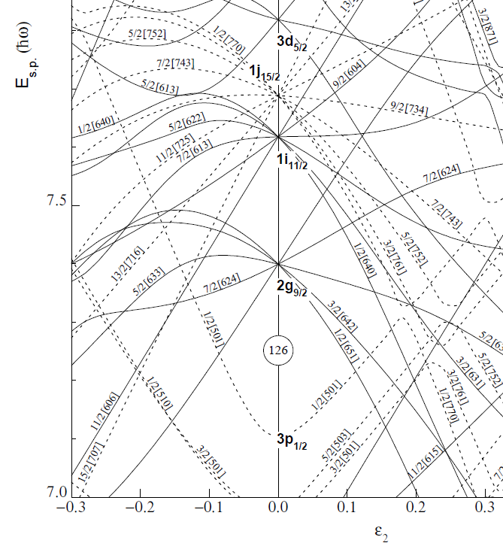
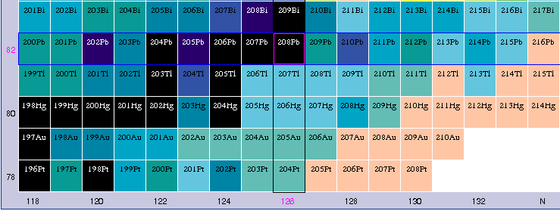
Spectroscopy nearby ²⁰⁸Pb and ¹³²Sn
Scarce information in ²⁰⁸Pb region
²⁰⁶Hg (d, p) ²⁰⁷Hg to extend the spectroscopy, nothing known
2 proton holes in s_{1/2} and d_{3/2}
How is the transition taking place from spherical to deformed region?
D. Mengoni: ¹³⁴Sn (t, p) Neutron pairing beyond N=82

Slide 16
Conclusions
The developments and tests need to be put in the proper time frame and requires careful planning
High resolution on missing mass +
high resolution on gammas
→ great physics potential for:
  Heavy nuclei with high level density
  Nuclei at shell closures with orbitals with large difference in angular momentum → isomers
ISOLDE beams are very interesting
  Looking forward for future beams at the SPES facility

