Slide 1

Single-particle behaviour towards the “island of inversion” - ^{28,30}Mg(d,p)^{29,31}Mg in inverse kinematics
David Sharp,
The University of Manchester
ISS workshop, July 13th 2017
Notes:
1

Slide 2
Motivation - Island of inversion
Ground states and low-lying excitations from intruder configurations have been observed. Deformed configurations in low-lying and ground states.
First identified in anomalous ground-state binding energies.
E. K. Warburton, J. A. Becker, and B. A. Brown Phys. Rev. C 41, 1147 (1990).

Slide 3
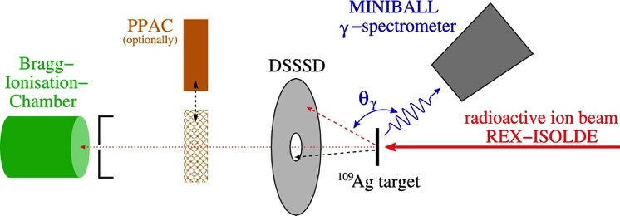
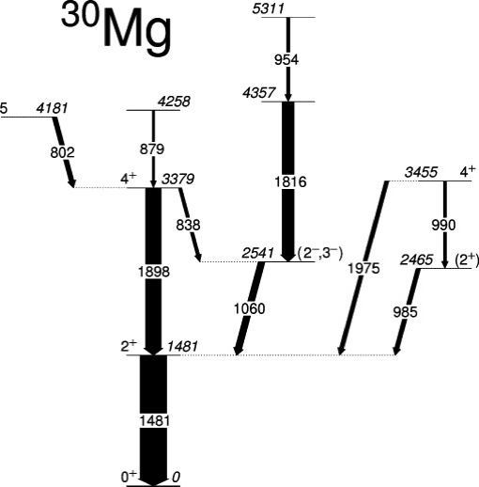
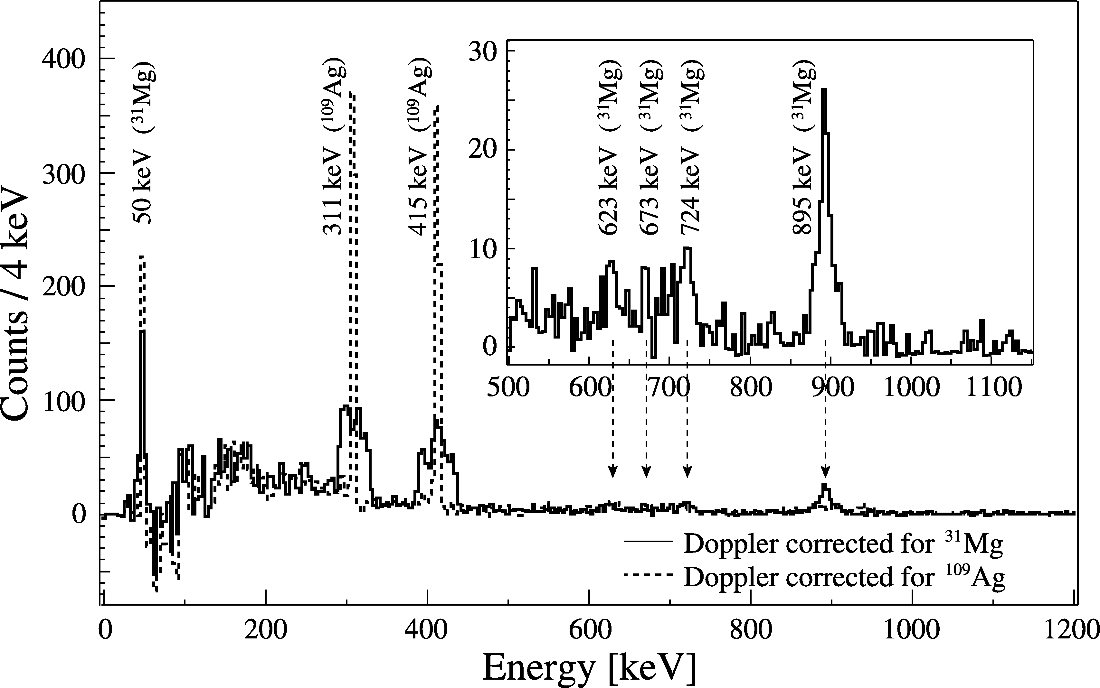
Motivation - Island of inversion
Ground states and low-lying excitations from intruder configurations have been observed. Deformed configurations become the ground states.
First identified in anomalous ground-state binding energies.
Subject of a wealth of studies characterizing this region (beta-decay, gamma-ray spec, coulex, knock-out, beta-NMR, (t,p)…...).
K. Wimmer, et al.,
PRL 105, 252501 (2010)
A.N. Deacon, et al.,
PRC 82, 034305 (2010).
M. Seidlitz, et al.,
PLB 700, 181 (2011).
F. Marechal, et al.,
PRC 72, 044314 (2005)

Slide 4
Motivation - Island of inversion
In the Ne, Al and Na isotopes there is a soft transition to a deformed ground state.
In Mg isotopes this transition is sharper with ³¹Mg inside the island and ³⁰Mg outside.
Measurements of the single-particle properties moving in to the island of inversion provide important systematic information on the behavior of the relevant orbitals and shell gaps.
In particular the difference between the 1d_{3/2} and 1f_{7/2} and 1f_{7/2} and 2p_{3/2} which define the N=20 and 28 shell gaps.
So far very little information on single-particle energies and strength within the IOI. Some knock-out measurements – probe hole states.
Aim is to measure single-particle properties outside (²⁹Mg) and inside the IOI (³¹Mg).

Slide 5
Motivation - Changing shell structure
The island of inversion is indicative of a weakening N=20 shell gap.
In the oxygen isotopes the N=20 shell gap has been shown to disappear with the emergence of an N=16 shell gap in ²⁴O.
Again measurement of the single-particle states involved in this evolution of single-particle structure will provide valuable comparison with theory.
²⁹Mg is an N=17 isotone – single-particle structure outside N=16 informative in tracking disappearance of N=20 shell gap.
T. Otsuka et. al., Eur. Phys. J. A 15, 151–155 (2002)

Slide 6
Shell model calculations
Calculations using the SDPF-MU interaction with 0p-0h excitations only for the positive-parity states.
1p-1h excitations for the negative-parity states.
Are higher order excitations (2p-2h,3p-3h) needed to describe the observed spectra?
At what point are they needed?
Observation of previously unobserved and unbound 1/2- states will provide further important quantities for comparison with SM.
Y. Utsuno. Priv. comm

Slide 7
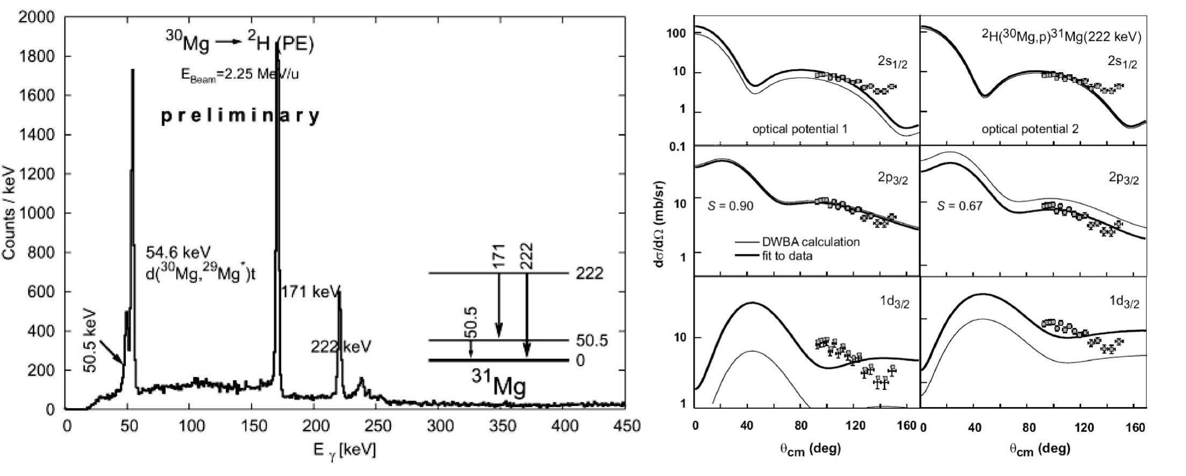
Previous ³⁰Mg(d,p) measurements at ISOLDE
Angular momentum assignments difficult due to limited angular coverage – backwards CM angles.
Only identified fist two excited states.
Some issues with gamma-ray efficiency due to long lived states.
V. Bildstein. PhD Thesis, Technische Universita ̈t Munchen, (2010)

Slide 8
ISOLDE Solenoid Spectrometer
4T superconducting former MRI magnet. Installed on 2nd beamline in ISOLDE hall.
Same principles as successfully implemented at ANL in HELIOS.
Does not suffer from any kinematic compression.
~75 keV Q-value resolution achieved for charged particles.
Does not require coincident γ-ray detection - not affected by lifetime of states.

Slide 9
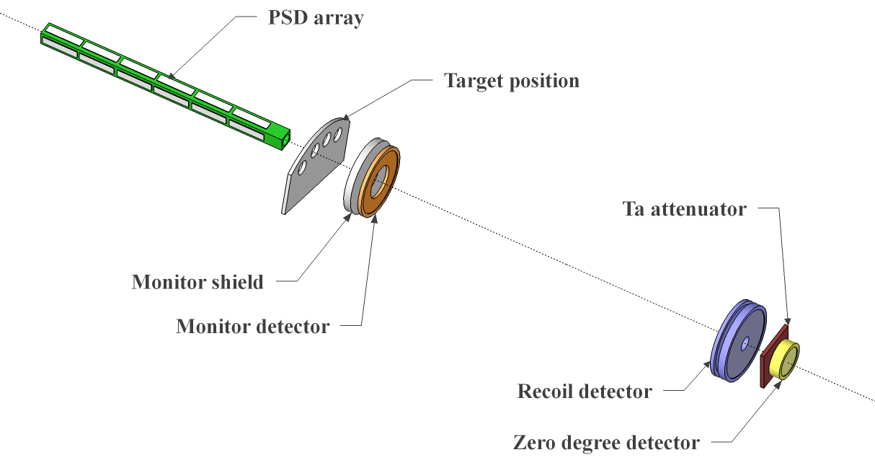
Experimental set up
C. R. Hoffman et. al., Phys. Rev. C 85, 054318 (2012)
Monitor detector to monitor target thickness.
ΔE-E recoil detector (annular silicon) used to remove beam contamination.
Zero-degree detector to ascertain degree of contamination and monitor beam intensity.
Target ladder can hold multiple CD₂ targets.

Slide 10
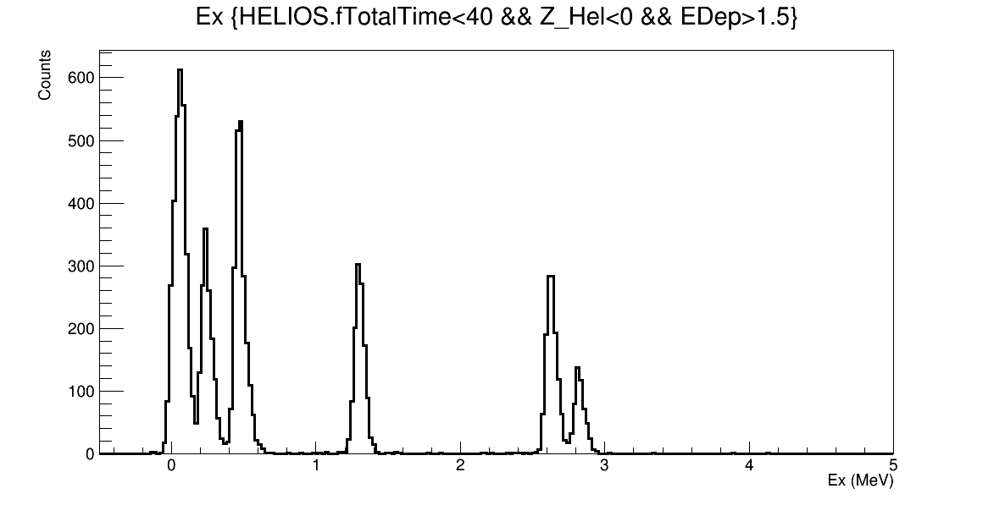
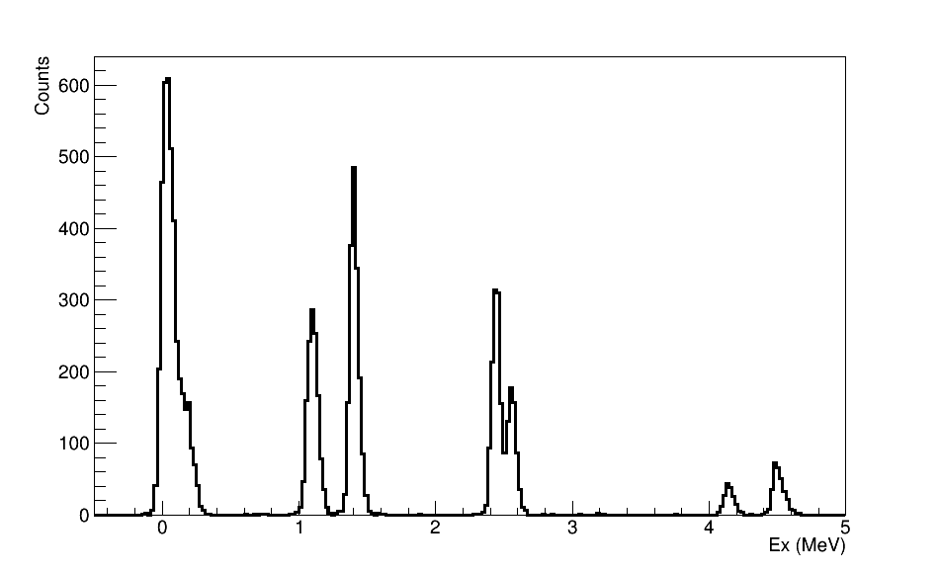
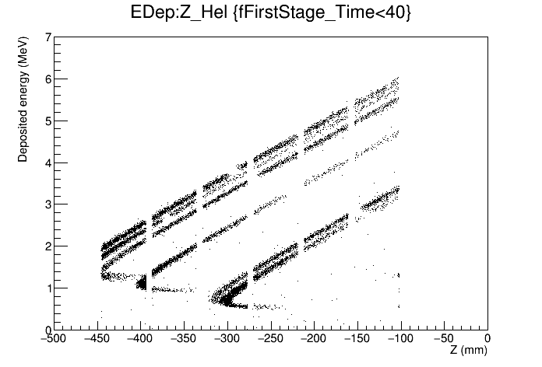
Solenoid spectrometer simulations
g.s. 𝓵=0 + 50 keV 𝓵=2
g.s. 𝓵=2 + 55 keV 𝓵=0
³⁰Mg(d,p)
²⁸Mg(d,p)
221, 𝓵=1
2500, 𝓵=2
2670, 𝓵=3
1431, 𝓵=3
461, 𝓵=3
1300, 𝓵=1
1095, 𝓵=1
2870, 𝓵=1
2615, 𝓵=1
4623, 𝓵=3
4247, 𝓵=1
2.0T
Expected resolution ~80 keV assuming:
40 keV intrinsic detector resolution
100 μg/cm² CD₂ targets
HIE-ISOLDE beam properties. (2.3mm beam spot, divergence = 1.8 mrad, ΔE = 0.26%)
ANL array geometry.
Comparable to achieved resolution at ANL.
Marc Labiche simulations using NPTool

Slide 11
Angular distributions – choice of beam energy
Generally aim to measure transfer reactions at 5-10MeV/u to maximise direct reaction contribution.
7.5 MeV/u chosen as a trade off between cross sections and angular coverage of finite silicon array.
These measurements could run at 10MeV/u with reduced cross section but increased angular coverage. Dependent on HIE-ISOLDE running.

Slide 12
Comments on contamination
²⁸Mg – 50% ²⁸Al contamination. ³⁰Mg – 10% ³⁰Al contamination.
Recoil detection used to select reaction of interest so contamination levels are not limiting for this measurement. Majority of scattered beam passes through center of recoil detector.
Kinematics of Al(d,p) very different to Mg(d,p) – only states above 6 MeV incident on array in region of interest.
Release characteristics from the target can be used to reduce ²⁸Al.

Slide 13
Summary
Neutron-adding reactions are ideal probe for studying single-particle properties of states of interest.
Measurements will probe region of changing single-particle structure, from outside to inside the IOI providing tests of SM calculations.
No published data on ²⁸Mg(d,p), proposed measurements will greatly improve on previous ³⁰Mg(d,p) REX-ISOLDE measurement with reaction performed at improved energy for transfer.
²⁸Mg(d,p) measurements approved by INTC. Future ³⁰Mg(d,p) approval based on demonstration of ²⁸Mg.

Slide 14








Collaborators for accepted proposal
D. K. Sharp and S. J. Freeman The University of Manchester, UK
B. P. Kay, B. B. Back, C. R. Hoffman and R. V. F. Janssens Argonne National Laboratory, USA
P. A. Butler and R. D. Page The University of Liverpool, UK
L. P. Gaffney ISOLDE, CERN
R. Raabe KU Leuven, Belgium
M. Labiche STFC Daresbury Laboratory, UK
W. N. Cafford, G. Lotay and A. Matta, University of Surrey, UK
Th. Kroll Technishe Universitat Darmstadt, Germany
And many more technical staff at both CERN and STFC Daresbury
Notes:
14

Slide 15
Simulated distributions
³⁰Mg(d,p)
0.0 MeV 𝓵=0
0.05 MeV 𝓵=2
0.221 MeV 𝓵=1
0.461 MeV 𝓵=3

Slide 16
Choice of beam energy

Slide 17
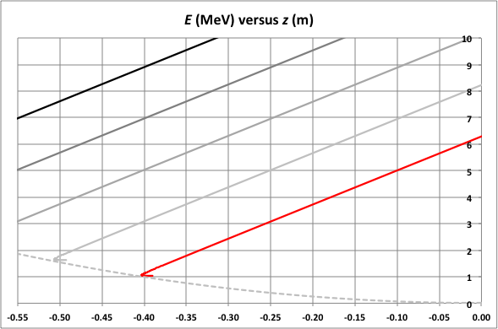
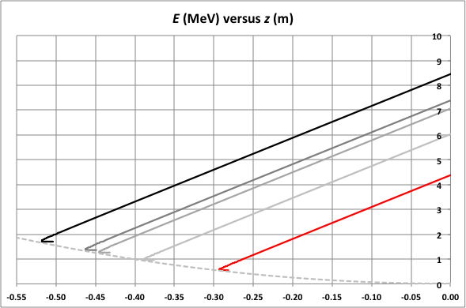
²⁸Al(d,p)
²⁸Mg(d,p)
0 MeV
2 MeV
4 MeV
6 MeV
8 MeV

