Slide 1
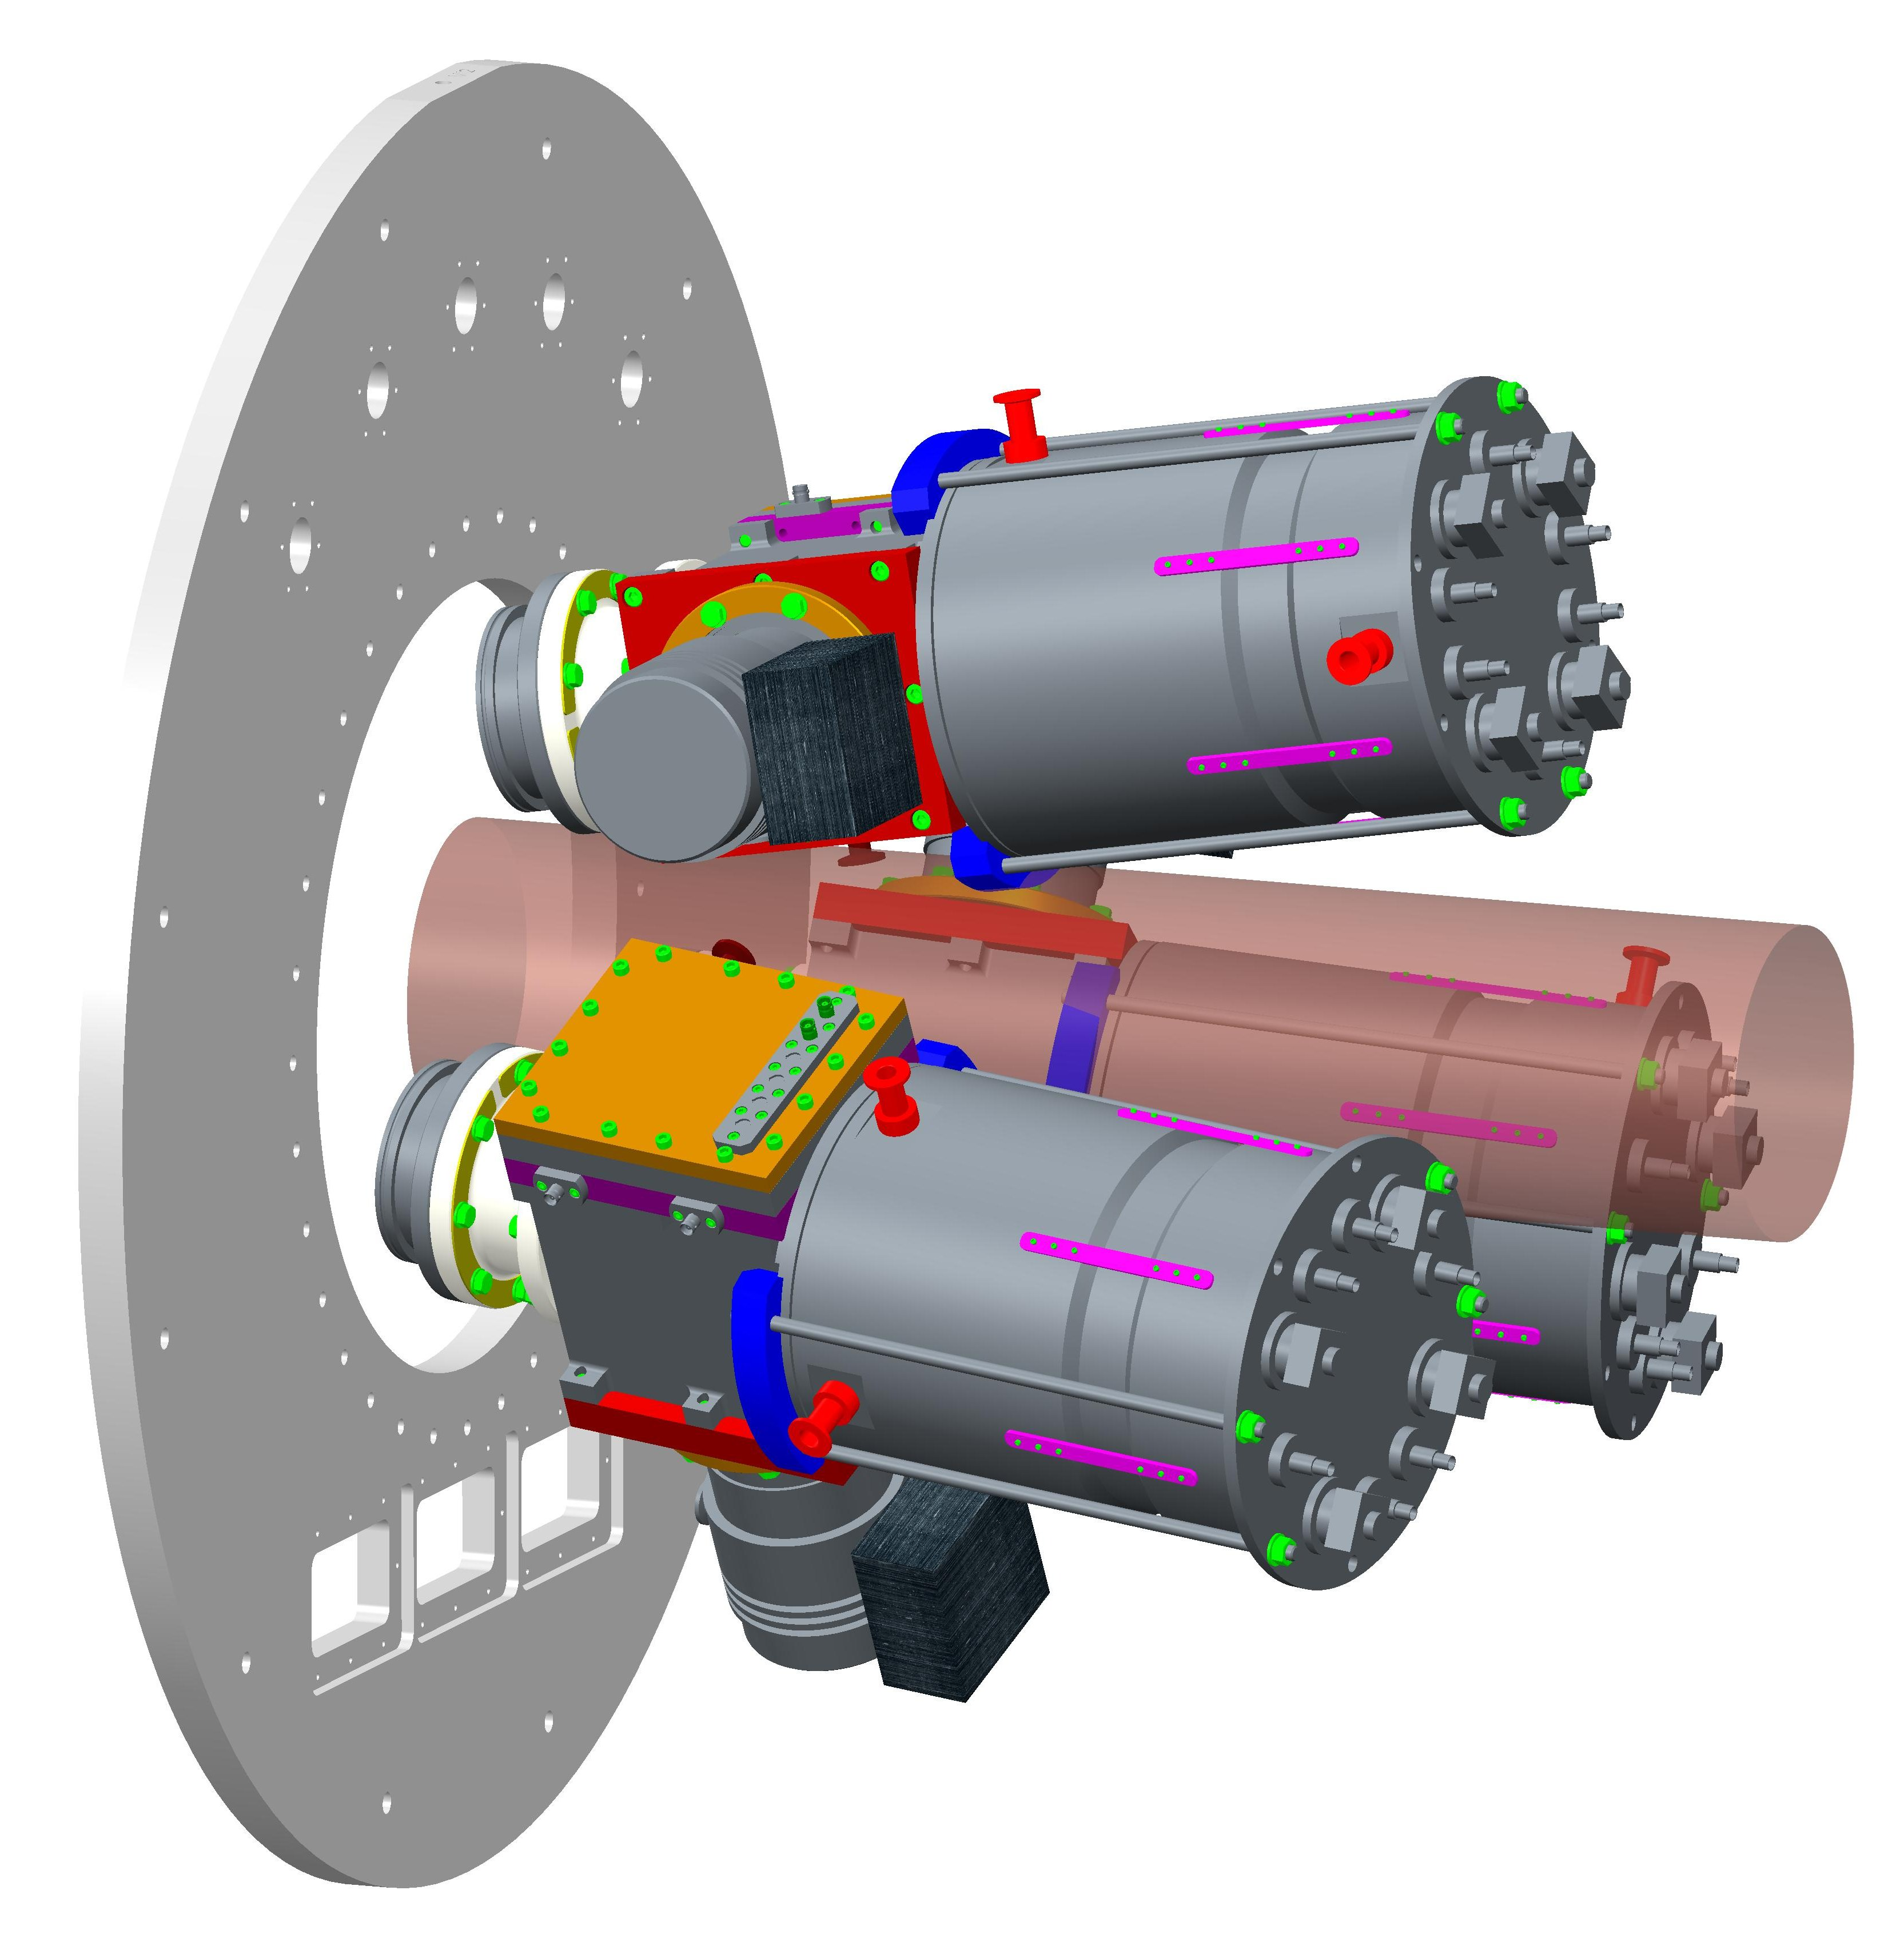
Actinide Transfer-Induced Fission In Inverse Kinematics with ISS
A.G. Smith, P. Davies, T. Wright , D.Sharp, N.Sosnin*, S.Bennett*
and the ISS/ISOLDE Collaboration
Proposal for INTC 2017
* PhD Students starting 2016/2017

Slide 2
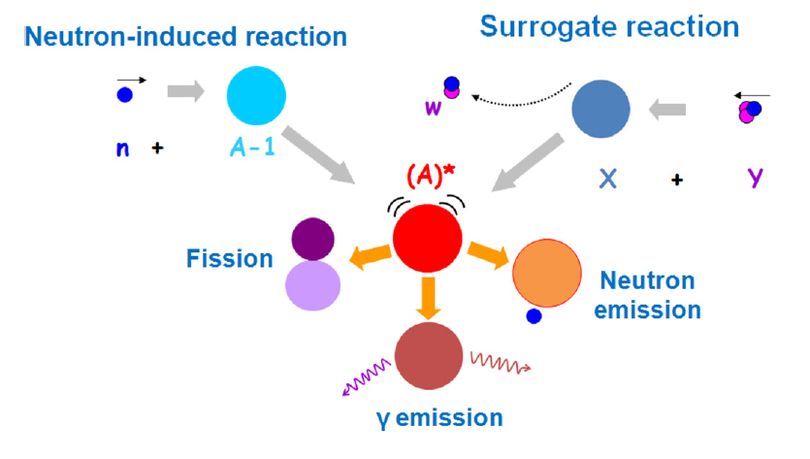
(d,pF) as a Surrogate Reaction for (n,F)
Aim to produce similar Compound Nucleus
State to neutron capture
Formation by capture (calc)
Desired n cross section
Decay
Brit and Cramer, PHYSICAL REVIEW C 2, 1758(1970)
Ducasse, et al., PHYSICAL REVIEW C 94, 024614 (2016)
Notes:
Would like to study nucleus of mass A
Perhaps its not possible to get a stable target
Use a surrogate, not new already employed e.g. Nuclear Astro, FF studies.
If decay is independent of the formation then its possible to extract the desired cross section

Slide 3
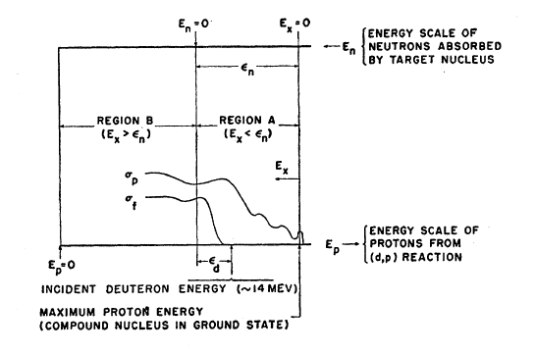
Energetics of (d,pF)
(d,p) allows Measurement of Fission Threshold in Fissile Nuclei
n capture
Threshold region
Fission
Notes:
In fissile nuclei the possibility to probe the fission barrier region is benefit
Not possible in direct reactions

Slide 4
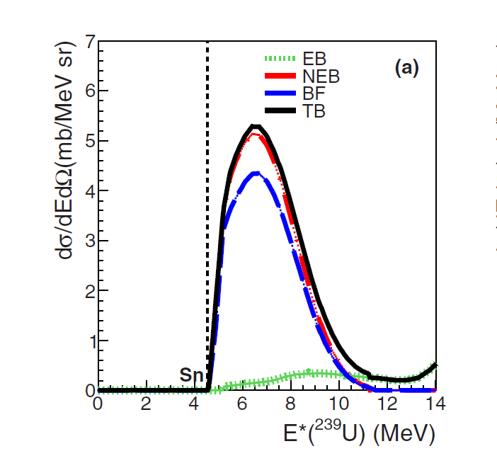
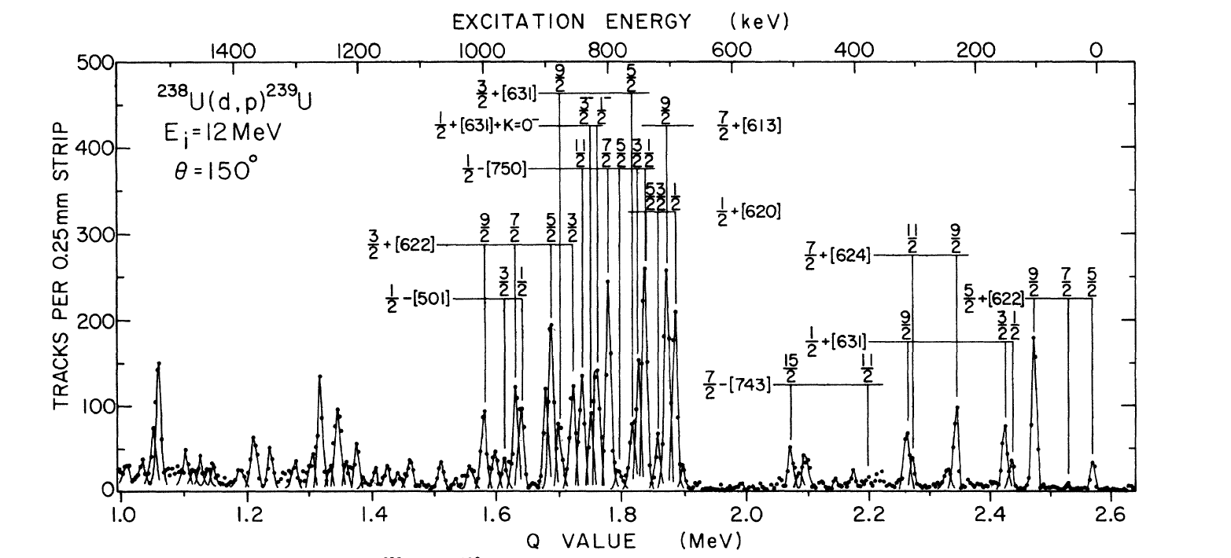
Energetics of (d,pF)
Compound Nucleus states in Continuum above S_{n} (e.g. ²³⁹U)
Probe fission barrier region with measurement of
L transfer
Control over deuteron break-up required
Activation energy 6.2 MeV
Erskine, PHYSICAL REVIEW C 17, 934 (1978)
Ducasse, et al., PHYSICAL REVIEW C 94, 024614 (2016)
Notes:
Where the Sn is below the activation energy the opportunity to probe L roll in the fission process presents itself
Previously tried but the Deuteron break-up complicated anaylsis
Role of J and pi not fully understood

Slide 5
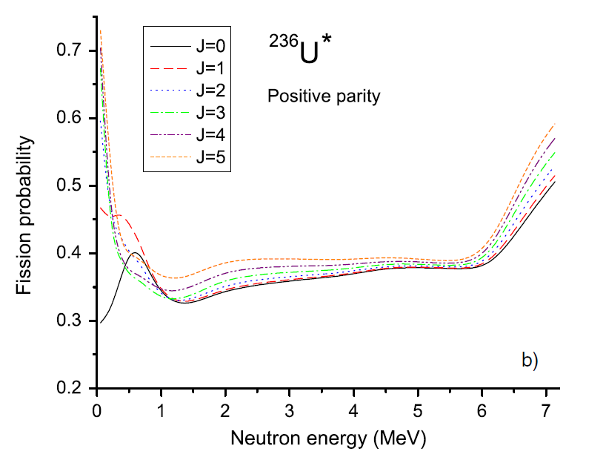
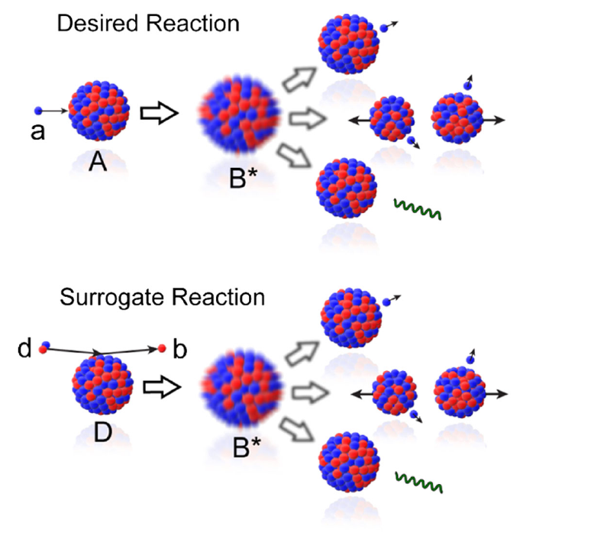
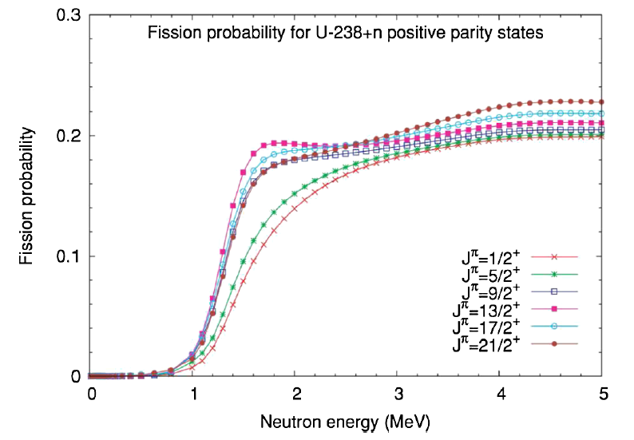
Importance of L-transfer in Surrogate Reactions
Weisskopf-Ewing Limit: Surrogate and direct
Reactions have same J and π distribution
OR decay independent of J
Escher & Dietrich, 2006, Phys. Rev. C74,054601
Chiba & Iwamoto, 2010, Phys. Rev. C81,044604.
The surrogate reaction method works if
the reactions match the distributions of J^{π}
Calculations show fission at low energy sensitive to J
Need to measure L-transfer in (d,pF)
Escher et al., REVIEWS OF MODERN PHYSICS, VOLUME 84, JANUARY–MARCH 2012
Notes:
Weisskopf-Ewing limit
J^pi the same, unknown
Decay independent of J clearly not applicable
Can we measure L-transferred in Fissioning systems

Slide 6
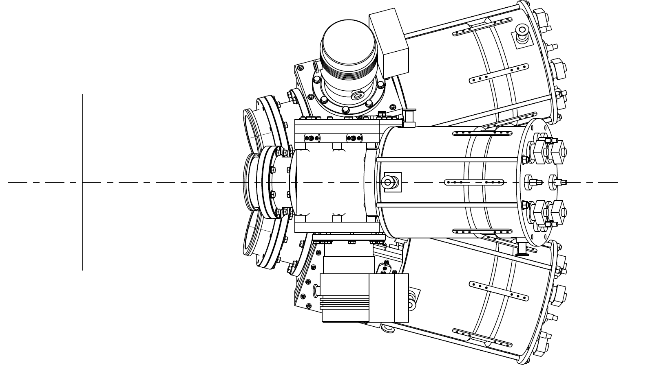
FiFI@ISS
Three FiFi Arms for Fragment Detection already in service – used at CERN (STEFF)
Each FiFi detector composed of
SED MCP for ns fission fragment timing
Bragg ion chamber for fragment energy measurement (~1MeV Resolution)
Proton
FF ~π/2 in COM
SED
Beam
~9 MeV/u
BRAGG

Slide 7
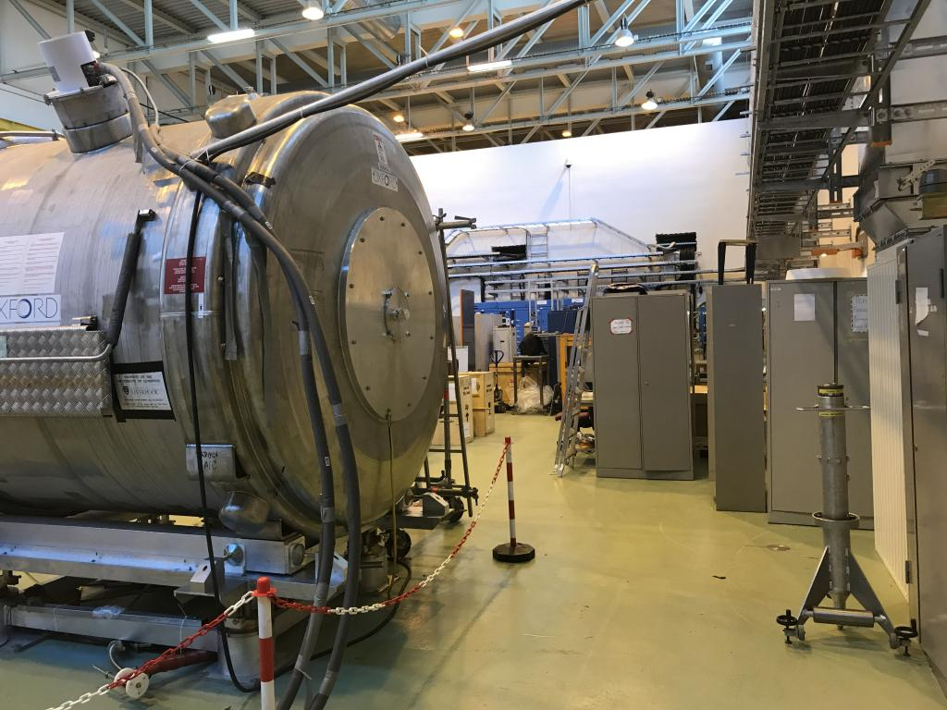
Fission-fragment Detectors
FiFI@ISS
Recoil Detector

Slide 8
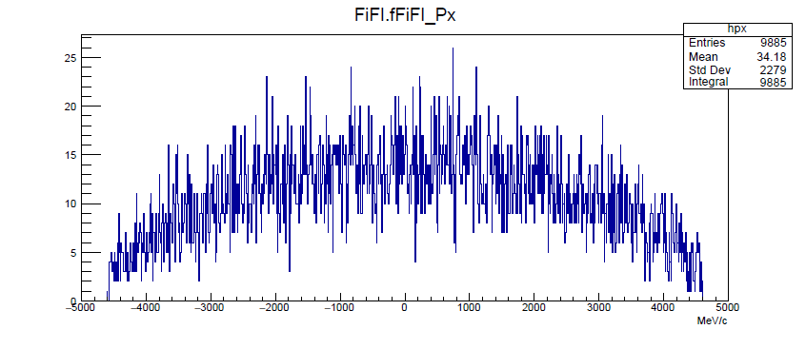
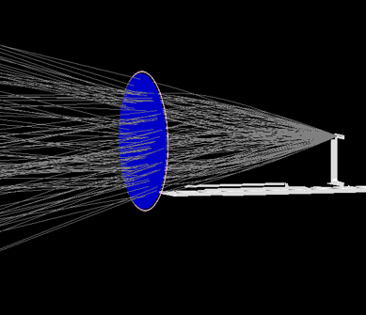
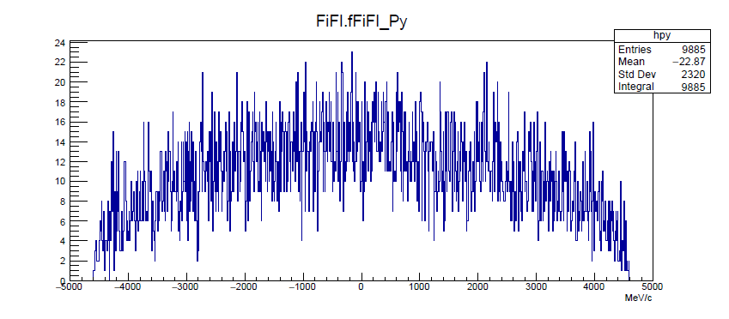
Path of Fission Fragments in B Field
Trajectory calculations: M. Labiche
Cone corresponds to 0 to π/2 in COM

Slide 9
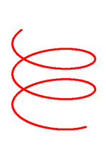
Possible Start Detector for FF TOF & Mass?
Fission Fragment
Proton
To FiFI in 10s of ns
-4 kV
GND
-2 kV
S.E.
GND
SED Foil
Channel Plates (Triangular Box?)
Beam Direction
Electron trajectories:
Path in mirror?
Will B field affect timing resolution?
B should help by constraining SE horizontal path
– large gap between SED and CP assembly possible
Does SED arrangement interfere with proton or FF detection?
Could be either upstream or downstream – opposite side to protons?
Thin SED foil ~100nm

Slide 10
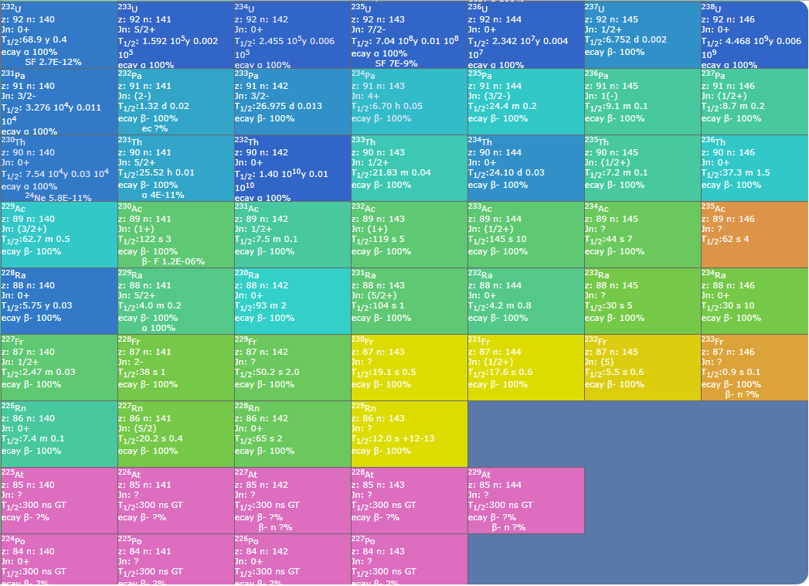
Possible Isolde Targets
92
91
90
89
88
87
86
85
84

Slide 11
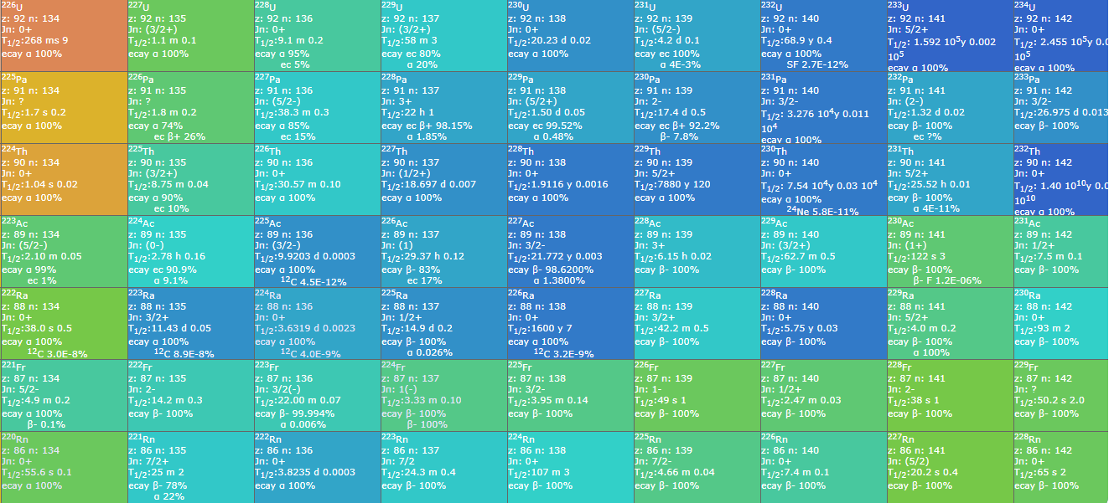
²³¹Pa (fissile) – as yet no (d,p) reaction data – production from ²³⁸U target?
²²⁷Ac (fissile) – as yet no (d,p) reaction data

Slide 12
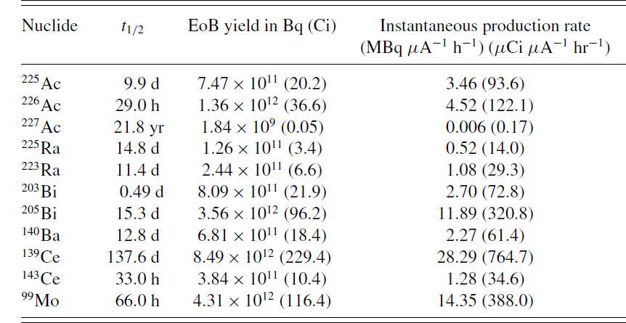
²²⁷Ac Production from 800 MeV Protons on ²³²Th
Engle et al, PHYSICAL REVIEW C 88, 014604 (2013)

Slide 13
Outline Proposal
Implement 3 FiFI arms and recoil detector for fission-fragment detection at ISS
Use actinide beams that can be extracted from a used target during LS2
Measure (d,pF) cross section as a function of E* and J near threshold

