Slide 1
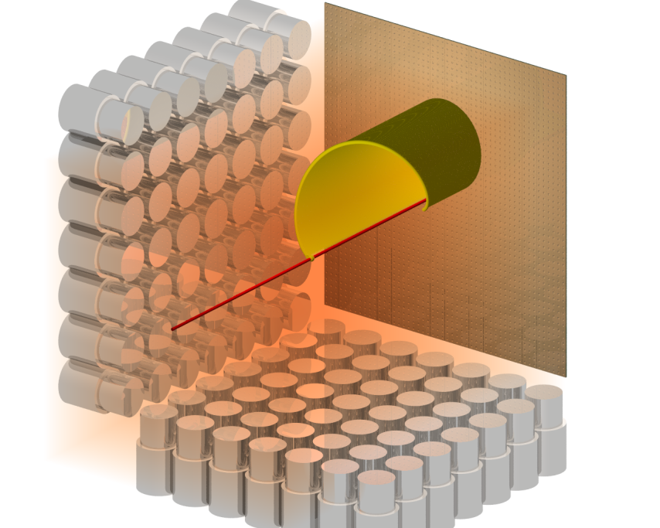
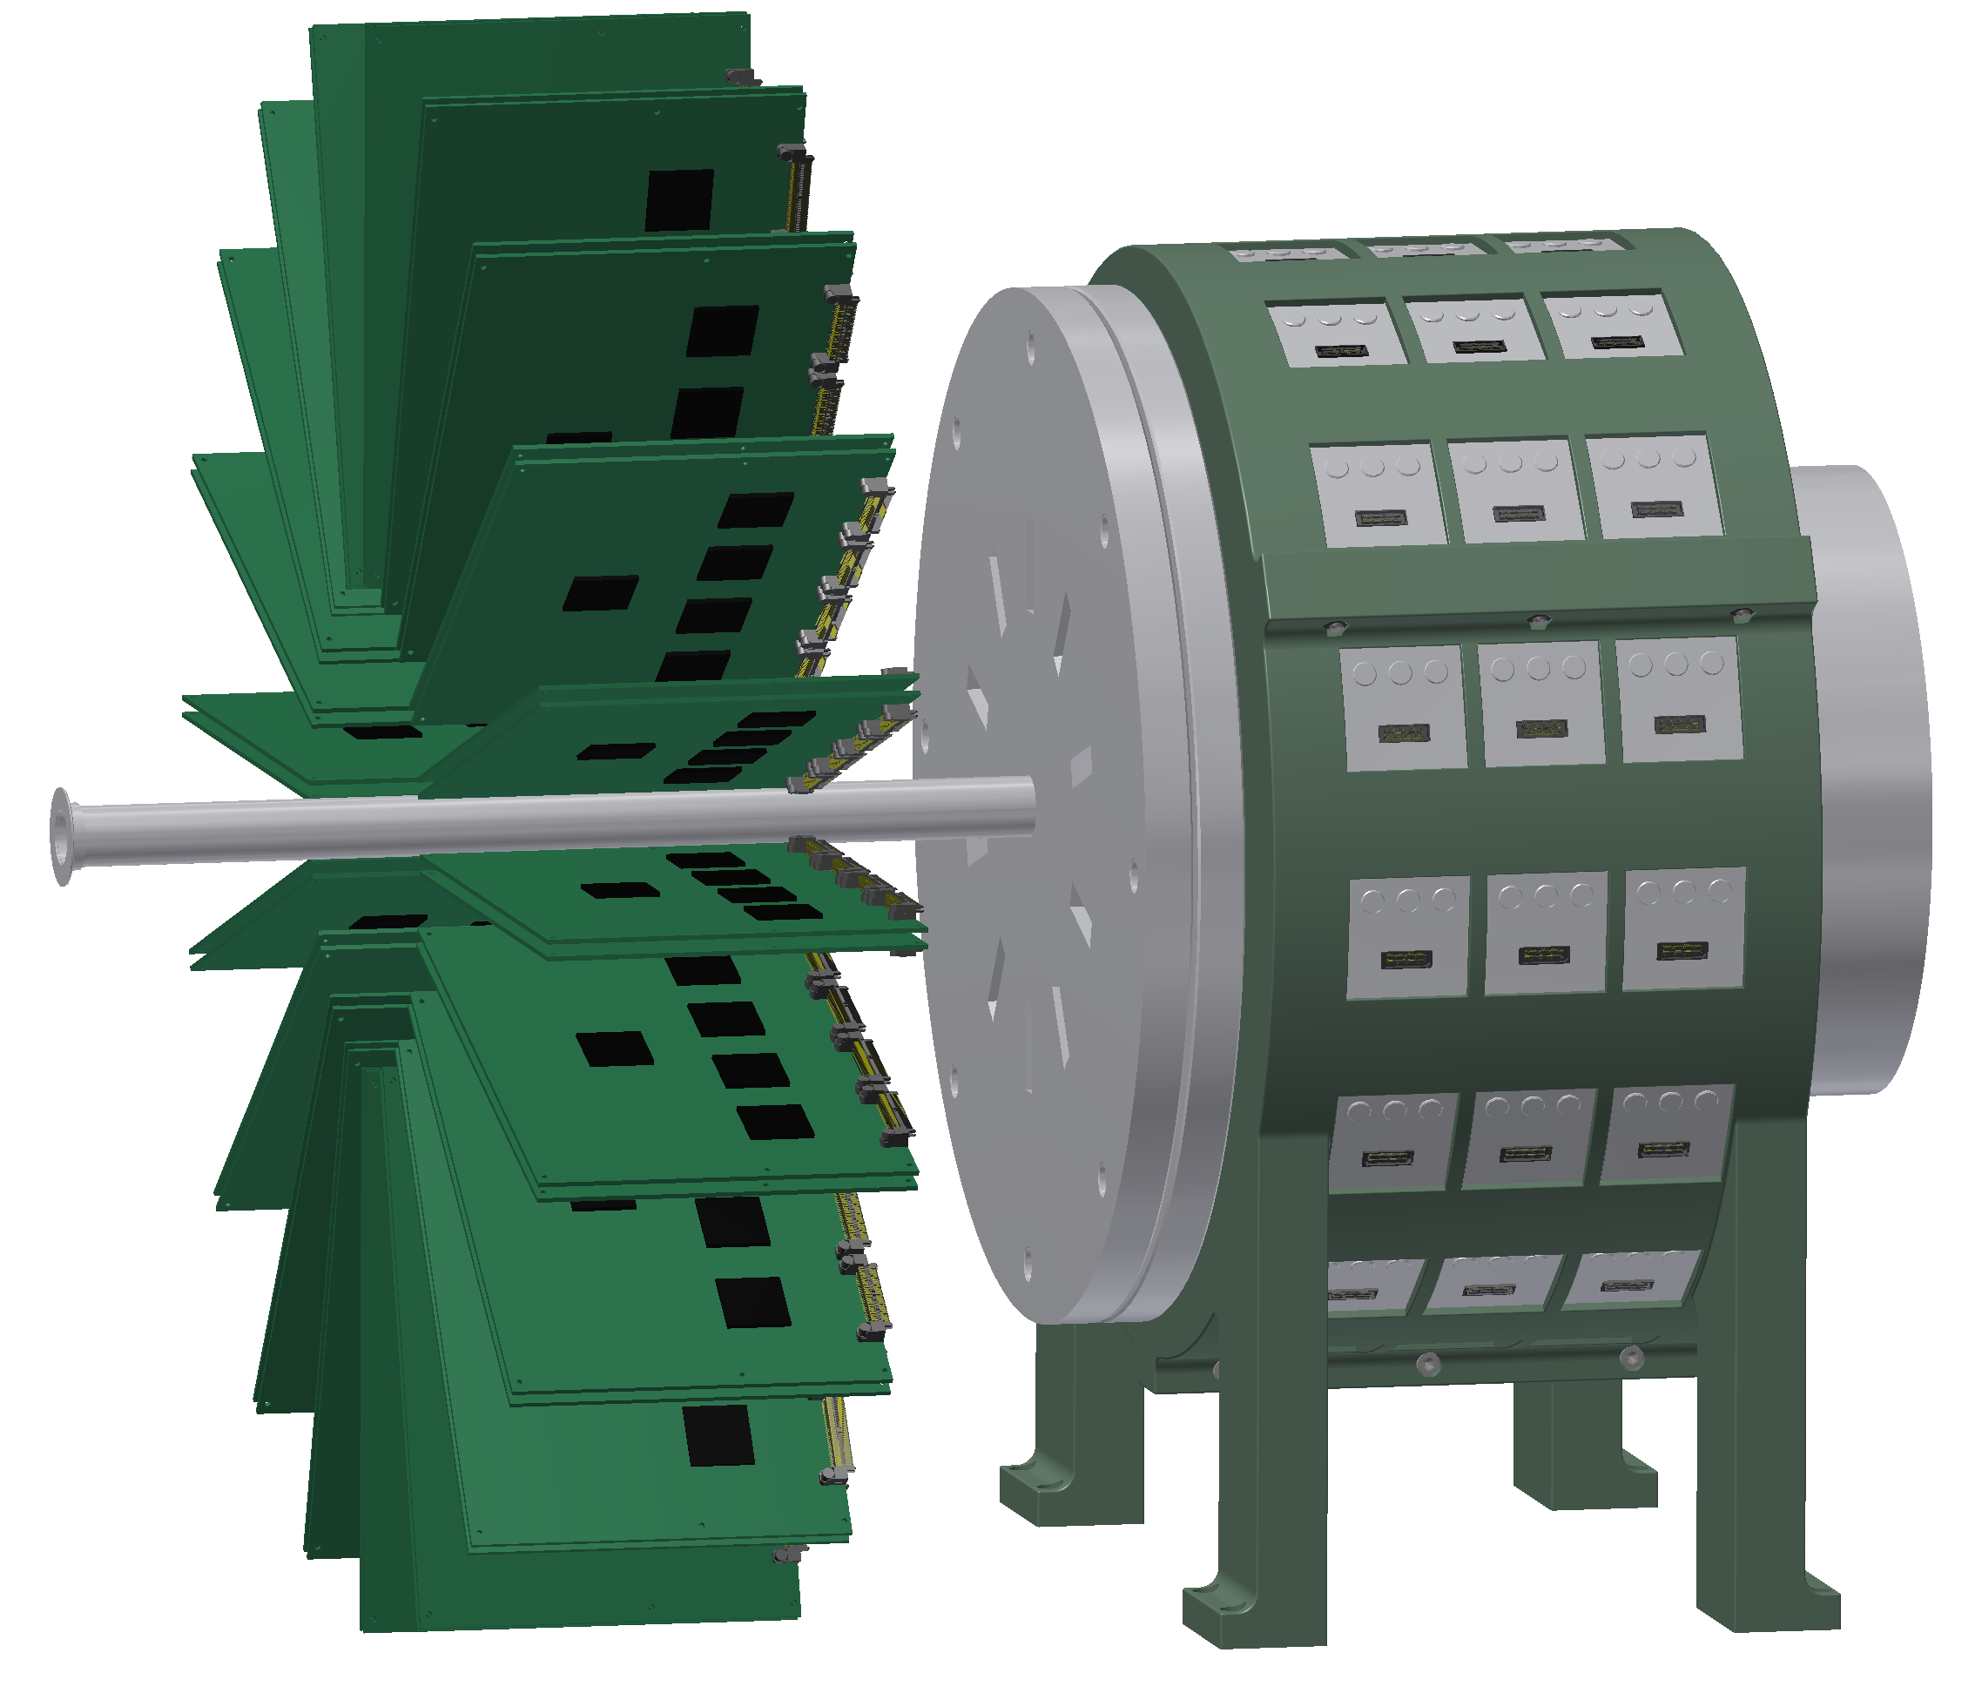
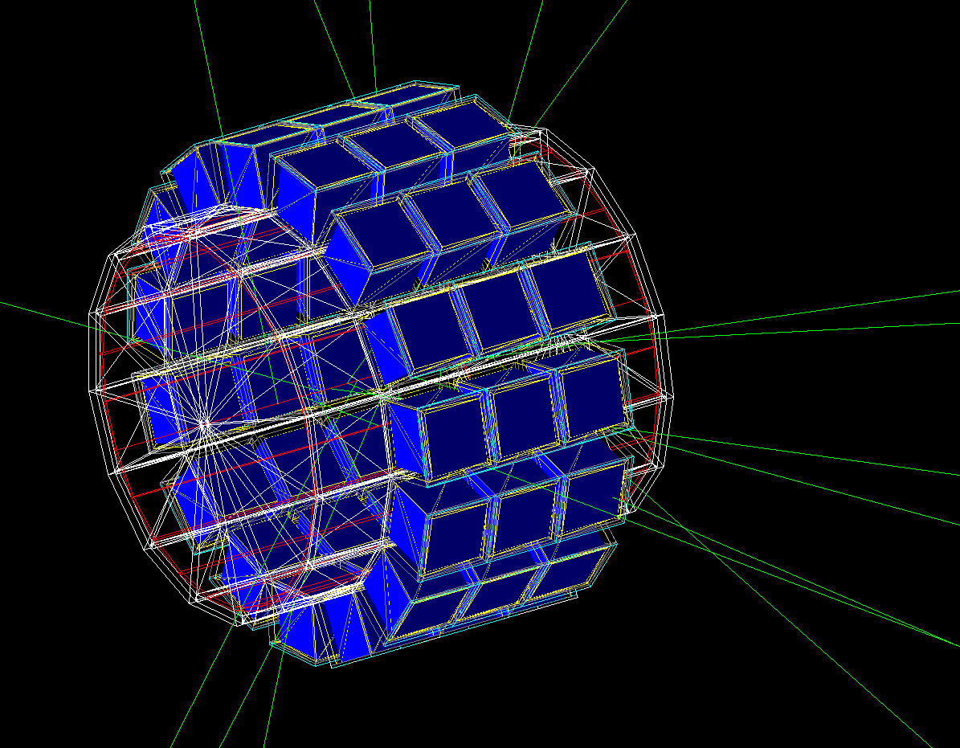
SpecMAT
Spectroscopy in a Magnetic Active Target
M. Babo, R. Raabe
KU Leuven, Instituut voor Kern- en Stralingsfysica

Slide 2
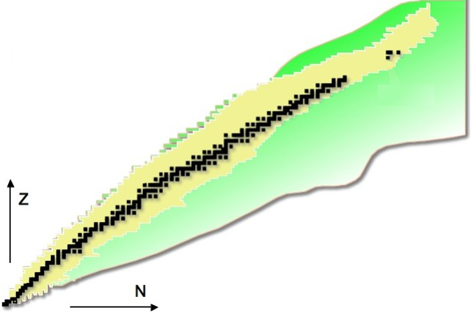
The physics (motivation)
Changes
in nuclear structure
far from stability
  Shell evolution
  towards ⁷⁸Ni
  Shape coexistence
  “west” of ²⁰⁸Pb
stable nuclei
observed nuclei
unknown nuclei (predicted)
82
²⁰⁸Pb
50
126
28
⁷⁸Ni
82
20
50
8
20
28
2
8

Slide 3
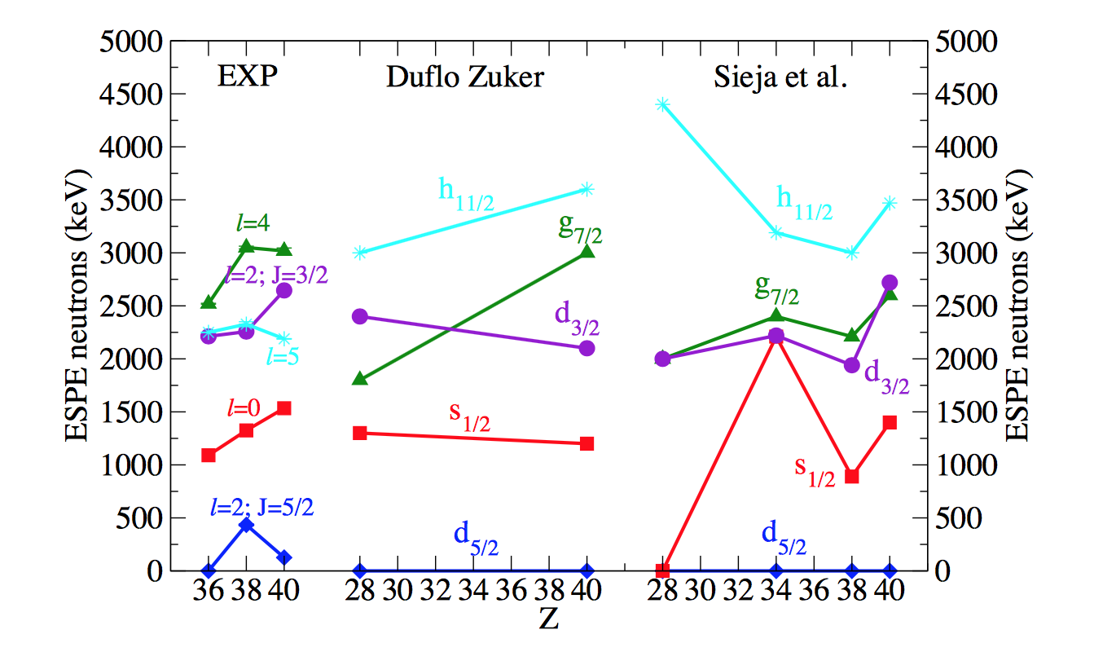
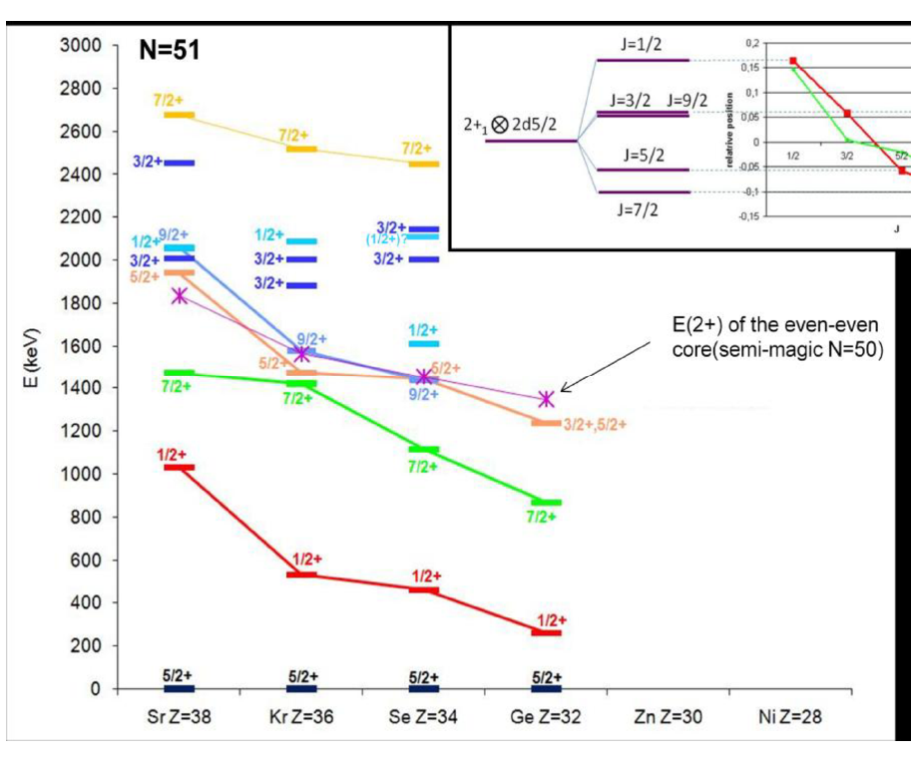
Shell evolution towards ⁷⁸Ni
  Emptying of the fp shells
  Migration (and inversion?) of d_{5/2} and s_{1/2} due to tensor interaction
Courtesy of D. Verney, IPN Orsay
  Low-energy state: half-life of the E2 transition increase
?

Slide 4
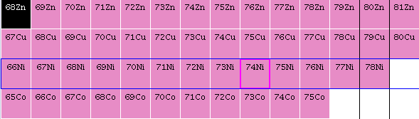
Shell evolution towards ⁷⁸Ni
  Migration of πf_{7/2}, πf_{5/2}
  as νg_{9/2} is filled
  (tensor interaction)
p3/2
f5/2
S. Franchoo et al., PRL 81 (1998) 3100
K. Flanagan et al.,
PRL 103 (2009) 142501

Slide 5
Shell evolution towards ⁷⁸Ni
  Migration of πf_{7/2}, πf_{5/2}
  as νg_{9/2} is filled
  (tensor interaction)
g_{9/2}
f_{5/2}
f_{7/2}
proton
neutron
T. Otsuka, et al.,
PRL 104 (2010) 012501
K. Sieja, F. Nowacki,
PRC 81 (2010) 061303(R)

Slide 6
Shell evolution towards ⁷⁸Ni
  Migration of πf_{7/2}, πf_{5/2}
  as νg_{9/2} is filled
  (tensor interaction)
g_{9/2}
f_{5/2}
f_{7/2}
proton
neutron
  (d,³He) on ⁷⁰⁻⁷⁶Zn
πf_{5/2}
T. Otsuka, et al.,
PRL 104 (2010) 012501
K. Sieja, F. Nowacki,
PRC 81 (2010) 061303(R)
πp_{3/2}
28
πf_{7/2}
Zn

Slide 7
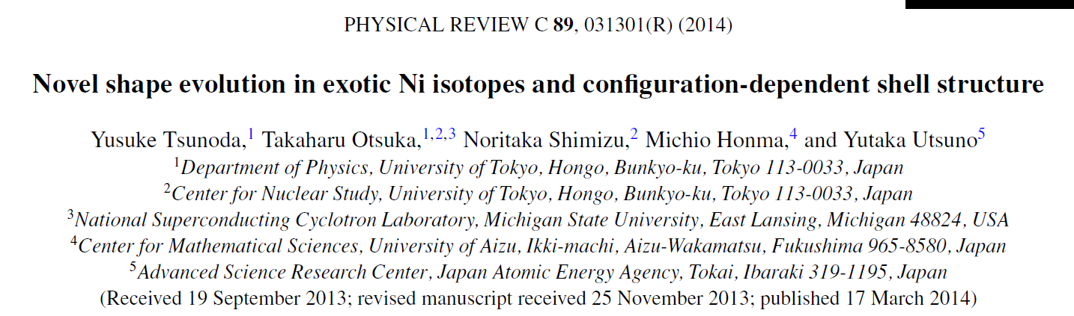
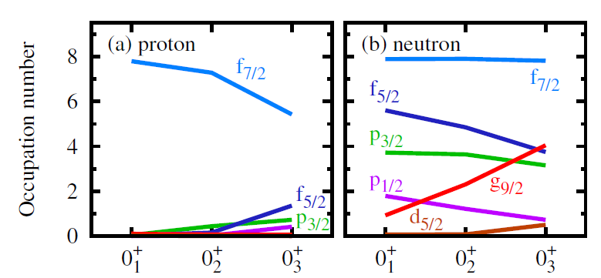
Single-particle and deformation
  “Type II” shell evolution
  Deformation can induce changes in occupancy…
  which, through the tensor interaction, modifies the gaps between shells
⁶⁸Ni

Slide 8
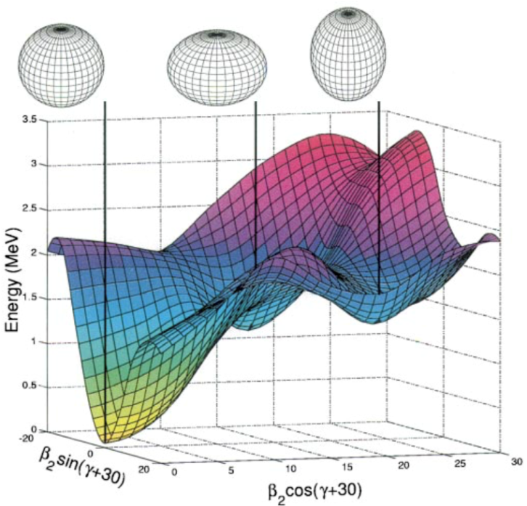
Shape coexistence “west” of ²⁰⁸Pb
A. Andreyev et al., Nature 405 (2000) 430
  States characterised by different shapes appear at low excitation energy
  Example: n-deficient Pb region
  ¹⁸⁶Pb triple-shape coexistence
  Hg nuclei: “parabolic intrusion” at mid-shell
¹⁸⁶Pb
Data: NNDC
Original figure in R. Julin et al., J. Phys. G 27 (2001) R109

Slide 9
Shape coexistence “west” of ²⁰⁸Pb
A. Andreyev et al., Nature 405 (2000) 430
  States characterised by different shapes appear at low excitation energy
  Example: n-deficient Pb region
  ¹⁸⁶Pb triple-shape coexistence
  Hg nuclei: “parabolic intrusion” at mid-shell
¹⁸⁶Pb
  (d,p) and (p,d) transfers on ^{184,185g,185m}Hg (possibly ¹⁸²Hg), ¹⁸⁸Pb, ¹⁹⁶Po
Data: NNDC, figure courtesy of Liam Gaffney
Original figure in R. Julin et al., J. Phys. G 27 (2001) R109

Slide 10
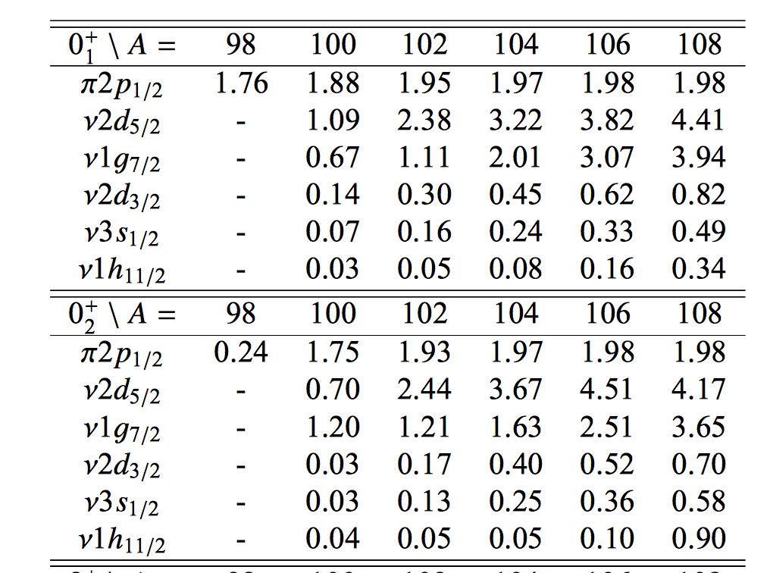
Shape coexistence “west” of ²⁰⁸Pb
  Deformation also in n-rich Cd isotopes
  Occupation number of the 2p-2h states 0⁺₂ is changing.
  Could be due to migration of
  (d,p) and (p,d) transfers on odd-A Cd and possible two-neutron transfer
A. Blazhev et al, EPJ Web of Conf. 93, 01016 (2015)

Slide 11
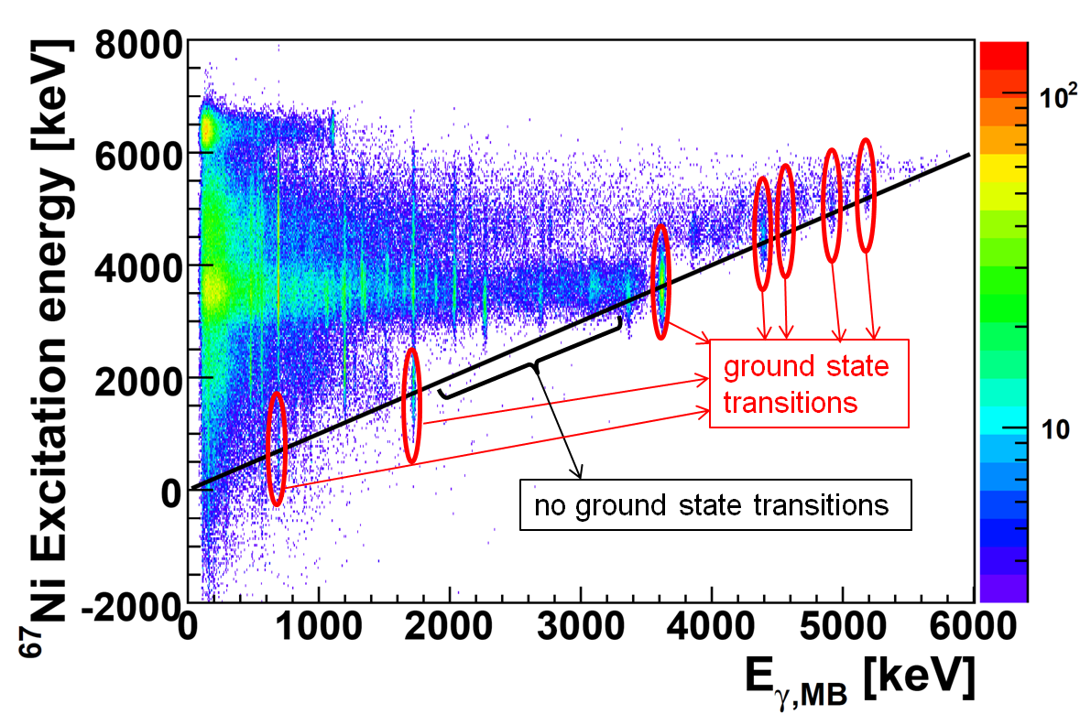
Problem: density of states
Importance of 𝛾-ray detection
  Transition probabilities
  Energy resolution from coincidences
  Build the decay scheme
²⁵Na(d,p)
⁶⁶Ni(d,p)
G. Wilson et al., PLB 759, 417 (2016)
J. Diriken et al., PLB 736, 533 (2014)
J. Diriken et al., PRC 91, 054321 (2015)

Slide 12
Method: active target + 𝛾-ray array
  Challenges
  Resolution
  Efficiency
  → Choices
  Active target
  Magnetic field parallel
  to beam direction
  to confine emitted particles
  and minimize material
  + 𝛾-ray detection

Slide 13

Challenges for 𝛾-ray detection
  Good resolution and efficiency
  Placement in a magnetic field
  Possible use of digital electronics
  Budget

Slide 14
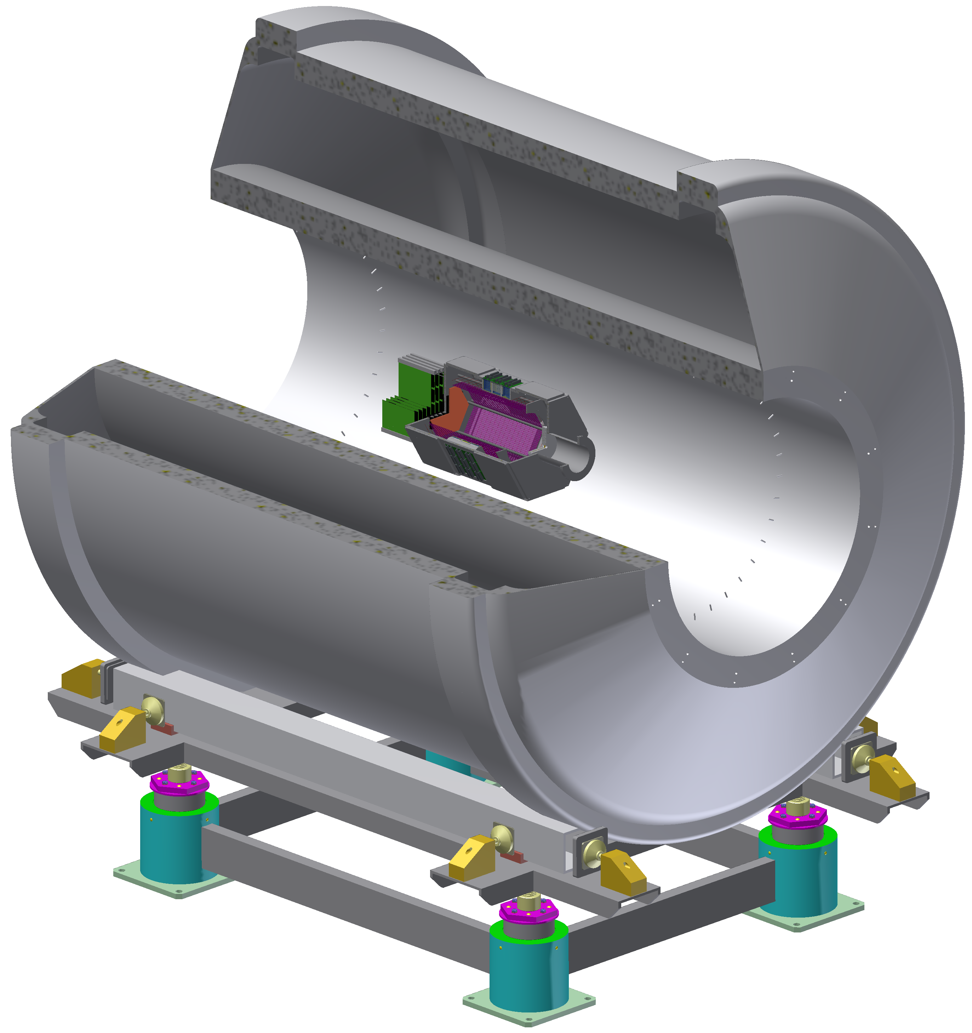
Challenges for 𝛾-ray detection
  Good resolution and efficiency
  Placement in a magnetic field
  Possible use of digital electronics
  Budget
  → Scintillation crystals (LaBr₃ or CeBr₃)
  → Silicon photomultipliers (SiPMs)
  → Compact design

Slide 15
Challenges for 𝛾-ray detection
  Good resolution and efficiency
  Placement in a magnetic field
  Possible use of digital electronics
  Budget
  → Scintillation crystals (LaBr₃ or CeBr₃)
  → Silicon photomultipliers (SiPMs)
  → Compact design

Slide 16
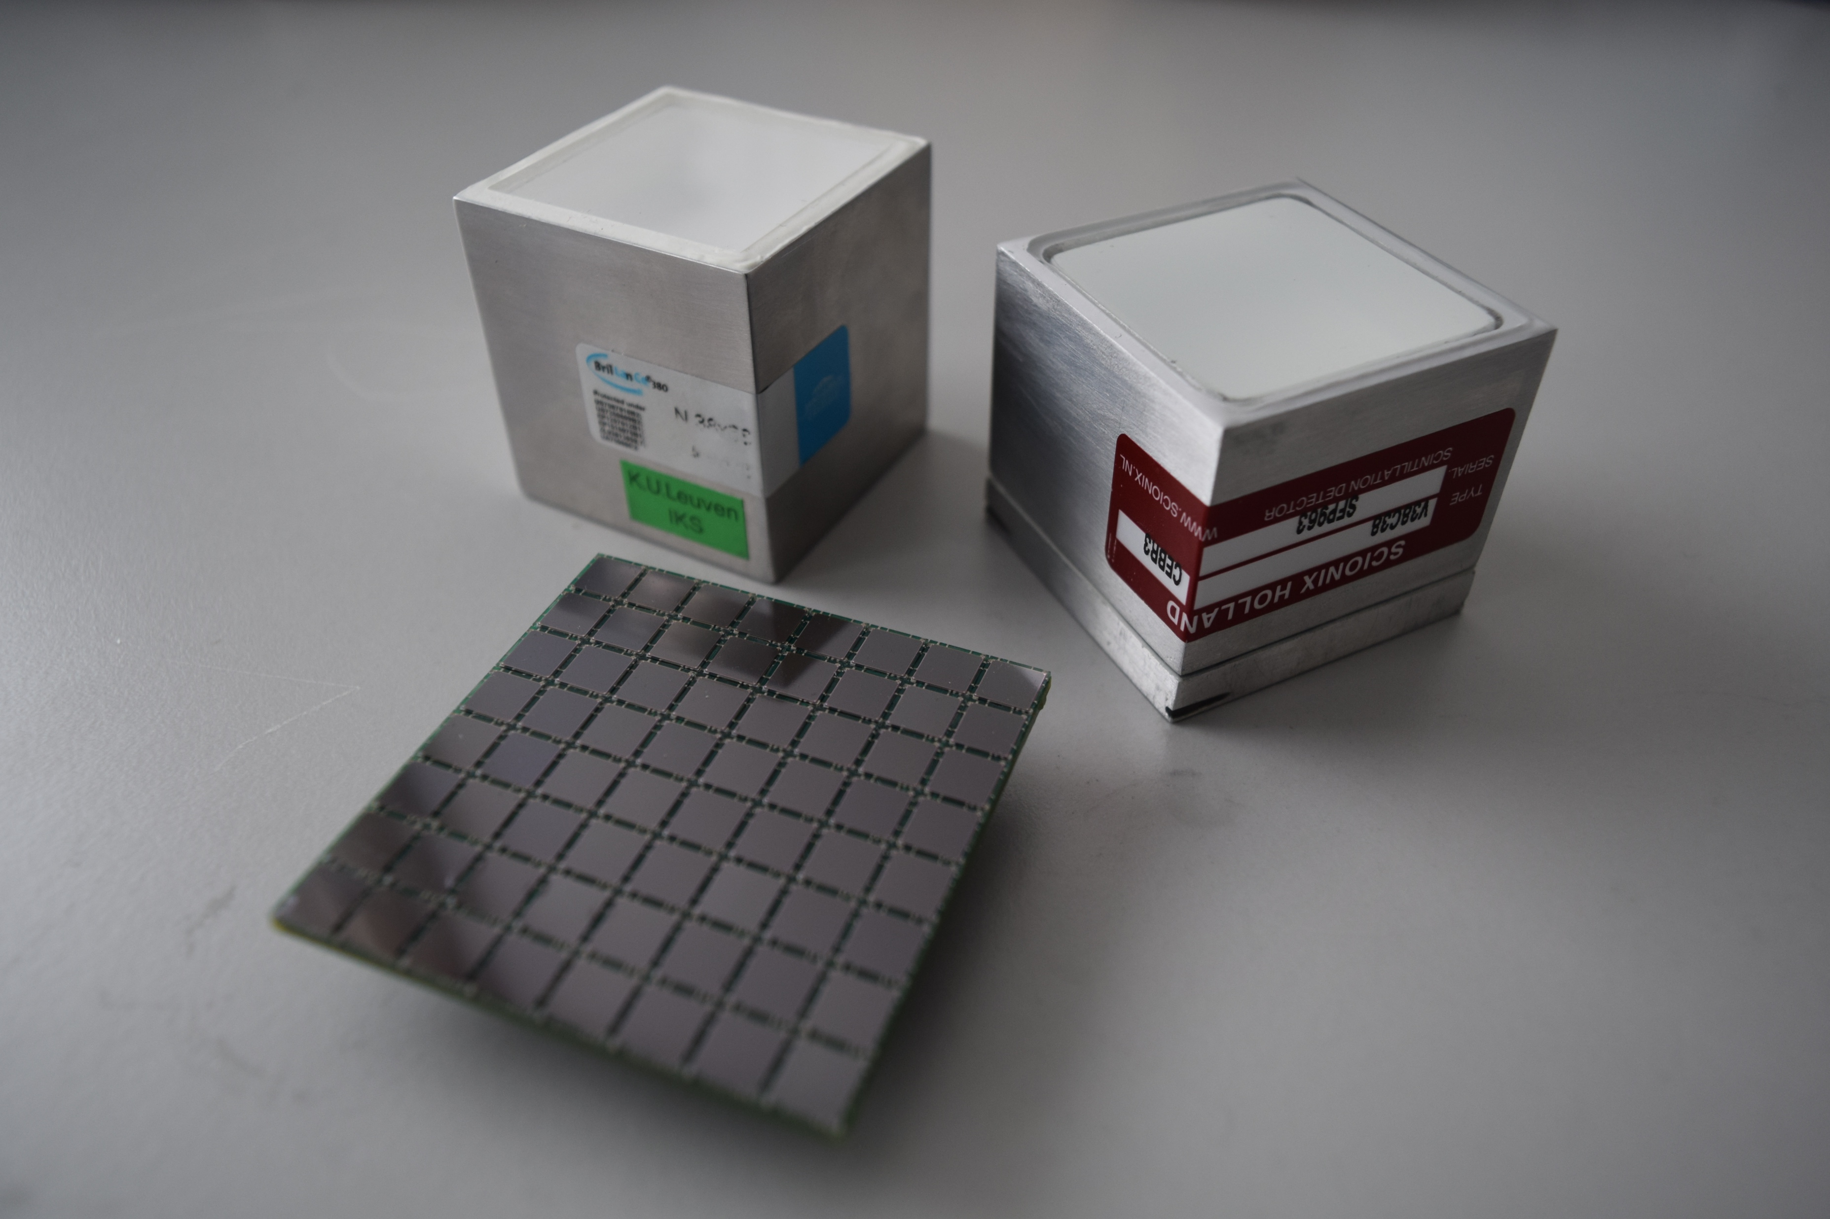
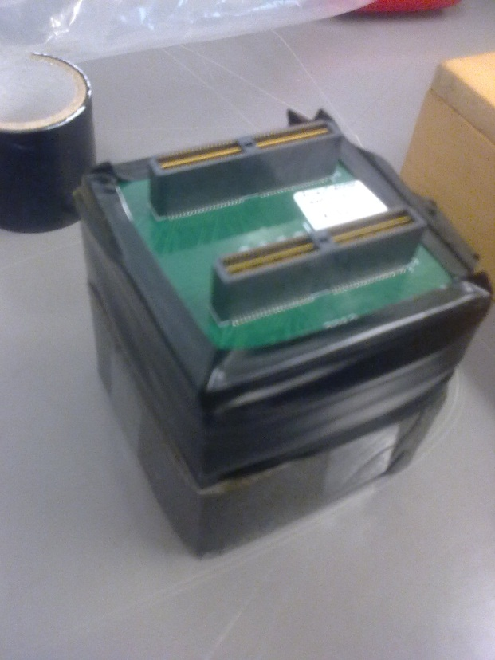
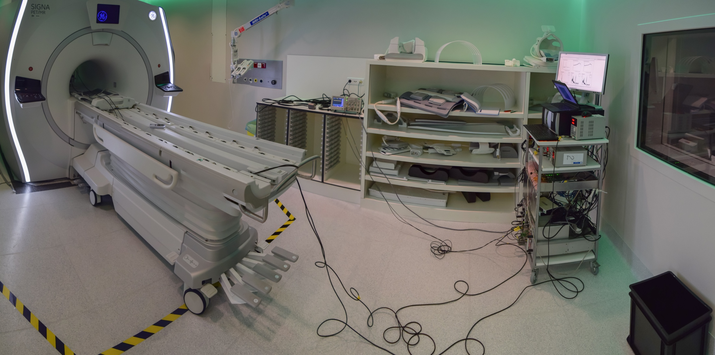
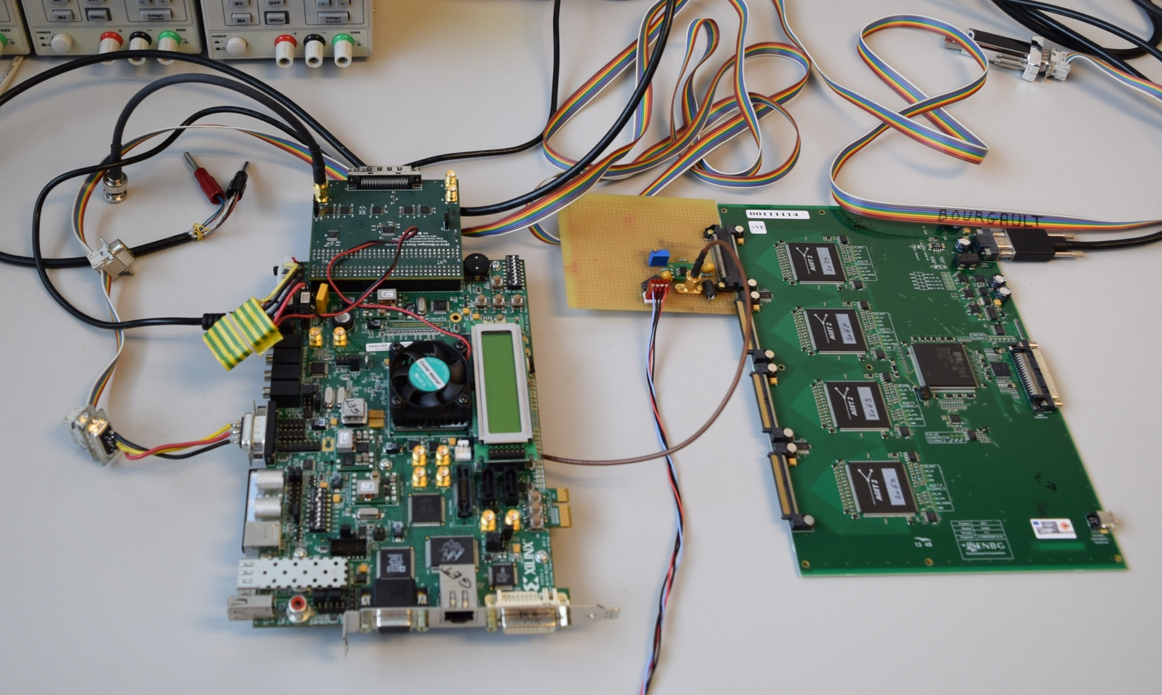
Characterising the scintillation crystals
  Test resolution against
  - SiPMs
  - Digital electronics
  - Magnetic field
  Optimise efficiency
  - validate results of simulations
  New tests this summer with final GET electronics

Slide 17
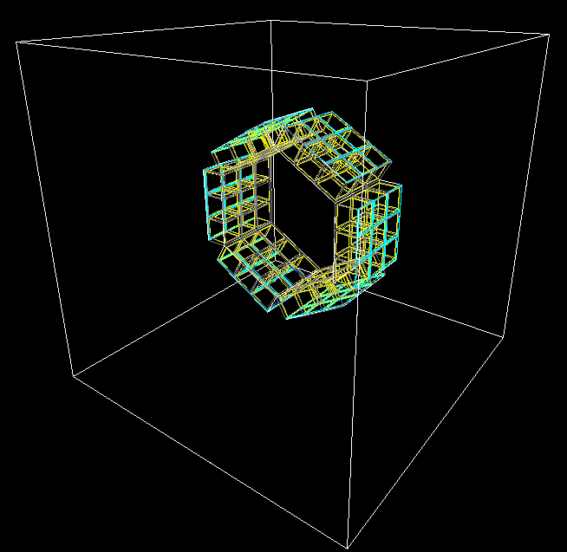
Efficiency
Work of J.A. Swartz, O. Poleshchuk
  Detector size
  → the bigger the better
mm
mm

Slide 18
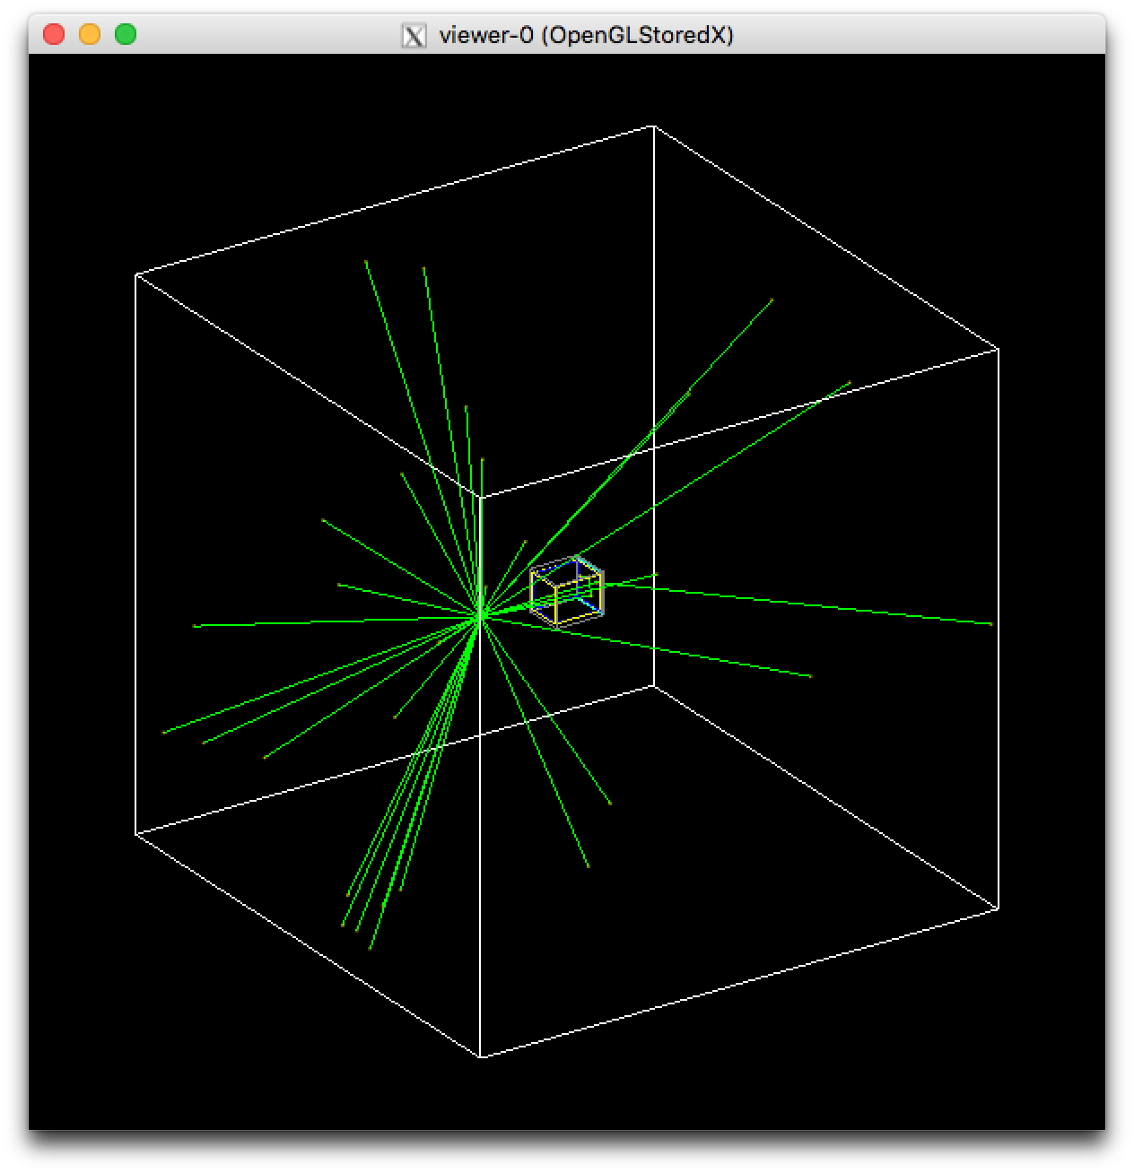
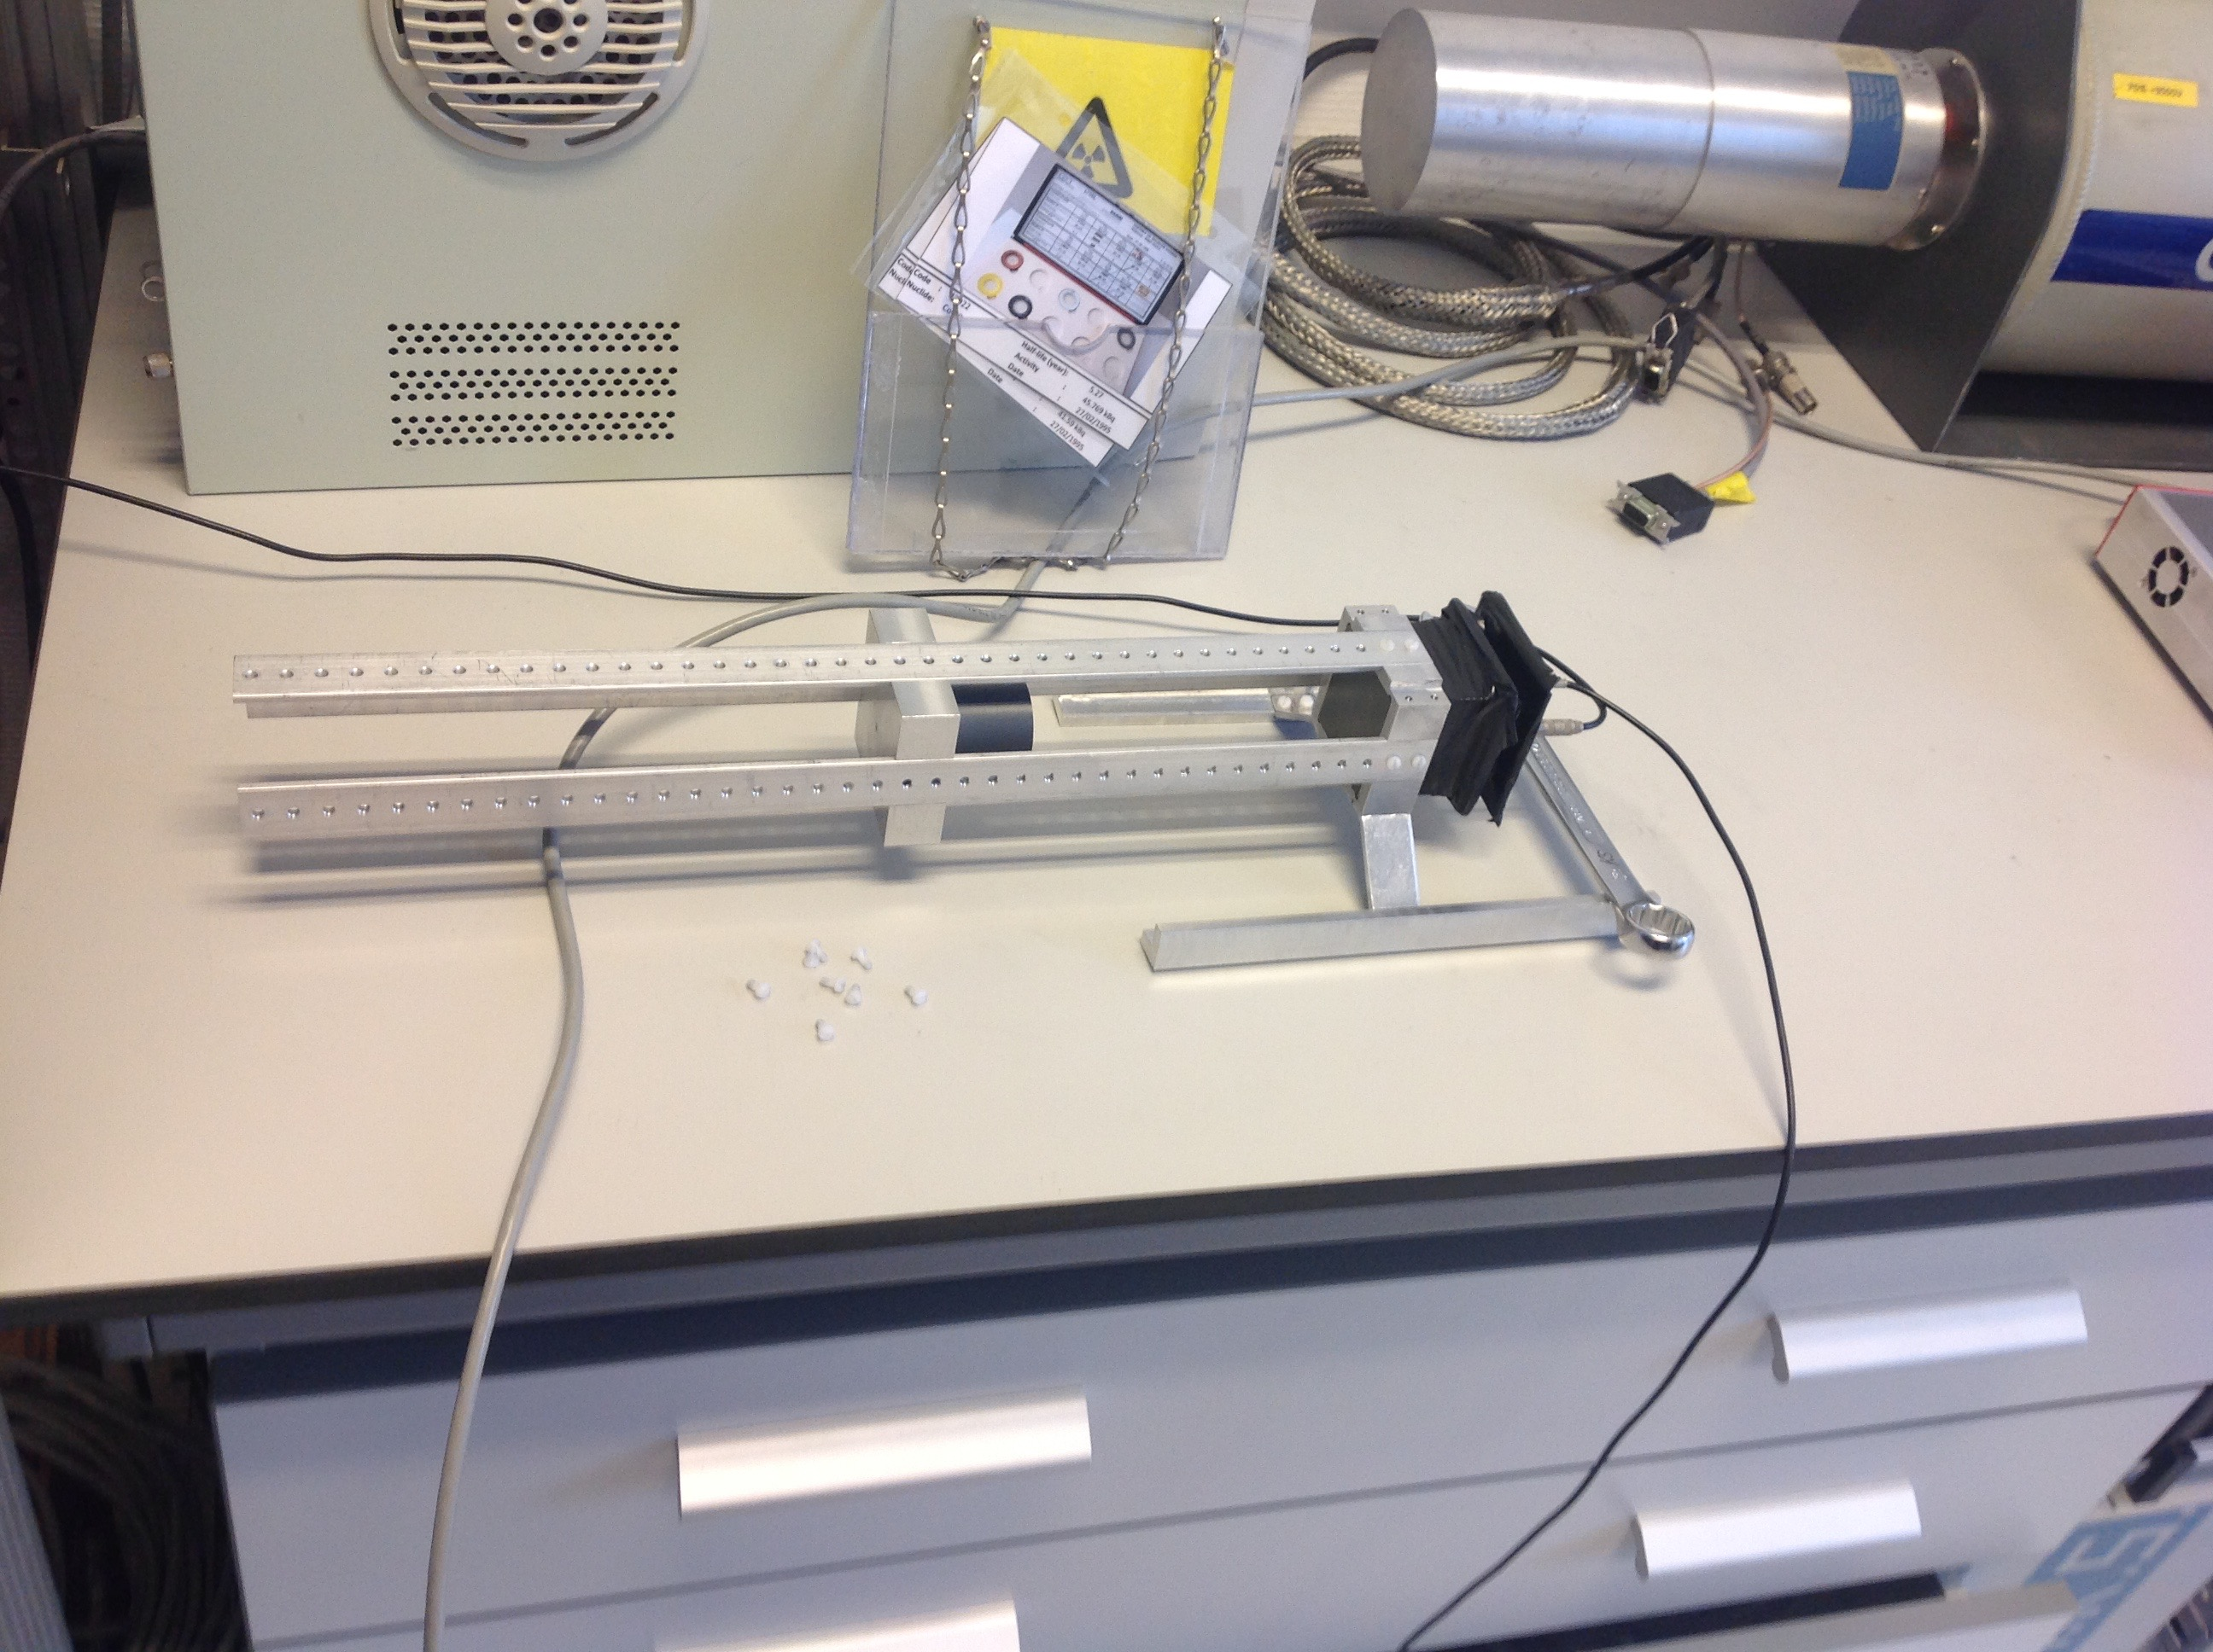
Efficiency
Work of J.A. Swartz, O. Poleshchuk
  1.5”x1.5”x1.5” CeBr₃ at 120 mm
  → Simulation under control

Slide 19
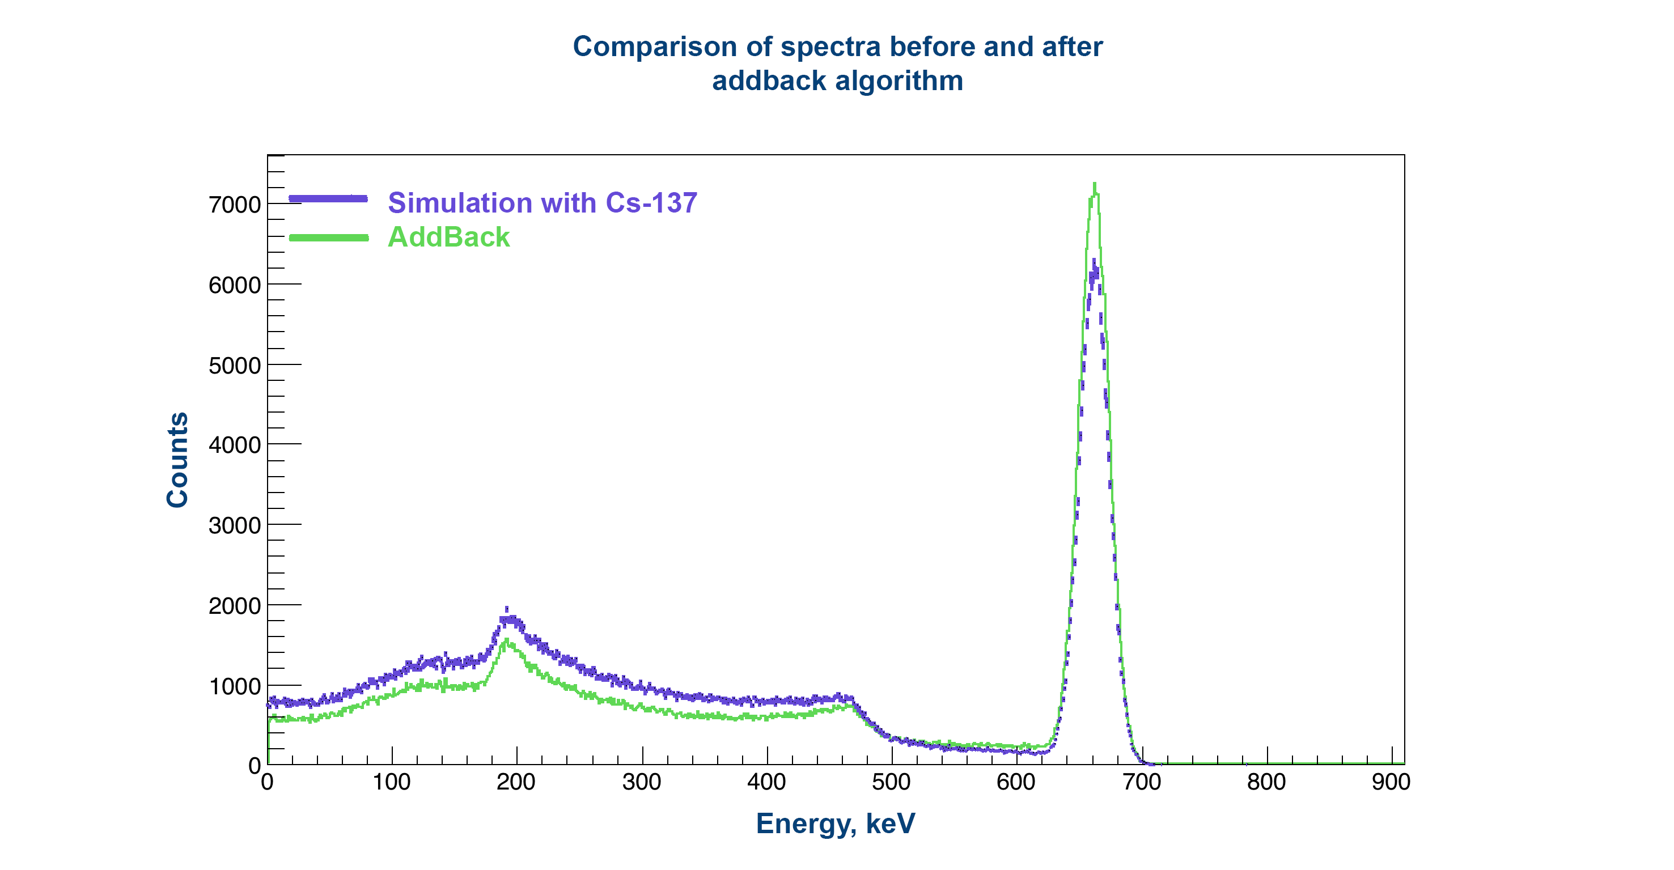
Efficiency
Work of J.A. Swartz, O. Poleshchuk
  Add-back
  only neighboring crystal
  @ 662 keV : eff. up to 17%

Slide 20
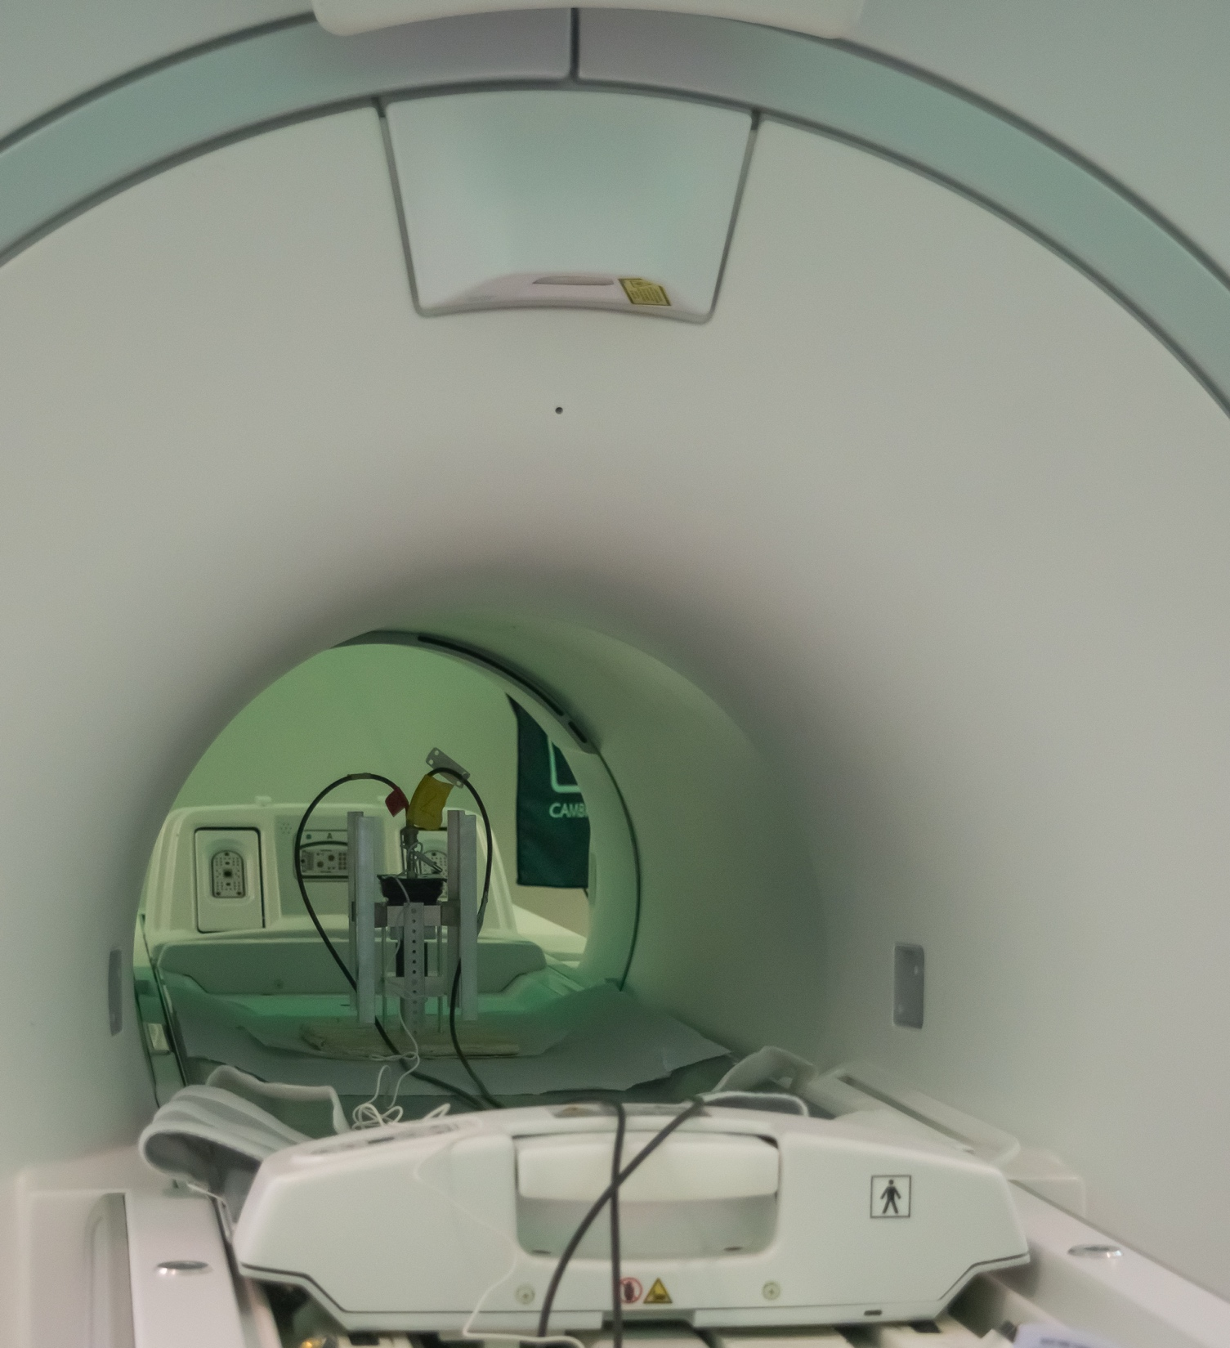
Resolution
Work of J.A. Swartz, O. Poleshchuk
  Tests in 3T-magnetic field at the UZ Leuven
  1,5”x1,5”x1,5” LaBr₃ and CeBr₃ crystals
  C-series SiPM array
  Analog, Standard digital (CAEN)
  and GET system
B-field direction
B-field direction
 | DAQ | Analogue | CAEN | GET | GET
Detector | B-field | No field | No field | No field | AsAd in 3T
CeBr₃+SiPM | No field | 5,3% | 5,7% | 6,0% | 6,5%
CeBr₃+SiPM | 3T | 5,3% | 5,6% | 6,0%
LaBr₃+SiPM | No field | 3,5% | 3,7% | 4,2%
LaBr₃+SiPM | 3T | 3,5% | 3,9% | 4,2%
  → No measurable effect of the magnetic field
  → Resolution worse (≈1%) through use of SiPMs
  and digital electronics

Slide 21
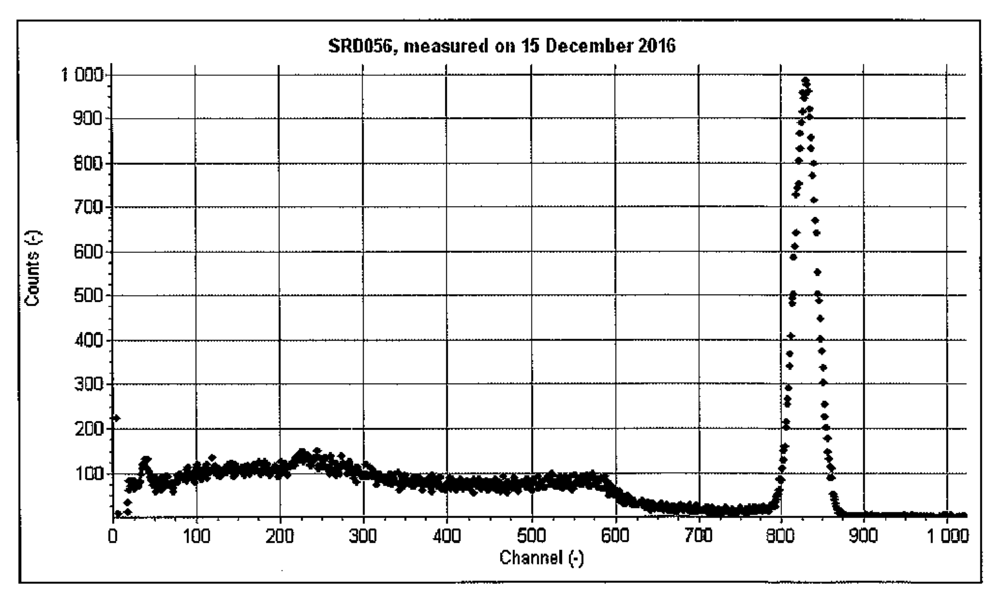
The real thing
  Tender assigned
  2”x 2”x 2” CeBr₃ crystals
  from Hellma (Germany)
  J-series SiPM array
  Custom break-out board
  Assembly: Scionix (Holland)
  guaranteed resolution: 3.9%
  30 scintillators in production

Slide 22
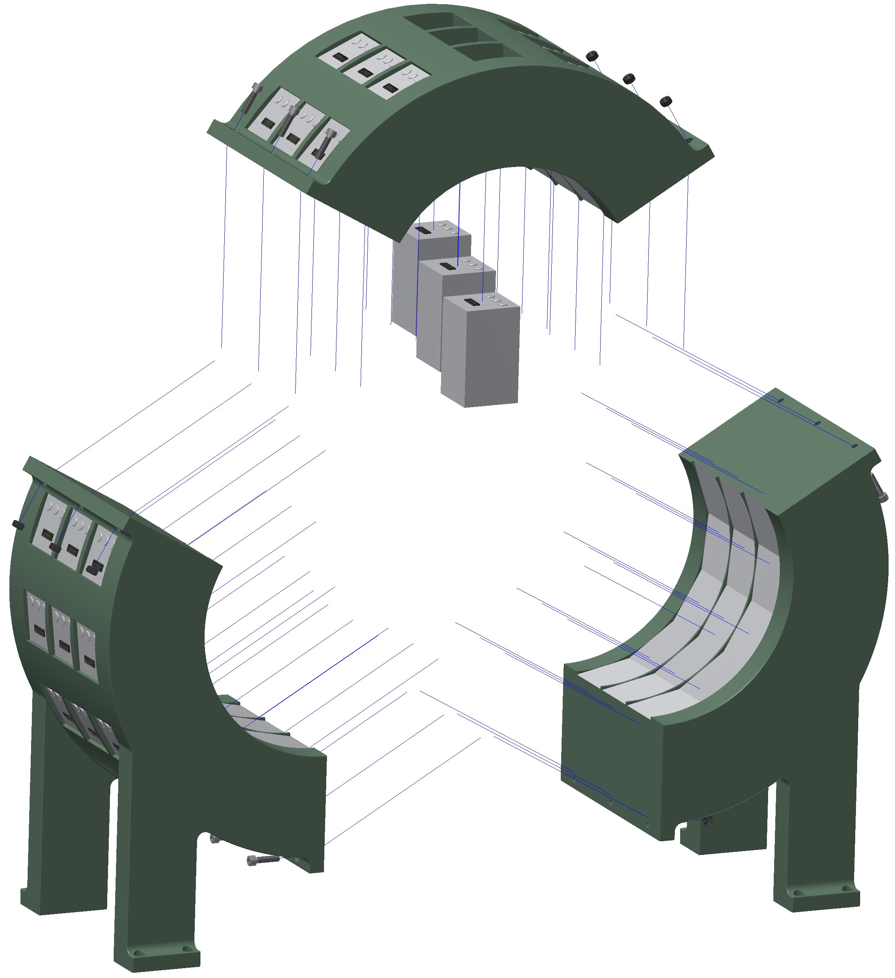
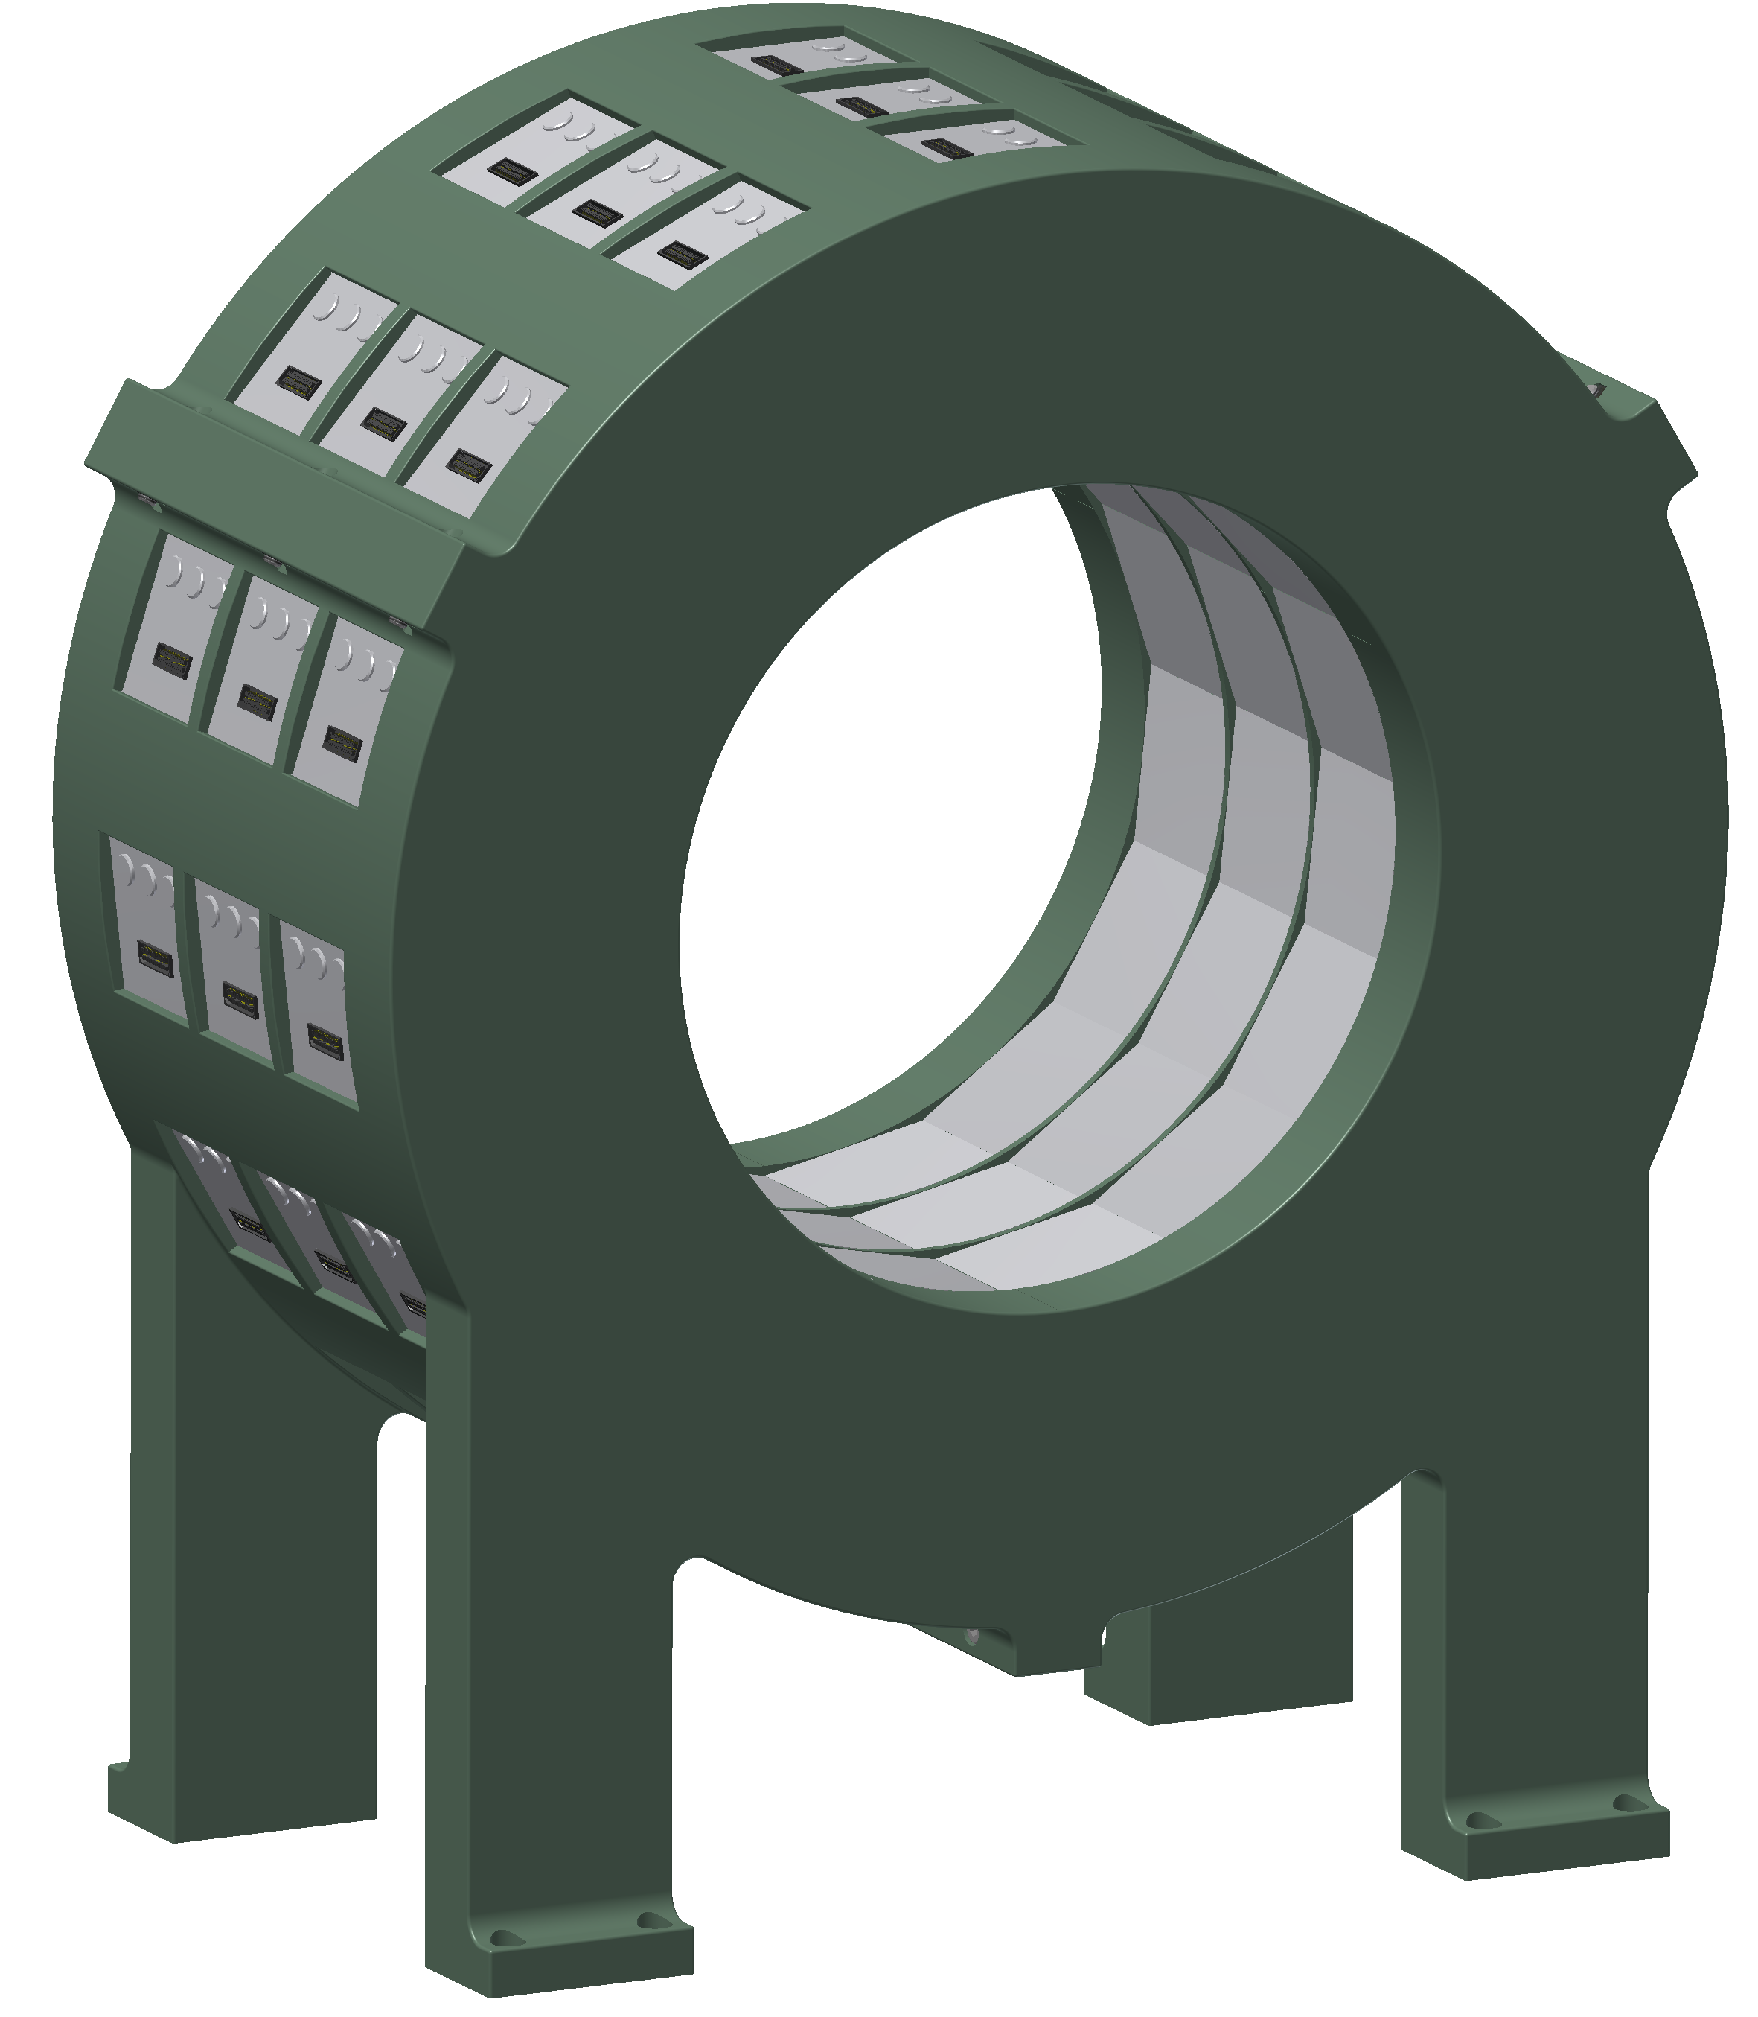
Challenges for 𝛾-ray detection
  (Preliminary) Schematic view of the geometry

Slide 23
Challenges for 𝛾-ray detection
  Electronics included …

Slide 24
Challenges for particle detection
  Pad plan for commissioning the electronics

Slide 25
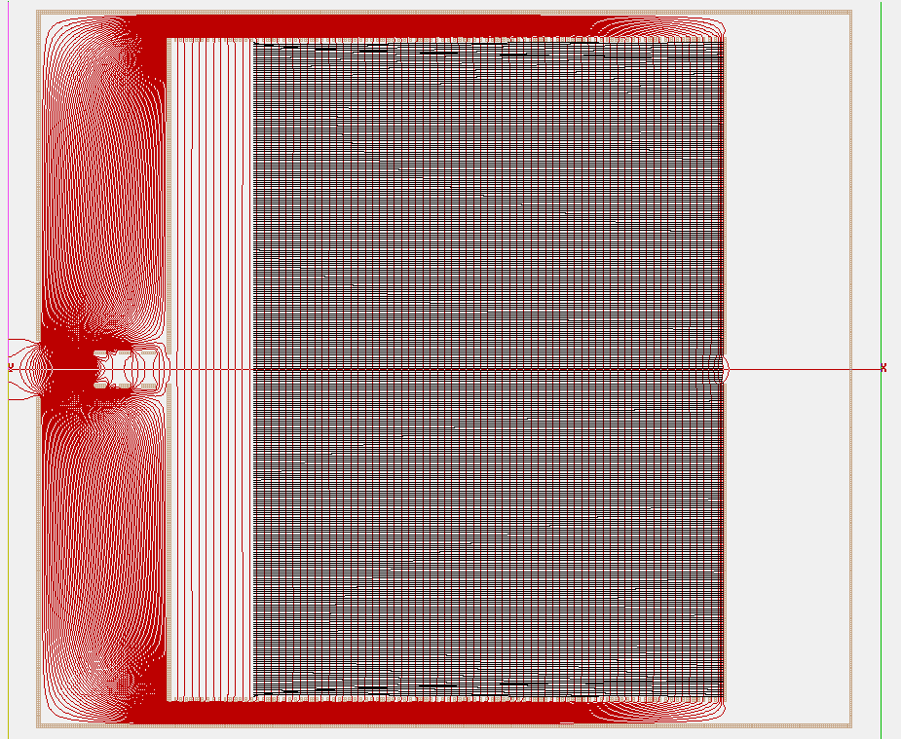
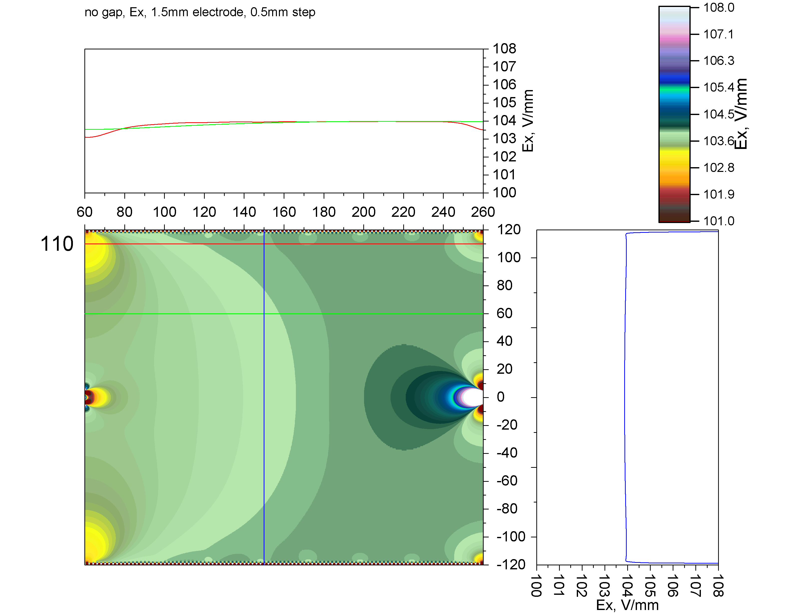
Challenges for particle detection
  Simulation of the drift cage (pitch and size of wires)

Slide 26

Status – Conclusions
  Scintillation detectors purchased, delivery within 8 months
  Chamber design in full progress
  GET electronics (2000 channels) acquired
  First version pad plane and assembly by Spring 2018
  First measurements in 2018-19
  Thanks to the SpecMAT team!
  A. Arokja Raj, M. Babo, S. Ceruti, T. Marchi, O. Poleshchuk,
  R. Raabe, M. Renaud, H. De Witte, J. Yang
  The research leading to these results has received funding from the
  European Research Council under the European Union's Seventh
  Framework Programme (FP/2007-2013) / ERC Grant Agreement n. 617156

