Slide 1


The BEta deLayEd Neutron emission measurements
M. B. Gómez Hornillos, R. Caballero, A. Riego
G. Cortés, A. Poch, C. Pretel, F. Calviño
SEN, UNIVERSIDAD POLITÉCNICA DE CATALUÑA
Barcelona, SPAIN
J.L. Taín, A. Algora, C. Domingo-Pardo, J. Agramunt and Gamma Spectroscopy Group
IFIC- Valencia, SPAIN
D. Cano, T. Martínez, A. García and Nuclear Innovation Group
CIEMAT-Madrid, SPAIN
I.Dillmann
Uni Giessen and GSI, GERMANY
Brighton 2011 SEN, UPC, Barcelona
Notes:
1

Slide 2
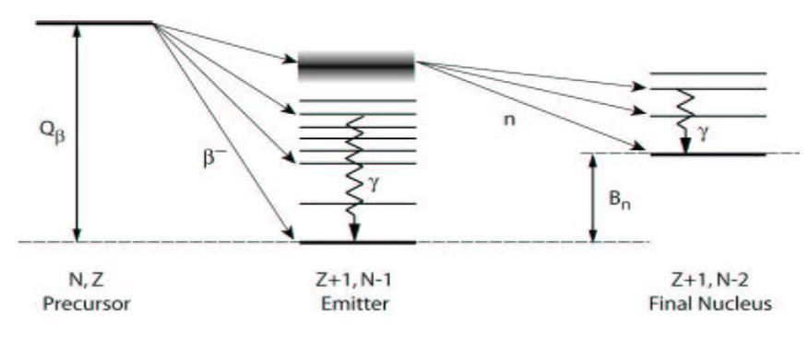
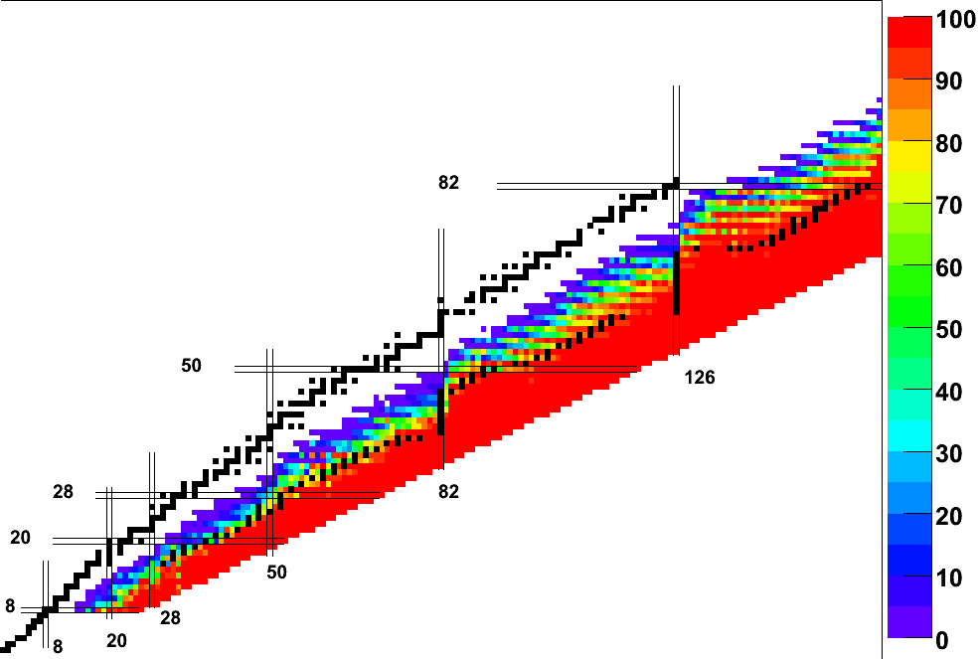
Beta decay of neutron rich nuclei
For enough neutron rich nuclei S_{n} lies below Q_{β}
If the decay proceeds to states above S_{n}, neutron emission dominates over γ-ray de-excitation
Far enough from the stability, β-delayed neutron emission becomes the dominant decay process
n
γ
β-delayed neutron emission probability
P_{n}
stability
r-process

Slide 3
IMPORTANCE OF BETA DELAYED NEUTRON EMITTERS
Nuclear power safety:
Some fission products undergo Beta Delayed Neutron Emission which is essential to control the reaction.
Nuclear Energy Agency (NEA) highlights the importance of experimental measurements and data evaluation of delayed neutron emission in its working group 6 “Delayed neutron data” [WPEC-SG6].
Rapid neutron-capture process of stellar nucleosynthesis:
Stellar abundances: delayed neutron emission probability (P_{n}) of r-process isobaric nuclei define the decay path towards stability during freeze-out, and provide a source of late time neutrons.
Nuclear Structure:
Additionally the measured half-lives (T_{1/2}) and β-delayed neutron-emission probabilities (P_{n}) can be used as first probes of the structure of the β-decay daughter nuclei in this mass region.
M. B. Gómez et al. UPC, Barcelona

Slide 4
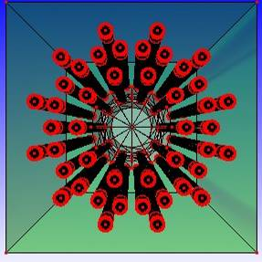
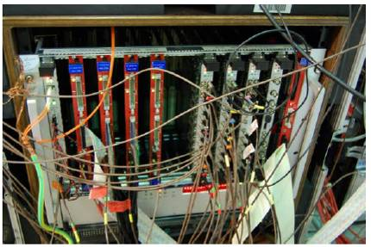
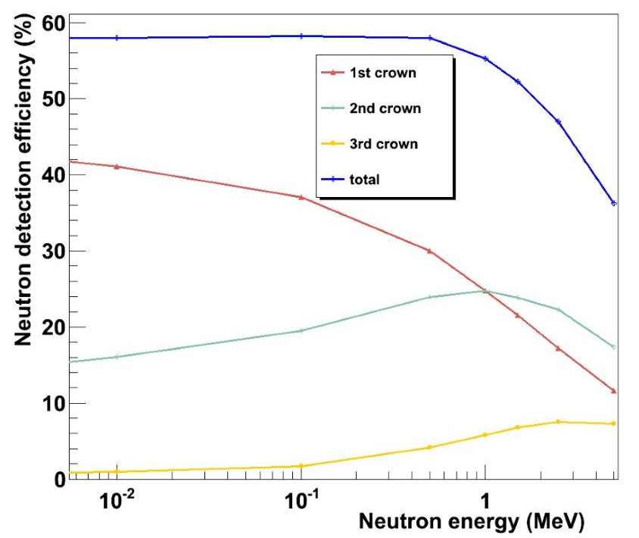
Detector layout
The neutron detector consists of 44 ³He counters arranged in 3 crowns. A beta detector will measure the beta decay.
Counter | 2527 LND
Gas | ³He
Effective length (mm) | 604.8
Effective diameter (mm) | 24.38
Gas pressure (torr) | 15200
Cathode material | Stainless steel
Triggerless DACQ. Full flexibility to modify correlation time neutron emission-detection => clean data
Correlation window 1ms with minimum dead time (~ 2 %)
M. B. Gómez et al. SEN, UPC, Barcelona

Slide 5
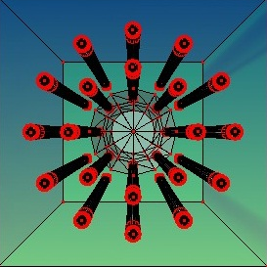
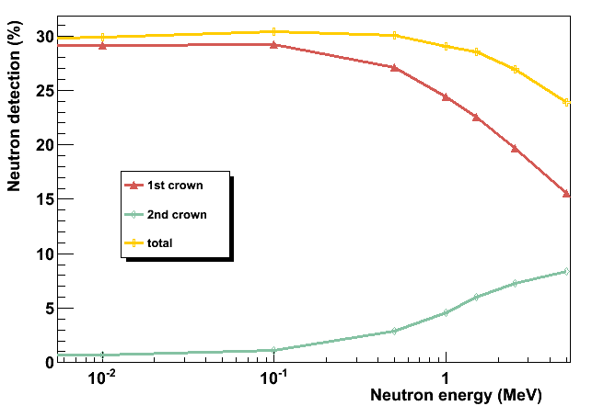
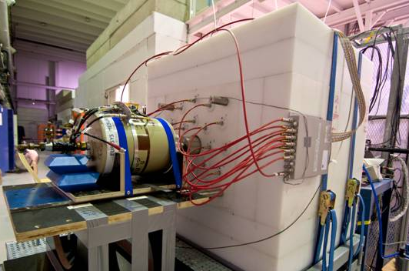
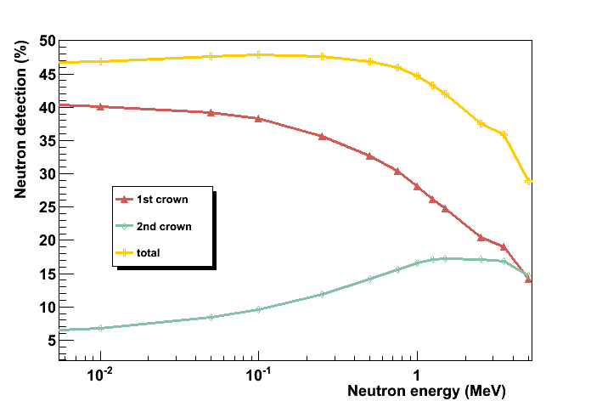
BEta deLayEd Neutron detector prototype
Detector consists of two crowns of (8+12) ³He detectors embedded in a polyethylene matrix with total dimensions 90x90x80 cm³ and a r=5 cm beam hole
Two different configurations.
Both used successfully at JYFLTRAP for measurement of
fission products
MCNPX simulation
MCNPX simulation
M. B. Gómez et al. UPC, Barcelona

Slide 6
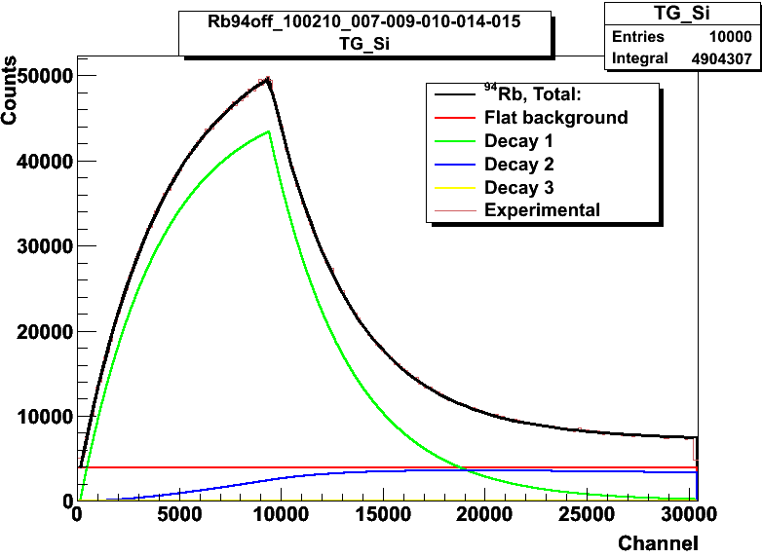
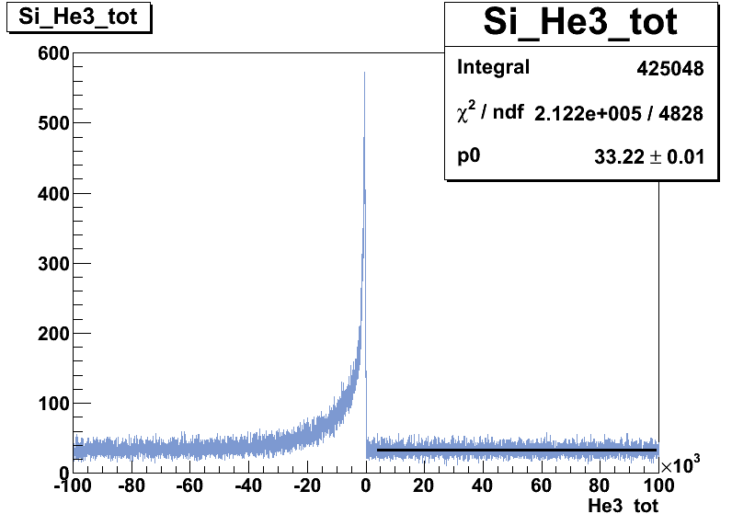
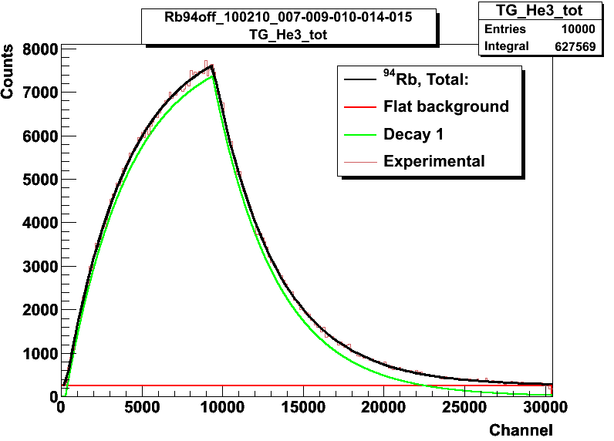
β-n time coincidence
β-rate along the time cycle
Preliminary analysis JYFL DATA
Experiment at JYFLTRAP with fission products
Ions were implanted on a tape for 3T_{1/2} and left decay for 7T_{1/2} before moving it away from the Si detector.
Decay fits to Bateman equations.
n-rate along the time cycle
M. B. Gómez et al. UPC, Barcelona

Slide 7
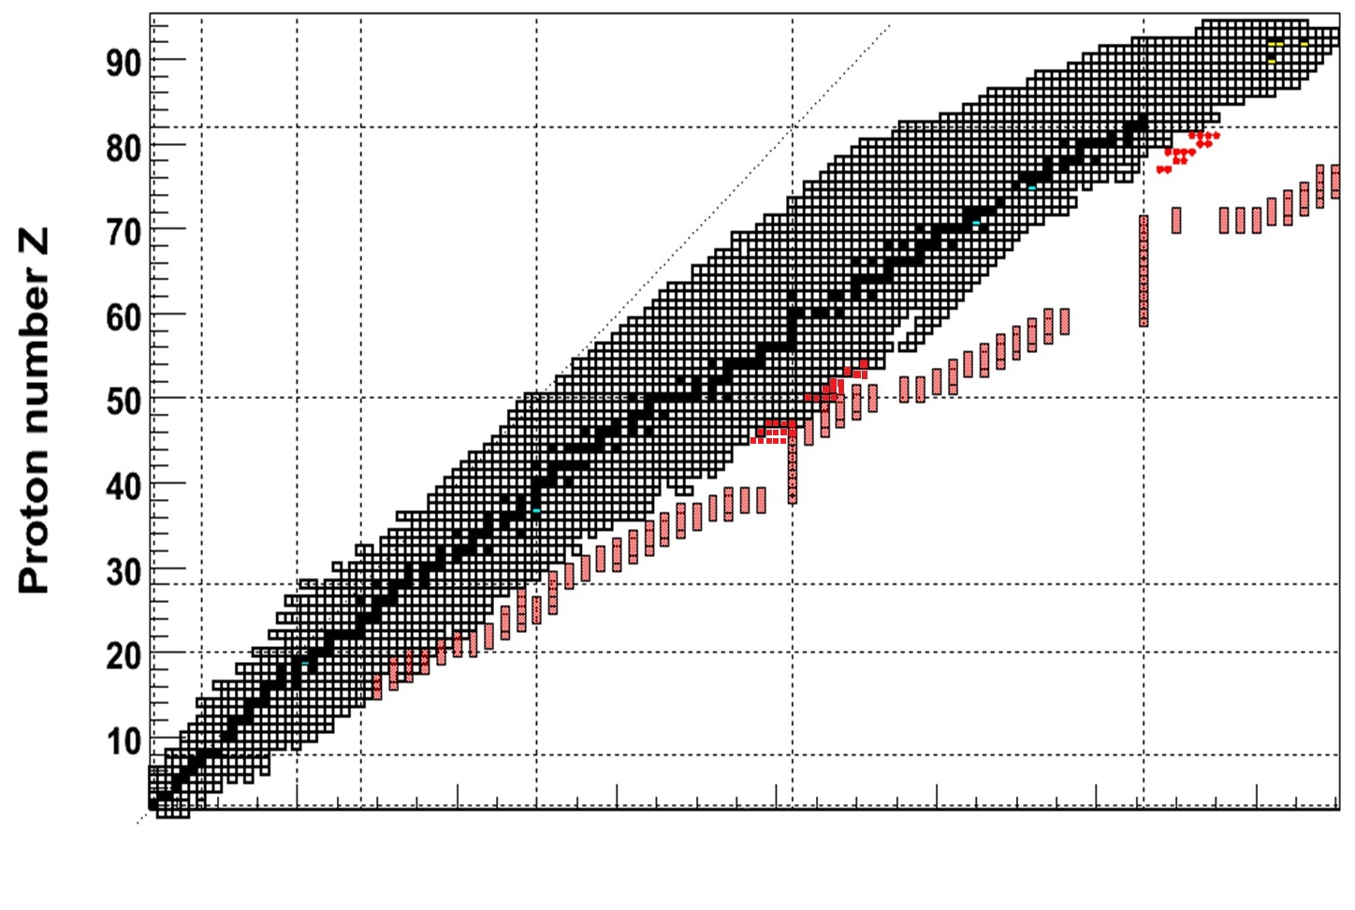
Pn measurements at GSI
S410 “Beta-decay measurements of new isotopes near the third r-process peak” C. Domingo-Pardo et al.
E040 “Nuclear astrophysics studies at FRS-ESR: neutron rich nuclei in the ¹³²Sn region” H. Schatz et al.
  S323 “Beta-decay of very neutron-rich Rh, Pd, Ag nuclei including the r-process waiting point ¹²⁸Pd”. F. Montes et al.
To be performed in 2011
Performed in 2000
To be performed in 2011
Z=28, N=50
Neutron number N
M. B. Gómez et al. UPC, Barcelona

Slide 8
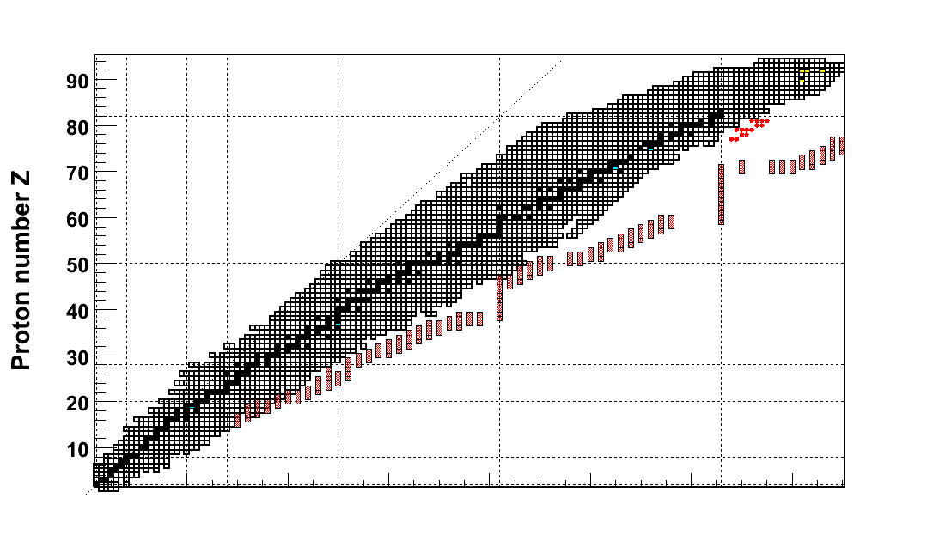
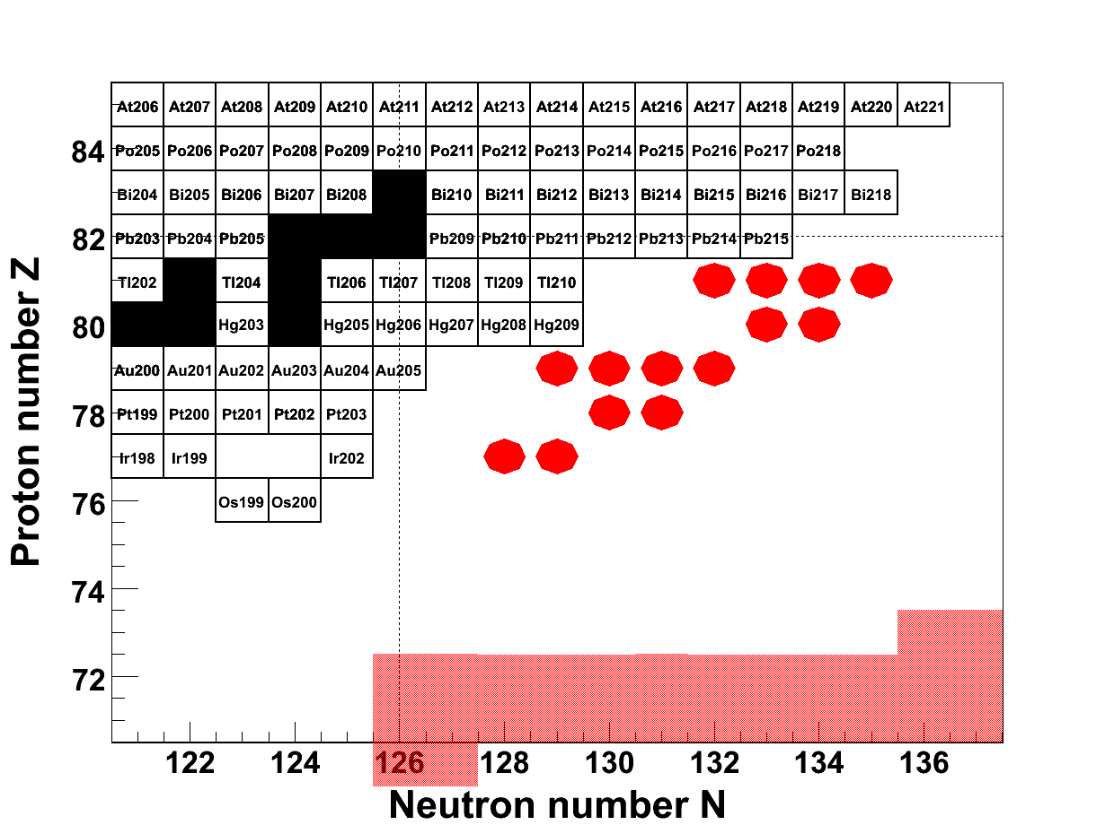
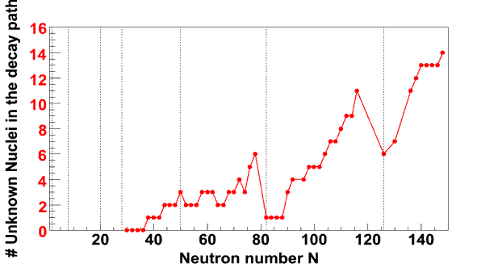
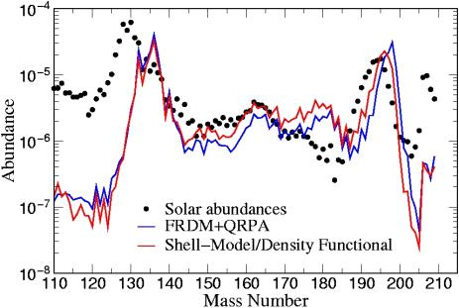
Scientific Motivation
Explosive nucleosynthesis and the r-process around the third abundance peak
Focus of present proposals:
r-path
Effect of half-lives:
“Ignorance”-Curve
The Astr. Jour., 579 (2002), H. Schatz et al.
Proc. CGS-13 (2009), G. Martinez-Pinedo

Slide 9
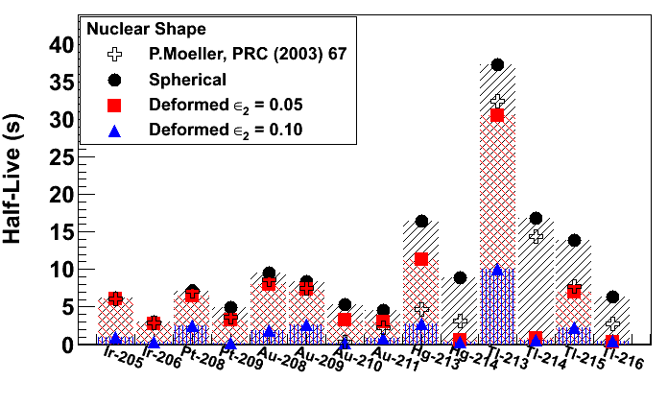
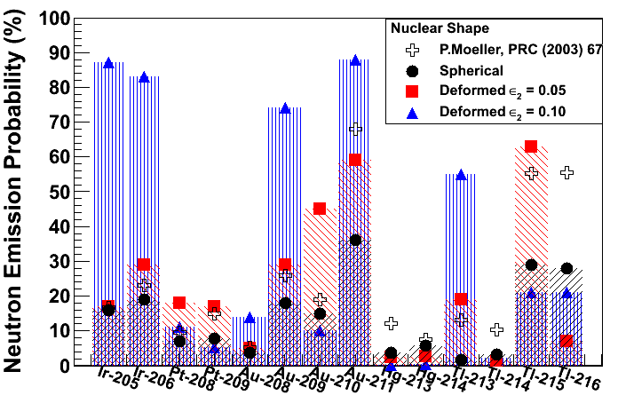
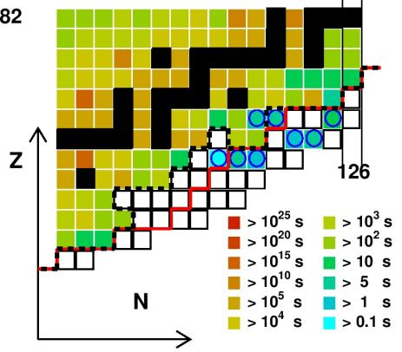
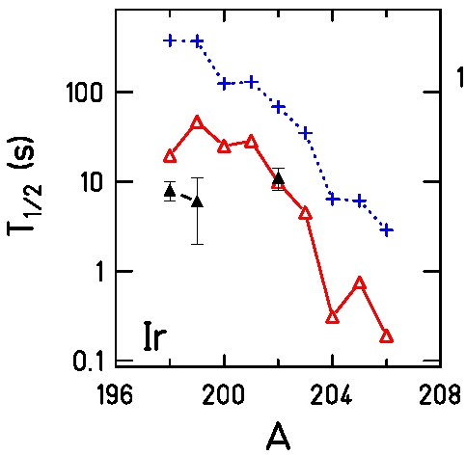
Scientific Motivation
Difficult to calculate/predict half-live and Pn-values of the nuclei in this region:
FRDM + QRPA
K.-L. Kratz, (private communication)
K.-L. Kratz, (private communication)
DF3 + QRPA
(I.Borzov, et al. 2003)
+ FRDM + QRPA
(P.Moeller, et al. 2003)
Exp. T. Kurtukian et al.
T. Kurtukian-Nieto, et al., Phys. Lett. B (Submitted)

Slide 10
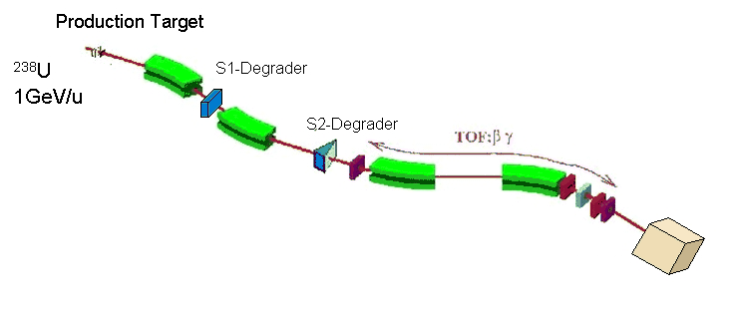
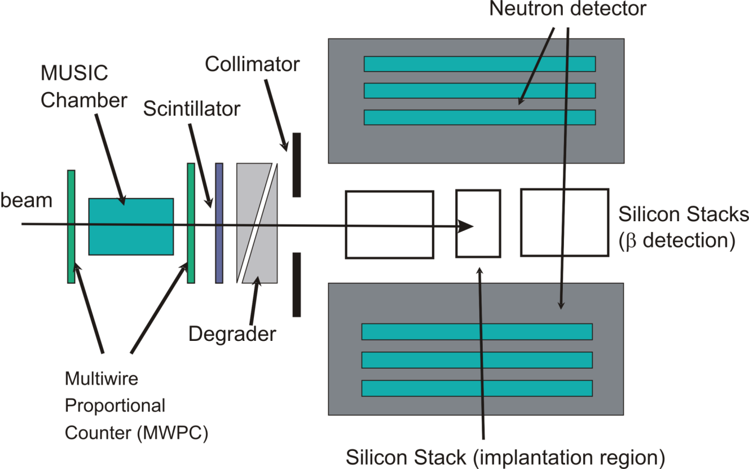
MOTIVATION & SETUP
The measurements will help to improve/validate theoretical models for determining more accurately the beta-decay properties of the neutron rich nuclei and for the r-process.
From the point of view of the nuclear structure, these measurements will provide the first insight into the β-strength distribution, and the relevance of FF transitions for the proposed nuclei.
DSSDs + Neutron Detector
X-Y SSSDs 6x6 cm²
0.3 mm each
DSSDs 6x4 cm²
0.7 mm each
SSSDs 6x4 cm²
1 mm each
SSSDs 6x4 cm²
1 mm each
M. B. Gómez et al. UPC, Barcelona

Slide 11
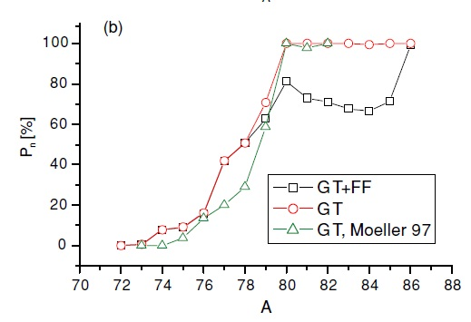
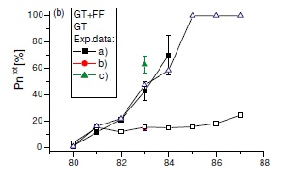
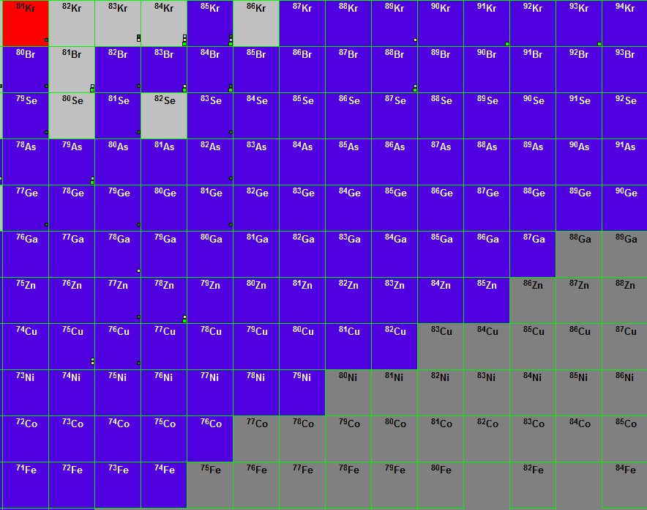
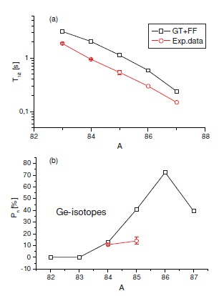
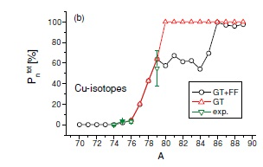
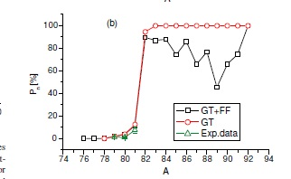

Other areas of interest
Z=28, Ni isotopes
Z=31, Ga isotopes
Interested in nuclei in the area around doubly magic ⁷⁸Ni
  Previous measurements in this area are scarce and unreliable.
  Study influence of GT + FF transitions in this region.
  Yields and experiment feasibility needs to be checked.
  Input is welcome !
Z=29, Cu isotopes
Z=32, Ge isotopes
Need of experimental values to validate Gammow Teller + First Fobidden role in beta decay as shell closures are crossed in the r-process region
Z=30, Zn isotopes
Z=33, As isotopes
I. Borzov, PRC 71, 065801, (2005)
M. B. Gómez et al. UPC, Barcelona

Slide 12
STATUS
Successful measurements of P_{n} of fission products at JYFLTRAP.
Test time requested for:
    Further background test of the whole BELEN setup at GSI
    Needed to test BELEN detector + Implantation detector (AIDA) + DACQ at GSI
Two proposals approved at FRS-GSI will use the BELEN detector
  S323 “Beta-decay of very neutron-rich Rh, Pd, Ag nuclei including the r-process waiting point ¹²⁸Pd”. F. Montes et al.
  S410 “Beta-decay measurements of new isotopes near the third r-process peak”. C. Domingo et al.
Interest in the Z=28, N=50 area around doubly magic ⁷⁸Ni.
M. B. Gómez et al. UPC, Barcelona

Slide 13
SUMMARY
M. B. Gómez et al. UPC, Barcelona

Slide 14
SUMMARY
M. B. Gómez et al. UPC, Barcelona

Slide 15
SUMMARY
M. B. Gómez et al. UPC, Barcelona

Slide 16
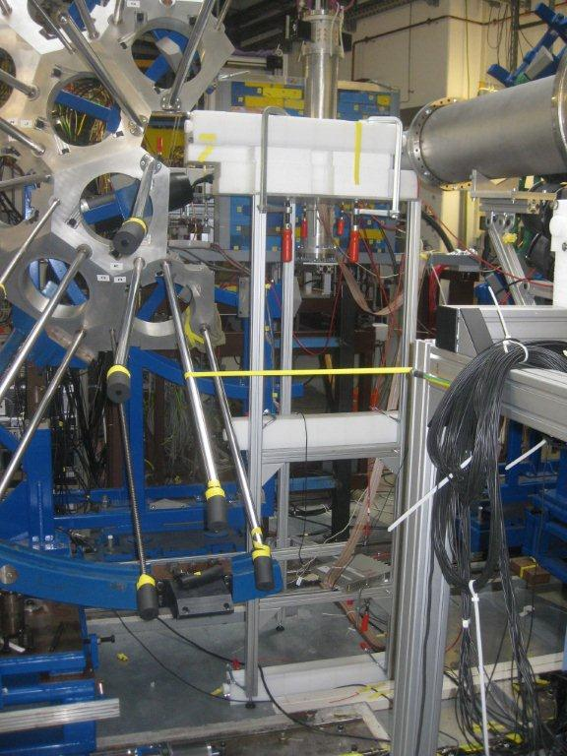
Background test has been performed at GSI
A test has been performed at S4 to study the neutron background with beam.
Six counters with individual polyethylene matrix were deployed around S4 to study the neutron background around the experimental hall and in different beam conditions.
Data is currently under analysis.
M. B. Gómez et al. UPC, Barcelona

Slide 17
Theoretical Pn predictions
Z=28, Ni isotopes
Z=31, Ga isotopes
Z=29, Cu isotopes
Z=32, Ge isotopes
Need of experimental values to validate Gammow Teller + First Fobidden role in beta decay as shell closures are crossed in the r-process region.
Z=30, Zn isotopes
Z=33, As isotopes
I. Borzov, PRC 71, 065801, (2005)

Slide 18












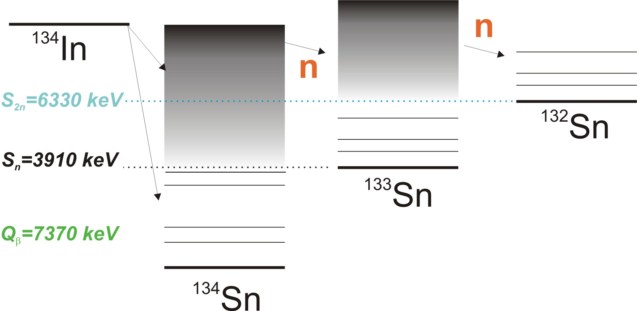
























Influence of P(1n) and P(2n)
During „Freeze-out“:
detour of β-decay chains
⇨ solar r-abundance changes
QRPA predictions:
β-decay: 0%
P(1n): 0.6 %
P(2n): 99.4%
In 134
138 ms
βn, β2n

Slide 19
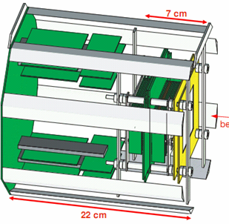


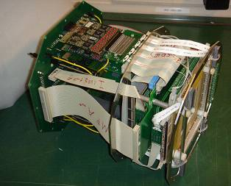
Silicon IMplantation detector and Beta Absorber
SIMBA
Constructed and developed at
• 1 x and 1 y-detector, 60x60x0.3 mm³, 60fold segmented each
2 SSSSD, 60x40x1 mm³, 7fold segmented in x
3 DSSSD (implantation area), 60x40x0.7 mm³, 60fold segmented in x-, 40fold in y-direction
2 SSSSD, 60x40x1 mm³, 7fold segmented in x
PhD thesis C. Hinke, TUM (2010)
Diploma thesis K. Steiger, TUM (2009)
Pictures: K. Steiger

Slide 20
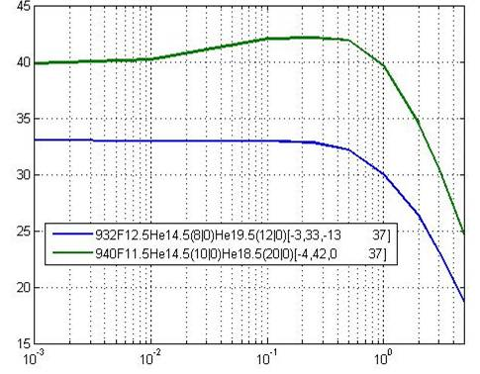
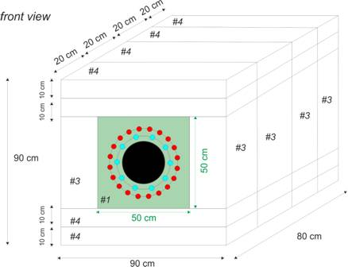
BEta deLayEd Neutron detector
30 counters
DETECTION EFFICIENCY [%]
20 counters
NEUTRON ENERGY [MeV]
20 ³He counters (20 atm) +
10 ³He counters (10 atm)
Efficiency 40%
ca. 1t PE
Value of ³He: 625 k$
(worldwide shortage)
„BELEN-30“ (2011)
M.B. Gómez Hornillos et al., Proc. Int. Conf. on Nucl. Data for Science and Techn. (2010)

Slide 21
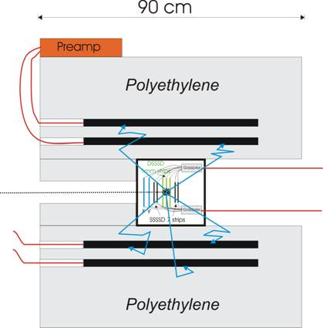
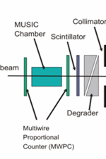
SIMBA + BELEN @ S4
BEta deLayEd Neutron detector
Silicon IMplantation
detector and
Beta Absorber
Δt (β-n)~ 200 μs
2 experiments planned for 2011
Collaboration with MSU/NSCL, TUM, Barcelona/Valencia/Madrid

Slide 22
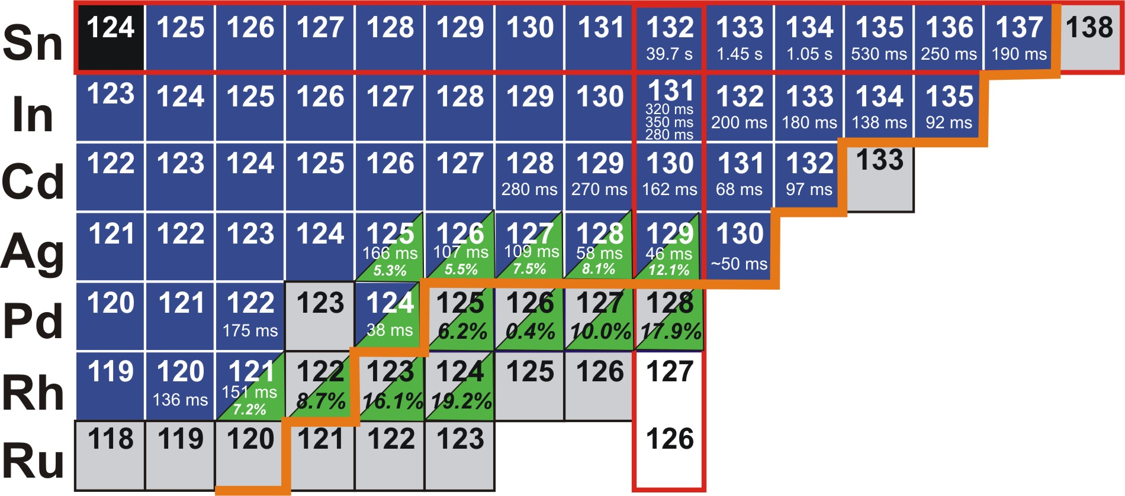
N=82: Planned experiment
N=82
GSI proposal
t_{1/2} exists
identified
S_{n}= 2-3 MeV
P_{n} (%) QRPA

Slide 23
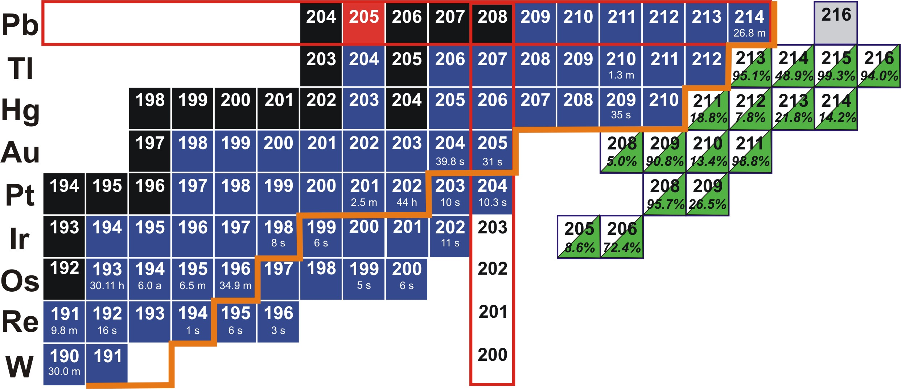
N=126: Planned experiment
N=126
GSI proposal
t_{1/2} exists
identified
S_{n}= 2-3 MeV
P_{n} (%) QRPA

Slide 24
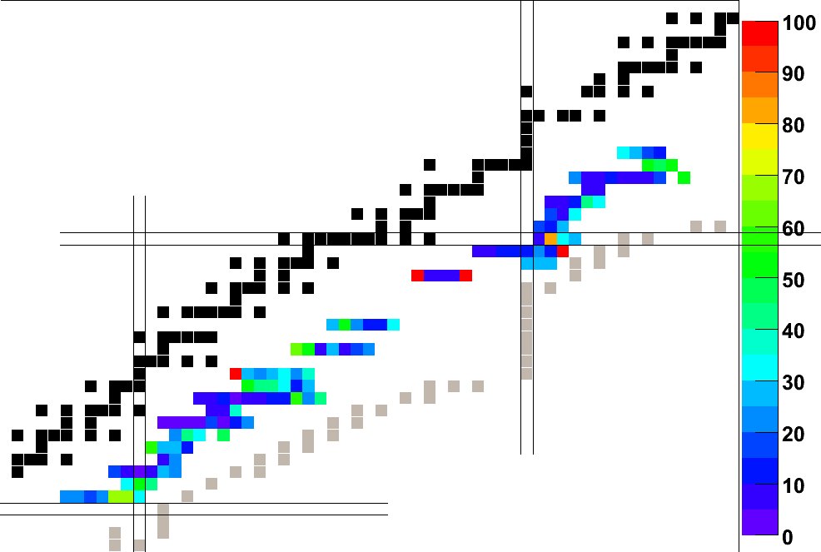
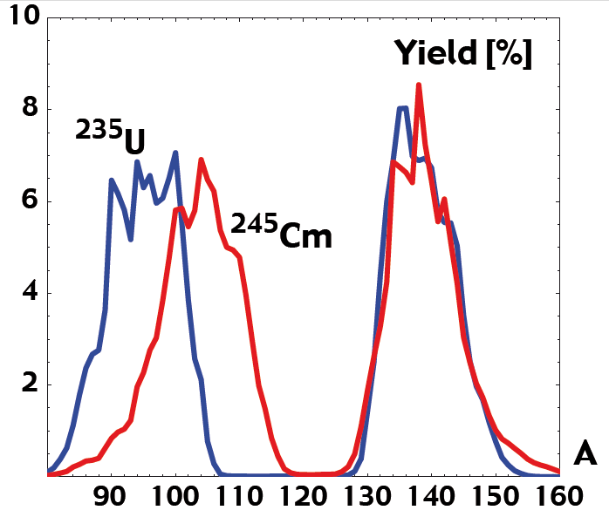
The neutron emission probability P_{n} determines the delayed neutron fraction β_{eff} : reactor kinetics. More accurate measurements will improve summation calculations for GenIV reactors with MA containing fuel
Fission Fragment distribution
Uncertainties in Pn values (%)

