Slide 1
Isomeric states in ⁹⁸Cd and ⁹⁸Ag
Andrey Blazhev
University of Cologne
PRESPEC Decay Physics Workshop
12-13 January 2011, Brighton, UK

Slide 2
Outline
Introduction
RISING S352 Experiment
⁹⁸Cd Isomer Spectroscopy
⁹⁸Cd → ⁹⁸Ag Decay Data
Summary and Outlook

Slide 3
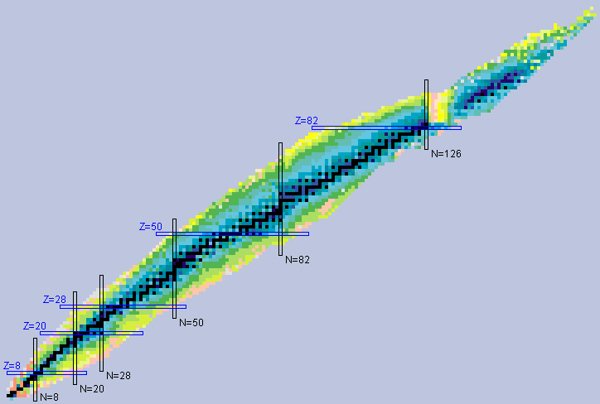
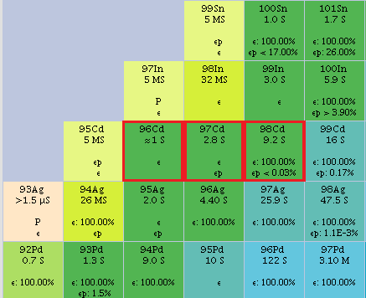
Introduction
N=Z line
Adapted from The NNDC Chart of The Nuclides
Adapted from The NNDC Chart of The Nuclides

Slide 4
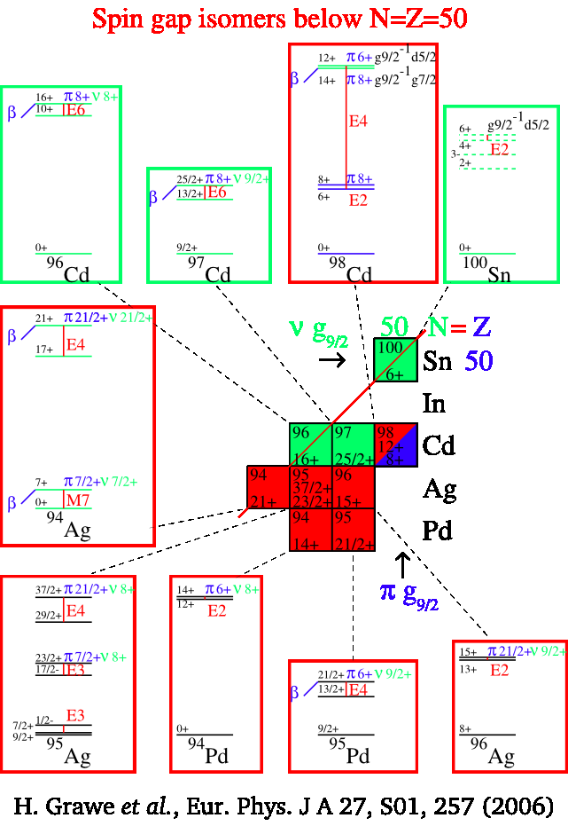
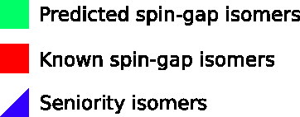
Isomers in the ¹⁰⁰Sn region
Importance of isomers
Test of the shell model
Single-particle structure
Residual interaction
Astrophysics
Properties of isomers
Existence
Excitation energy
Halflife (transition strength)
Spin and parity
γ-decay cascades
Particle decays

Slide 5
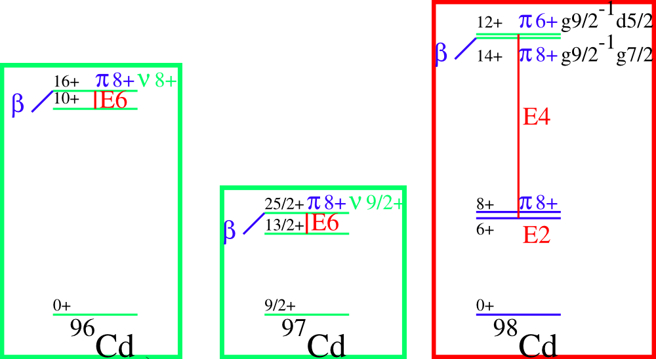
Main goals of the RISING S352 experiment
K. Ogawa, Phys. Rev. C 28, 958, (1983)
A. B. et al., PRC 69 064304 (2004)

Slide 6
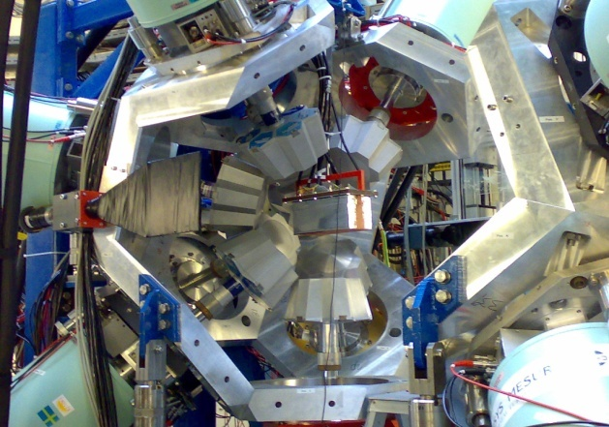
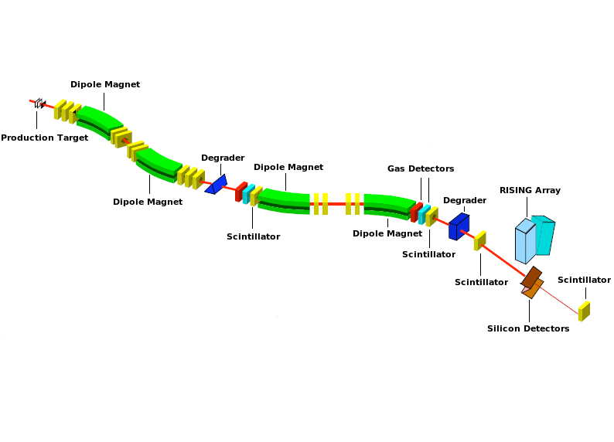
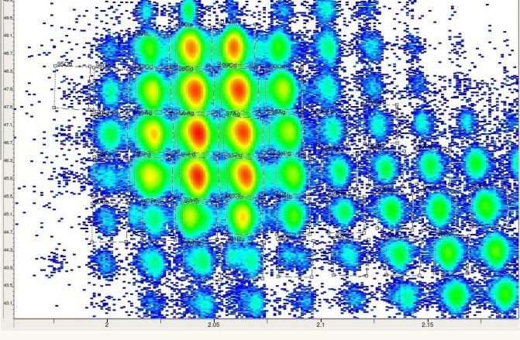
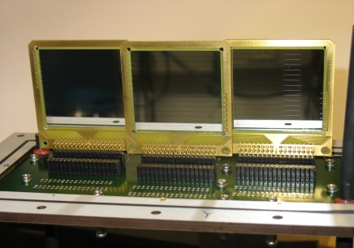
RISING S352 Experimental Setup
Stopped RISING
Primary beam
¹²⁴Xe @ 0.85 GeV/u
⁹⁸Cd
Z
A/Q
Number of ⁹⁸Cd implanted ~ 3 · 10⁵
Active stopper

Slide 7
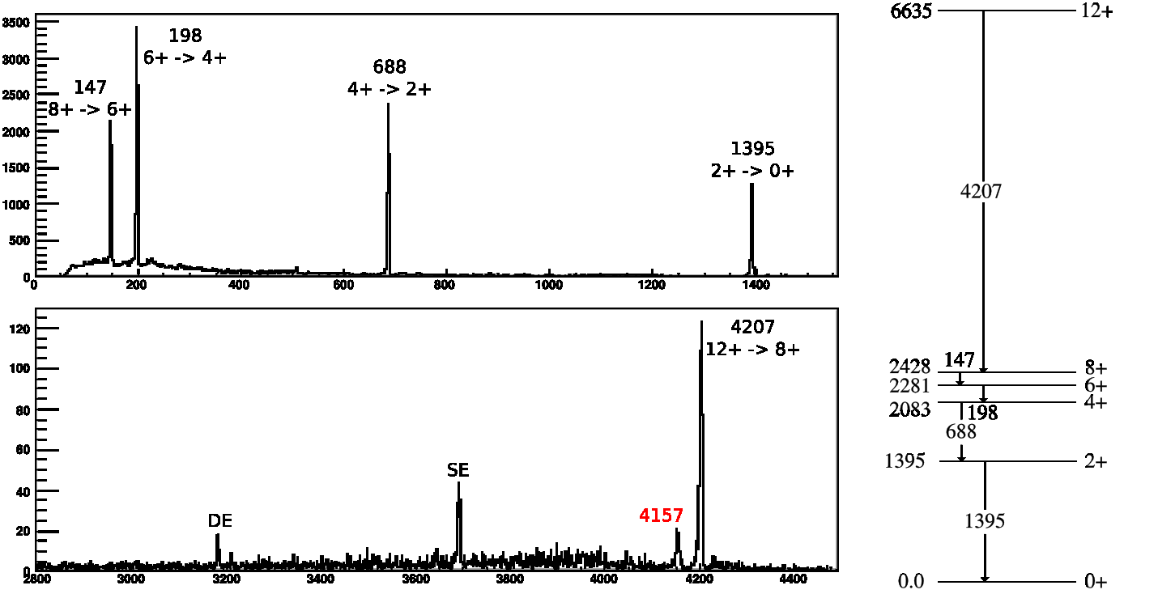
⁹⁸Cd-gated Ge-spectrum

Slide 8
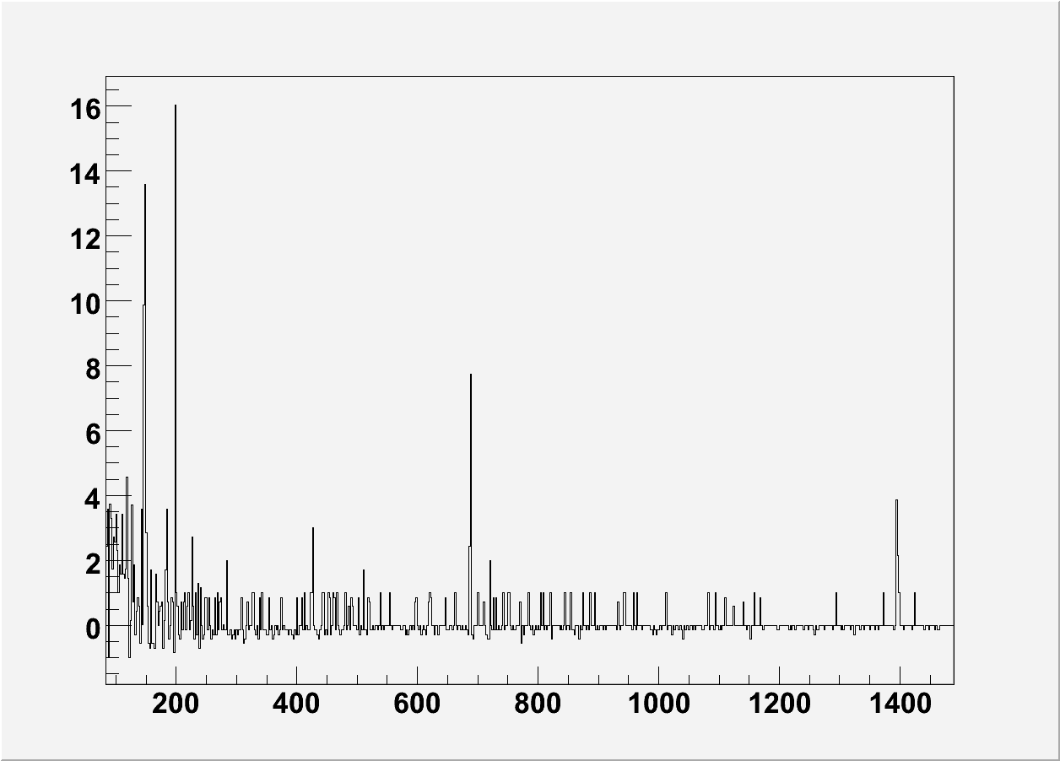
⁹⁸Cd-gated Ge-spectrum
Gate 4157

Slide 9
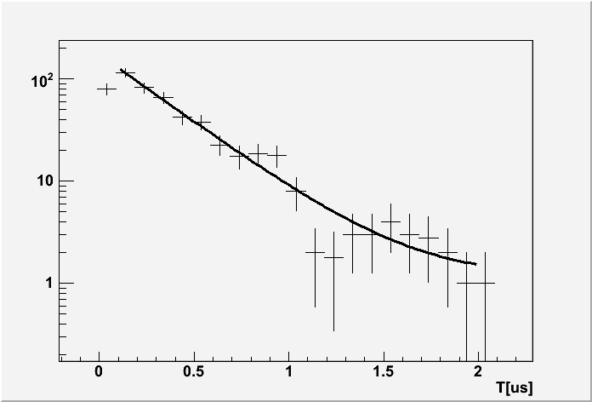
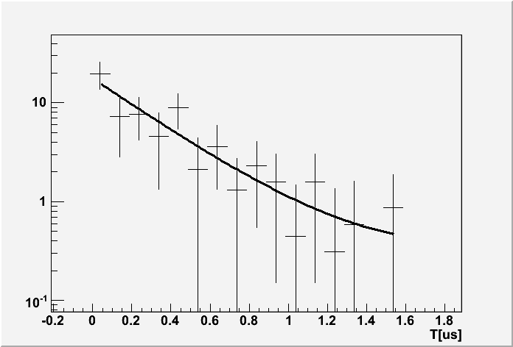
Lifetime measurements (preliminary)
4207 keV: T_{1/2} = 226(30) ns
4157 keV: T_{1/2} = 230(80) ns
Literature: T_{1/2} = 230 (⁺⁴⁰₋₃₀ ) ns
(A. B. et al., Phys. Rev. C 69, 064304 (2004))

Slide 10
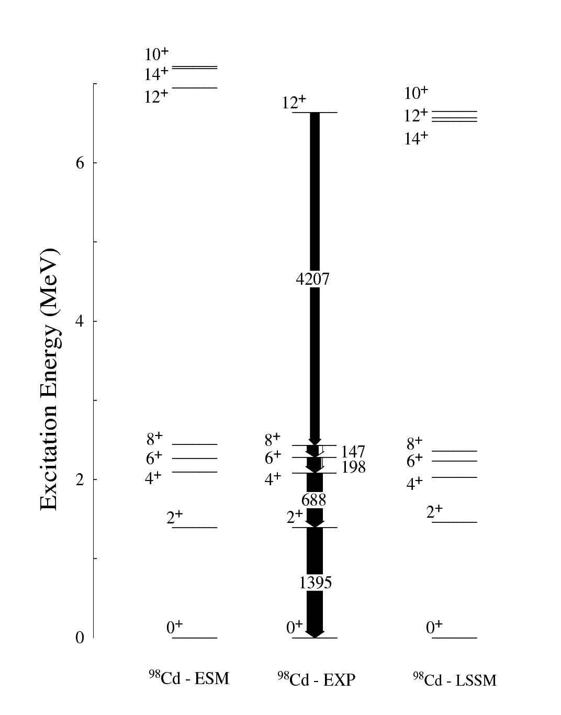
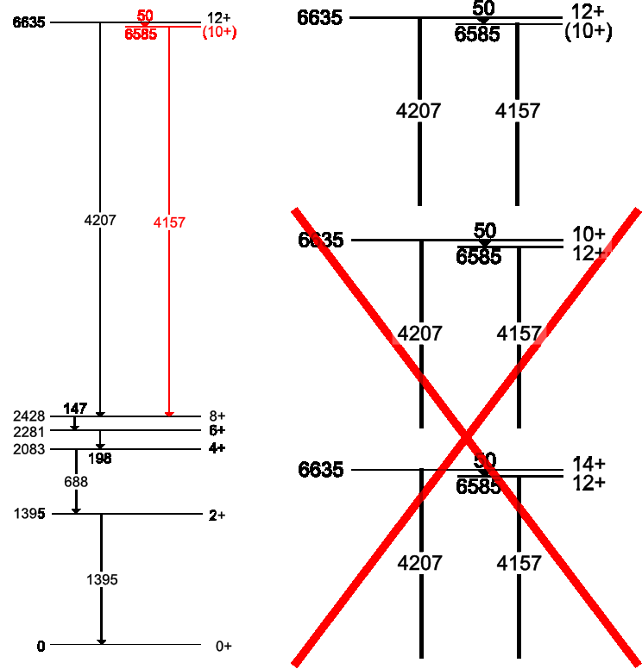
⁹⁸Cd high-energy level scheme
Preliminary:
B(E4; 12⁺ → 8 ⁺) = 3.0(10) W.u.
B(E2; 12 ⁺ → 10 ⁺) = 2.1(13) W.u.
A. B. et al., Phys. Rev. C 69, 064304(2004)
A. B. et al., J. Phys.: Conf. Ser. 205 (2010) 012035.

Slide 11
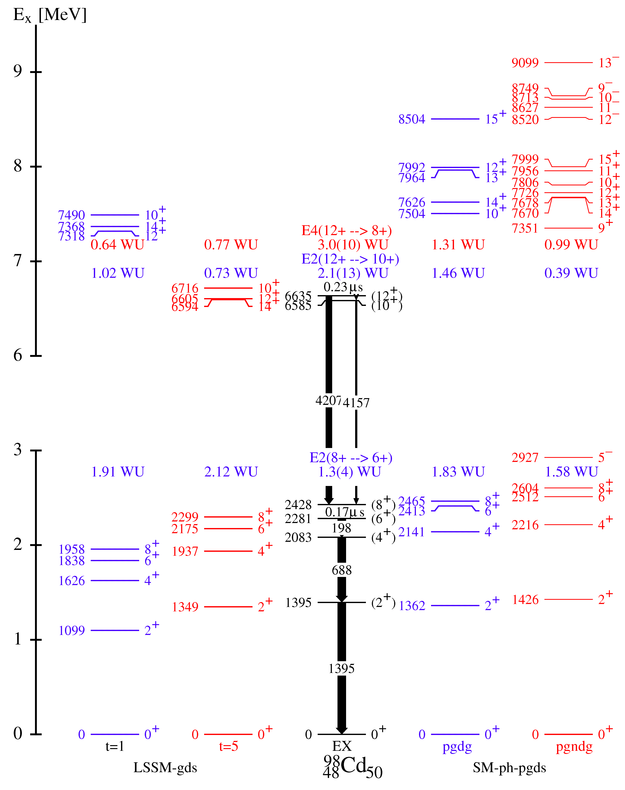
SM Calculations
● LSSM-gds t=1,5
π ν g_{9/2}d_{5/2}g_{7/2}d_{3/2}s_{1/2}
● SM-ph-pgds truncated to 1p1h in any orbit in the model spaces:
pgdg:
π ν p_{3/2}f_{5/2}p_{1/2}g_{9/2}d_{5/2}g_{7/2}
pgndg:
π ν p_{3/2}f_{5/2}p_{1/2}g_{9/2}νd_{5/2}g_{7/2}
TBME from OXBASH (SNA+GF)*
SPE tuned to ¹⁰⁰Sn
Calculations: F. Nowacki H. Grawe

Slide 12
Possible decay modes of ⁹⁸Cd core-excited isomers
Exp. data
12⁺
p (l = 4, 6)‏
17/2⁺
14⁺
E6
γ
β⁺
p (l = 8, 10)‏
9/2⁺
S_{p}
⁹⁷Ag+p
E4
13⁺- 15⁺
8⁺
p
6⁺
E2
γ
0⁺
5/2⁺
S_{p}
⁹⁸Cd
γ
⁹⁷Pd + p
5⁺
⁹⁸Ag

Slide 13
⁹⁸Cd gated decay data
511
347
Energy [keV]
107
61
Time [μs]

Slide 14
⁹⁸Cd g.s. → ⁹⁸Ag GT decay
A. Plochocki et al., Z. Phys. A 342 (1992) 43
(including CE spectroscopy)

Slide 15
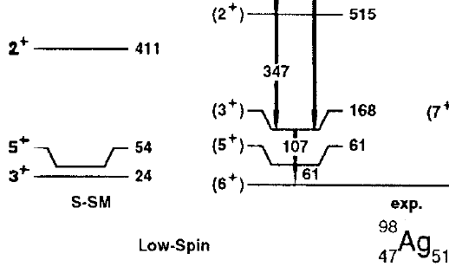
98Ag – EXP and SM
R. Schubart, H. Grawe, et al.,
Z. Phys. A 34252 (1995) 373

Slide 16
⁹⁸Cd gated decay data (cont.)
Energy [keV]
107
61
Time [μs]

Slide 17
⁹⁸Cd gated decay data (cont.)
Projection on the energy axis (y)
107 keV
61 keV
Energy [keV]

Slide 18
⁹⁸Cd gated decay data (cont.)
Time spectra with background subtraction
Gate 107 keV
Gate
61 keV
Time [channels]

Slide 19
Summary and outlook
New transition (4157 keV) in ⁹⁸Cd, suggesting a (10⁺ ) level (6585 keV), 50 keV below the (12⁺ ) level
Exp. B(E4) and B(E2) estimates of the (12⁺ ) depopulating transitions
Not reproduced by previous shell-model calculations
SM analysis of the proton and neutron transition matrix elements
New isomeric transition in ⁹⁸Ag, tentative new ordering of 61-107 keV cascade and exp. B(E2) estimate for the 107 keV transition
Now ⁹⁸Ag-EXP excellent agreement with SM energies and B(E2) strength
Still to do:
Final γ-γ and lifetimes analysis
Continue decay (active stopper) analysis
Good SM description of the ¹⁰⁰Sn region incl. core excited states

Slide 20
Collaboration
Ayse Atac, Linus Bettermann, Andrey Blazhev, Plamen Boutachkov,
Norbert Braun, Tim Brock, Lucia Caceres, Cesar Domingo, Tobias Engert,
Katrin Eppinger, Thomas Faestermann, Fabio Farinon, Florian Finke,
Kerstin Geibel, Jurgen Gerl, Namita Goel, Magda Gorska, Andrea Gottardo, Hubert Grawe, Jerzy Grebosz, Christoph Hinke, Robert Hoischen, Gabriela Ilie, Hironori Iwasaki, Jan Jolie, Ivan Kojouharov, Reiner Krucken, Nikolaus Kurz, Zhong Liu, Edana Merchant, B. S. Nara Singh, Chiara Nociforo,
Frederic Nowacki, Johan Nyberg, Marek Pfutzner, Stephane Pietri,
Zsolt Podolyak, Andrej Prochazka, Patrick Regan, Peter Reiter, Sami Rinta-Antila, Dirk Rudolph, Clemens Scholl, Par-Anders Soderstrom, Steve Steer, Robert Wadsworth, Nigel Warr, Hans-Jurgen Wollersheim, Philip Woods

Slide 21
Current status S352
⁹⁸Cd new level (10⁺ ) and Exp. B(E4) and B(E2) estimates of the (12⁺ ) depopulating transitions - [A. B. et al., J. Phys.: Conf. Ser. 205 (2010) 012035 ] + [N. Braun et al., in preparation]
⁹⁴Pd a new high-spin (19⁻ ) E3 isomer [T.S. Brock et al., Phys. Rev C82, (2010) 061309(R) ]
⁹⁶Ag – new isomeric states including core excited, extended level scheme [P. Boutachkov et al., in preparation]
New isomer in ⁹⁸Ag, tentative new ordering of 61-107 keV cascade and exp. B(E2) estimate for the 107 keV transition (Cologne)
Hints of beta-delayed proton decay in ⁹⁶Cd (Univ. York) and ⁹⁷Cd (GSI)
…
STILL remain 15 MAIN + 9 Parasitic SHIFTS and we look forward to the next stopped beam campaign to address still unanswered questions esp. ⁹⁶⁻⁹⁸Cd βp using better active stopper (AIDA)

