Slide 1
High-spin states feeding seniority isomers in the heaviest N=82 isotones
David O’Donnell
University of Liverpool

Slide 2
Motivation: N=82 isotones
¹⁴⁶Gd displays characteristics of doubly-magic nucleus
Closed N = 82 shell and subshell closure at Z = 64
Neighbours well described by shell model calculations π(h_{11/2})^{n} ⊗ ¹⁴⁶Gd core
What about heavier isotones?

Slide 3
Heaviest N = 82 isotones
Level schemes for ¹⁵²Yb, ¹⁵³Lu and ¹⁵⁴Hf established to 10⁺ or 27/2⁻ twenty years ago
These states are seniority isomers, decaying via low-energy E2 transitions
No ν > 2 states have been reported

Slide 4
What is a seniority isomer?
Seniority, ν, is minimum number of nucleons not coupled to 0⁺
For even-even and odd-odd nuclei ν is even; for odd-A nuclei ν is odd
Isomerism results from proximity of nuclear levels

Slide 5
Experimental details
⁶⁴Zn (265-295 MeV) + ⁹²Mo -> ¹⁵⁶Hf * at Jyväskylä, Finland
Main targets of experiment ¹⁵⁴Hf (2n), ¹⁵³Lu (p2n) and ¹⁵²Yb (2p2n)
Range of beam energies as cross sections maximised at different energies
Recoil Isomer Tagging used to unambiguously identify prompt γ rays

Slide 6
Recoil Isomer Tagging
Similar to Recoil Decay Tagging
Gate on delayed γ rays in the absence of (or in addition to) charged particle decay
Temporally correlate delayed γ rays with prompt γ rays at target position
High γ-ray efficiency at both ends of recoil separator

Slide 7
Recoil Isomer Tagging at JYFL
JUROGAM II located around target position
Fully digitised 39 Compton-suppressed HP-Ge detectors (15 EB phase 1 & 24 clovers)
Detect prompt γ radiation
ε ∼ 6% at 1.3 MeV
Four rings of detectors (three of which θ > 90°)

Slide 8
Recoil Isomer Tagging at JYFL
RITU – Recoil Ion Transportation Unit
He – filled recoil separator
QDQQ configuration
Angular acceptance ~ 10 msr
ε ∼ 30-50 %
Zero degree operation
ToF ~ 0.5 μs

Slide 9
Recoil Isomer Tagging at JYFL
GREAT – Gamma Ray Electron Alpha Tagging
Normally consists of MWPC, 2xDSSDs, Si PiN diodes, planar Ge detector and Ge clover detector
Under normal conditions ToF measured between MWPC and implantation in DSSDs

Slide 10
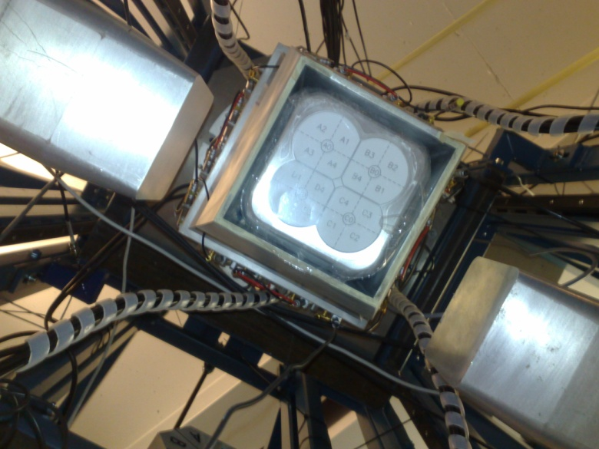
Recoil Isomer Tagging at JYFL
Present work: DSSDs removed and replaced with second MWPC and passive stopper
ToF then measured between signals in gas detectors
Three further clover detectors added to focal plane Ge to maximise γ-ray efficiency
ε~30 % at 100 keV and ε~2% at 1.3 MeV

Slide 11
Some results
Establish coincidences between delayed and prompt γ radiation
Allowing prompt γ rays to be unambiguously identified

Slide 12
Results: ¹⁵²Yb
Once prompt radiation is identified can use γ−γ and γ−γ−γ coincidences
Analysis currently being performed by student

Slide 13
Results: N=83 nuclei
Transitions decaying from high-spin ν > 2 states which have to date not been published
Analysis is still in progress but nearing completion

Slide 14
Conclusions/Further work
Successful in populating high-spin ν > 2 states in N = 82 nucleus ¹⁵²Yb and N = 83 nuclei ¹⁵²Tm and ¹⁵³Yb
Analysis is on-going but progressing well
Compare experimental observations with shell model calculations (P. Van Isacker et al.)
Search for deformed bands ¹⁵²Er and ¹⁵³Tm
Based on success, apply for remaining three days beam time to study ¹⁵³Lu and ¹⁵⁴Hf

Slide 15
Collaborators
M. Labiche, J. Simpson - STFC Daresbury Laboratory
R. Carroll, L. Donosa, D. Joss, R. Page, P. Papadakis, E. Paul, H. Watkins - University of Liverpool
D. Cullen, M. Procter - University of Manchester
P. Greenlees, K. Hauschild, J. Hirvonen, U. Jakobsson, P. Jones, R. Julin, S. Juutinen, S. Ketelhut, J. Konki, M. Leino, P. Nieminen, M. Nyman, P. Peura, P. Rahkila, P. Ruotsalainen, M. Sandzelius, J. Saren, C. Scholey, J. Sorri, S. Stolee, J. Uusitalo - University of Jyväskylä

